Slide 1
Leading and Coordinating Strengthening Families Efforts

Slide 2
Not your ordinary initiative
Implementing Strengthening Families is about:
  small but significant changes in everyday practice
and
  the shifts in policies and systems that allow/promote those changes in practice
Implementation funds come from existing dollars
All national implementation tools are available free of charge
Notes:
Strengthening Families is not “another initiative” that adds to the workload of a program or agency. It is an approach that can be applied to any interaction with children and families.
Implementing Strengthening Families is about small but significant changes in everyday practice, and about the shifts in policies and systems that allow and promote those changes.
In most cases, Strengthening Families has been implemented using existing funding streams. While a few states in the Strengthening Families National Network have found dedicated funding streams to implement Strengthening Families on a large scale, most states have integrated the Protective Factors Framework into existing grants, professional development systems, trainings, and so on. Many implementation activities for Strengthening Families can be carried out at little cost, particularly when partner agencies and systems bring resources such as staff time to the table.
To support this work, implementation tools are available free of charge from the Center for the Study of Social Policy and many of our national and federal partners.

Slide 3
The four Big Ideas behind
Strengthening Families
Building protective and promotive factors, not just reducing risk
An approach – not a model, a program or a curriculum
A changed relationship with parents
Aligning practice with developmental science
Notes:
1. A protective and promotive factors approach
The first step in developing Strengthening Families was thoroughly investigating what the research tells us about reducing child maltreatment – about what is right with families that protects against child abuse and neglect. CSSP worked intensively with researchers and advisors for over a year to develop a synthesis of protective factors that reduce the likelihood of child abuse and neglect.
Protective factors act as a counter weight to risk factors. They buffer the impact of what the researchers call “toxic stress”. Risk factors, it turns out, are not very predictive of future events. And we cannot get to good outcomes for children only by focusing on reducing risk.
The protective factors in the Strengthening Families framework both protect against risk and promote positive outcomes.
2. An approach, not a model
Strengthening Families is not a scripted, structured program or model that designed to be implemented in a specific setting.
It is an approach that can be applied in any setting that serves young children and their families. Strengthening Families is implemented through small but significant changes in how professionals interact with families. It is not parallel to, but integrated into existing practice.
Cross-sector implementation is core to the approach. Strengthening Families brings together program-level and system-level partners from multiple sectors that serve children and families – providing a common language and set of outcomes to work toward.
3. A changed relationship with parents
Strengthening Families represents a shift for many systems that are designed to serve children. Programs and service providers in these systems sometimes see parents as irrelevant to their work, or worse, as obstacles to achieving the outcomes we all want for children. But we know that children grow up in families, not programs – and we cannot achieve good outcomes for children without engaging their parents as partners.
Working from a protective factors approach, workers and service providers will support parents’ ability to parent effectively and involve them as partners in achieving good outcomes for children. Programs also have a role to play in engaging parents in mutually supportive relationships that build protective factors.
Programs that work in this way will also engage parents as partners, leaders and decision-makers at the program level.
Parents who have had positive experiences shaping the programs that serve their children can then be engaged in helping design systems and policies that work for children and families.
4. Alignment with developmental science
Strengthening Families is committed to paying attention to what the research tells us, and helping programs and workers align their practice with what developmental science tells us will be most effective.
Critical periods of development – therefore we have the Strengthening Families framework for early childhood and the parallel Youth Thrive framework for adolescence
Looking at early childhood in particular, Strengthening Families emphasizes the importance of nurturing and responsive relationships with caregivers.
A fast growing body of research underscores the effects of traumatic experiences on children and youth – effects that can carry into the rest of a young person’s life. We know now that the presence of a buffering adult can be critical in helping children come through stressful experiences without negative effects on their development. But we also know that typical system responses to children’s traumatic experiences can exacerbate those negative effects – such as removal from the home, or punishment for “misbehavior” when children react to their experiences.
Through Strengthening Families and Youth Thrive, we provide tools and guidance to help those who work with children and families align their practice with what we know about development.

Slide 4
Why cross-system, multi-sector leadership?
Goal is system change to get to better outcomes for families
Families we care about are touched by many systems
Systems face lots of transitions and uncertainty – and often do not coordinate their efforts
Workers often move between systems

Slide 5
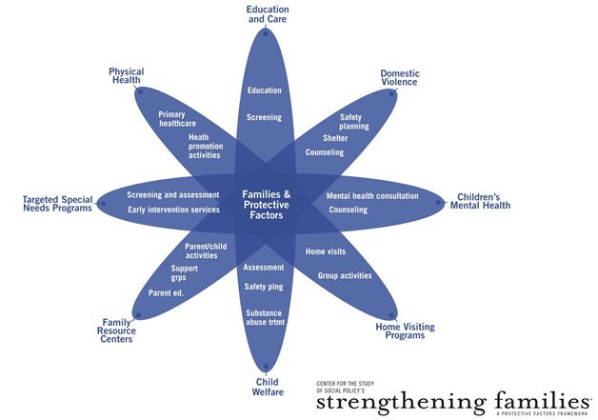
Notes:
This graphic shows the many systems that touch the lives of children and families. Strengthening Families efforts are one of the most effective ways we have seen to bring all of these parts of the service system together around shared outcomes, with shared language to talk about what we want to help families achieve.
A common framework, using a common language to describe results, can lead to:
better understanding of the role that each service system plays in supporting families
better partnerships among agencies and among individual workers,
a professional development system that fosters collaboration,
greater appreciation for the role that non-governmental community resources like informal networks, churches, social groups and cultural practices play in supporting family life,
more coherent, positive messages for families that encourage engagement, and most important:
cumulative impact when services and opportunities are working to achieve the same results.

Slide 6
The Strengthening Families National Network
WA
ME
MN
VT
MT
ND
NH
NY
MA
OR
WI
CT
RI
ID
SD
MI
WY
PA
NJ
IA
OH
MD
DE
NE
IL
IN
WV
DC
NV
VA
UT
KY
CO
KS
MO
NC
CA
TN
OK
AR
SC
AZ
NM
MS
GA
AL
AK
TX
LA
FL
States in Network
Newly Launching States
HI
States with some implementation activities
Notes:
In 34 states, cross-system teams have come together to lead efforts to implement Strengthening Families. Many of these states have active state leadership teams.
Map last updated April 2014

Slide 7
Leadership Teams
Often convened by Children’s Trust Fund/CBCAP lead
Some are embedded into existing cross-cutting planning efforts (e.g. ECCS, Project LAUNCH, ECAC)
Small leadership teams may meet frequently and less formally
Larger leadership teams tend to use less frequent, regularly scheduled meetings – and depend on committees to move work forward in the interim
Some have a small leadership team and larger “Roundtable” members with a learning focus
Notes:
There is a lot of variation in how leadership teams are structured and how they work.
Some leadership teams are very small (3-4 members) while others are quite large (75 members).

Slide 8
What state leadership teams look like
22 states reported on their cross-system, multi-sector leadership teams in 2013
Median number of members is 17, with 15 organizations represented
Five most common fields:
  Early care and education
  Family support
  Child abuse and neglect prevention
  Home visiting
  Maternal and child health
About 60% have parents or community members represented
In half of all states the following sectors are also represented:
  Advocacy
  Child welfare
  Parent leadership
  Public health
  Early intervention
Notes:
This slide based on 2013 state data:

Slide 9
The role of the leadership team
Set and hold the vision for the initiative
Sustain collaborative support
Support ongoing learning
Create tools and resources to support implementation across sectors
Communicate about the initiative
Maintain accountability
Notes:
Big picture, this is the role of the leadership team. We will get into more specifics shortly.

Slide 10
Leadership team members as advocates within their own systems
Identify synergies between the Strengthening Families vision and the needs and priorities within their own system
Sustain support for Strengthening Families within their own system
Support learning and implementation within their own system
Communicate about the initiative and about changes, trends and opportunities within their system
Monitor implementation within their own system
Notes:
Big picture, this is the role of members of the leadership team as they take the work back to their own agencies and systems. Again – we will be going into this in more detail shortly.

Slide 11
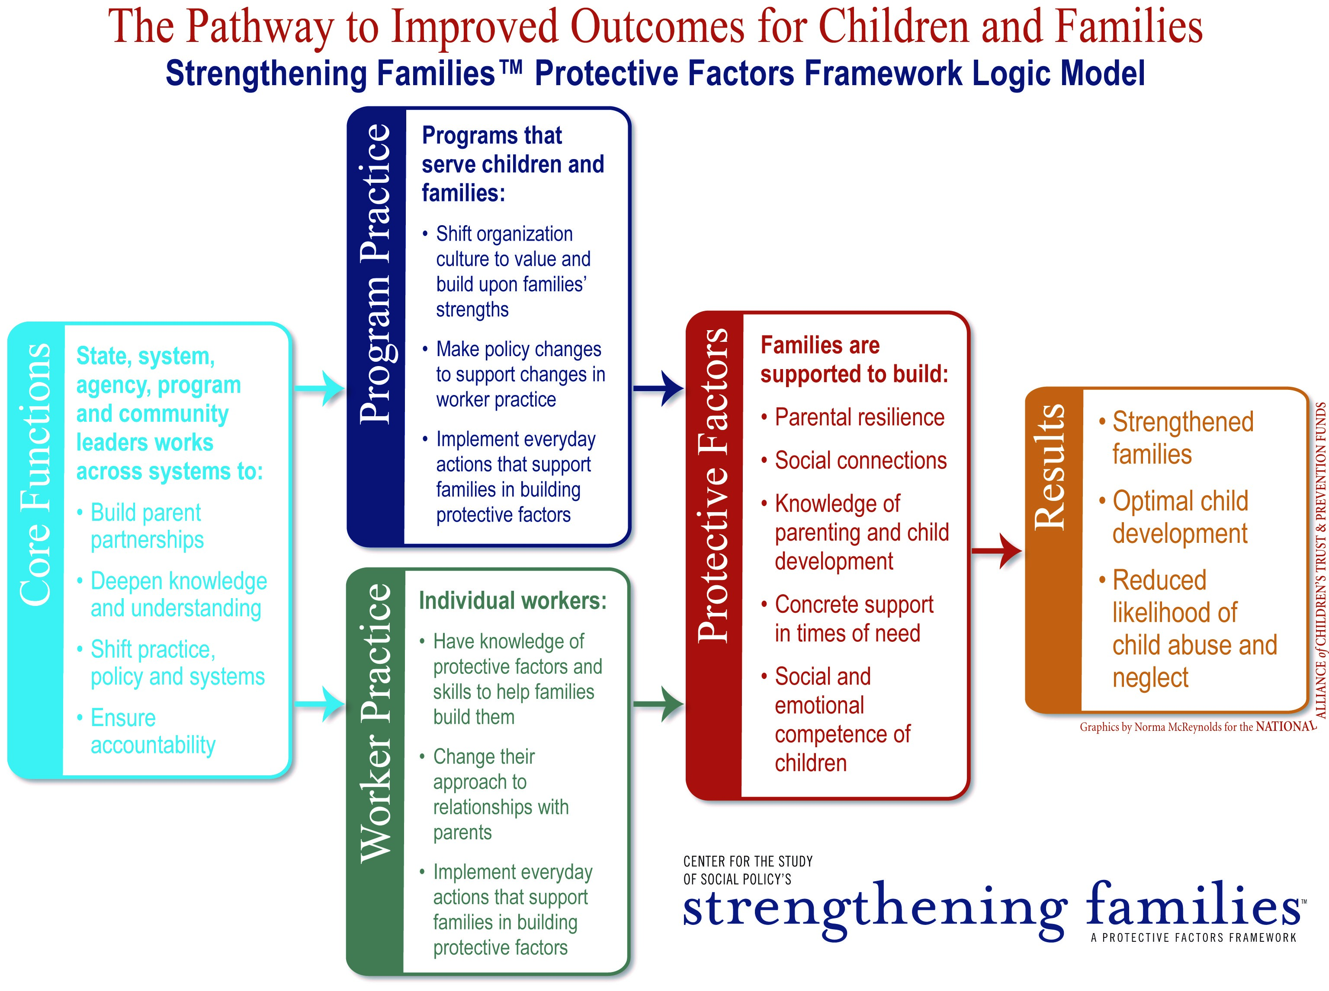
Notes:
In order to understand the specific tasks that leadership teams carry out, it is helpful to see the pathway we envision – the logic model for Strengthening Families work.
This graphic summarizes how implementation of the Strengthening Families approach leads to the outcomes we are working toward: strengthened families, optimal child development and reduced likelihood of child abuse and neglect – as shown in the box farthest to the right.
The second box from the right (light blue) shows the protective factors that families are supported to build when they experience program and worker practice as described in the stacked boxes. Shifts in program culture, policies and everyday practice will support parents in building these protective factors, just as workers’ knowledge, skills, approach to parents and everyday actions will. (Workers can make these changes on their own – and often do – but those efforts will be much more successful when their organizations make shifts that support and enable those changes.)
The rust-colored box on the left describes the functions that are carried out by leaders – at any level – to influence the shifts in program and worker practice that help families build their protective factors and achieve better outcomes.
We believe the future of Strengthening Families is in creating a “new normal” for child and family serving organizations and systems, so that they see their work as building protective and promotive factors to reduce the potential for child maltreatment, to bolster resilience and mitigate the impact of traumatic events when they occur, AND to create the best possible environment for development of children and youth.

Slide 12
Core functions of Strengthening Families implementation
Build an infrastructure to advance and sustain the work
Build parent partnerships
Deepen knowledge and understanding of the protective factors approach
Shift practice, policy and systems toward a protective factors approach
Ensure accountability
State, system, agency, program and community leaders work across systems to:
  Build parent partnerships
  Deepen knowledge and understanding
  Shift practice, policy and systems
  Ensure accountability
Core Functions
Notes:
It is important to note that the state leadership team carries out these functions for the state initiative – but that each member of the state leadership team is also in a position to lead the work in their own agency or system, which also carries out these functions for their own implementation of the Protective Factors Framework.
Refer to handout on the website:
http://www.cssp.org/reform/strengthening-families/resources/leadership-and-planning/SFCoreFunctionsHandout.pdf

Slide 13
The core functions are carried out in different ways at different levels to facilitate changes in program and worker practice:
Programs that serve children and families:
  Shift organization culture to value and build upon families’ strengths
  Make policy changes to support changes in worker practice
  Implement everyday actions that support families in building protective factors
Program Practice
Program: Implementation team including leadership, direct service and parent representative
Agency or system: Implementation team
State or jurisdiction: Cross-systems leadership team, learning community or roundtable
National: CSSP and national partners
Individual workers:
  Have knowledge of protective factors and skills to help families build them
  Change their approach to relationships with parents
  Implement everyday actions that support families in building protective factors
Worker Practice

Slide 14
Roles: Infrastructure
Strengthening Families Leadership Team | Individual Leadership Team Members
Create and hold a vision for the initiative within the state/jurisdiction Maintain a multi-sector implementation partnership Coordinate work across all implementing partners Create and support a state/jurisdiction level action plan Identify funding to support work in state/jurisdiction Build and sustain relationships with key agencies and individuals to expand leadership and support for the initiative Represent the state/jurisdiction and engage in learning activities through the Strengthening Families National Network | Create and hold a vision for the initiative within the home agency Advocate for the initiative’s vision within the home agency/constituency Represent the interests of the home agency/ constituency on the leadership team Integrate Strengthening Families into planning processes within home agency/constituency Identify funding to support work within the agency/system Reach out to partners within the home agency or those with which the home agency/constituency is allied

Slide 15
Roles: Parent partnerships
Strengthening Families Leadership Team | Individual Leadership Team Members
Engage parents in shaping systems and policies at the state level, including parent partnership in Strengthening Families leadership Encourage and promote parent partnerships among implementing programs and agencies Support parent leadership development (trainings, opportunities to network, communicate, participation in state summits, etc.) Develop parent engagement tools and strategies and put them to use in multiple ways | Recruit parents served by agency or system for SF leadership roles and support them in those roles Encourage parent participation within the Strengthening Families implementation team at the agency or system level Develop parent engagement tools and strategies for parents served by agency or system Include parent representatives on boards and advisory groups and actively seek their input

Slide 16
Roles: Deepen knowledge and understanding
Strengthening Families Leadership Team | Individual Leadership Team Members
Develop/adapt tools and messaging to build broad awareness of Strengthening Families and the protective factors Create a Strengthening Families professional development agenda for the state/jurisdiction Establish and support learning communities among implementers Identify opportunities to integrate protective factors into existing professional development systems or curricula Share knowledge and information with Strengthening Families partners and the broader Strengthening Families network both in the state and nationally | Share knowledge and information about the initiative within the home agency/constituency Create a Strengthening Families professional development agenda for the agency/system Identify opportunities to integrate the protective factors approach within existing professional development systems or curricula and learning tools being used within the home agency/constituency Share implementation experience, new tools and knowledge with the Strengthening Families National Network

Slide 17
Roles: Shift practice, policies and systems
Strengthening Families Leadership Team | Individual Leadership Team Members
Identify incentives or leverage to promote implementation by service providers, programs and agencies Create shared technical assistance resources to support implementation across sectors Work collaboratively to align Strengthening Families practice tools across disciplines Identify points of alignment with priorities of existing systems in the state/jurisdiction Work to integrate Strengthening Families into cross-system planning and thinking Infuse Strengthening Families into responses to new policy opportunities | Identify incentives or leverage for programs that build protective factors and/or use the self-assessment tool Weave Strengthening Families capacity into technical assistance, program monitoring and accountability infrastructures Integrate protective factors into practice tools for the constituency Infuse Strengthening Families and the Protective Factors Framework into policies and infrastructure within the home agency Engage in policy advocacy around Strengthening Families as appropriate Infuse Strengthening Families into responses to new policy opportunities

Slide 18
Roles: Ensure accountability
Strengthening Families Leadership Team | Individual Leadership Team Members
Establish outcomes and metrics to monitor implementation and its effects Monitor the arc of the initiative’s development and its impacts Monitor programmatic implementation Develop an evaluation plan for the initiative Evaluate the impact of the initiative | Establish programmatic outcomes and metrics that align with/contribute to those of the initiative Monitor implementation among programs funded or managed by the home agency or the activities undertaken by the constituency Evaluate the impact of a protective factors approach within the home agency and among programs funded Design, fund and implement evaluation strategies for Strengthening Families implementation within agency/system and at the program level as appropriate

Slide 19
Coordinating the Work
Twenty-two states had a designated Strengthening Families coordinator in 2013
  5 states with full-time coordinators
  4 with part-time coordinators
  13 where Strengthening Families is included in a position description that also includes other responsibilities
See Coordination of a Strengthening Families Initiative for more about this position.
Notes:
Strengthening Families coordinator serves as important glue for the larger SF inititiative.
*Based on 2013 state data

Slide 20



https://www.facebook.com/pages/Center-for-the-Study-of-Social-Policy
https://twitter.com/CtrSocialPolicy
www.cssp.org
www.strengtheningfamilies.net

