Slide 1


Working Toward
Well-Being: Community Approaches to Toxic Stress
An Early Childhood-LINC Webinar from the
Center for the Study of Social Policy
June 7, 2016

Slide 2
Our agenda for today
Shifting the Conversation: Toxic Stress & Well-Being – Cailin O’Connor, Center for the Study of Social Policy
Cities & Toxic Stress – Tonja Rucker and Laura Furr, National League of Cities Institute For Youth, Education & Families
Using the Framework: Community Examples and Recommendations – Cailin O’Connor, CSSP

Slide 3

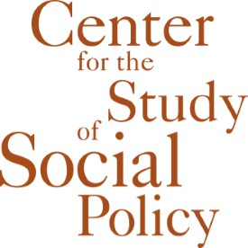
Shifting the Conversation:
Toxic Stress and Well-Being
Cailin O’Connor
Senior Policy Analyst

Slide 4
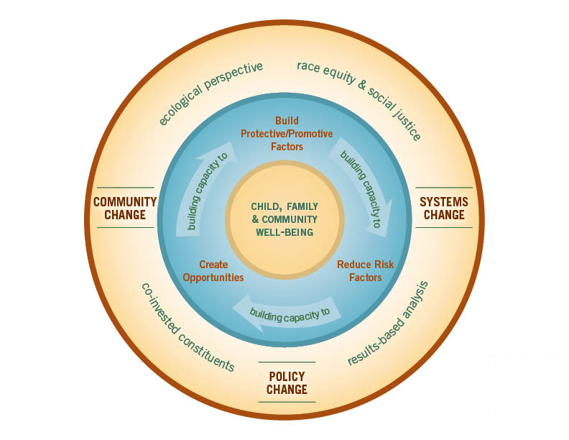
About the Center
The Center for the Study of Social Policy (CSSP) is a national, nonprofit organization recognized for its leadership in shaping policy, reforming public systems and building the capacity of communities. For more than 30 years, CSSP has influenced and supported elected officials, public administrators, families and neighborhood residents to secure equal opportunities and better futures for all children and families, especially those most often left behind.
CSSP’s Theory of Change

Slide 5
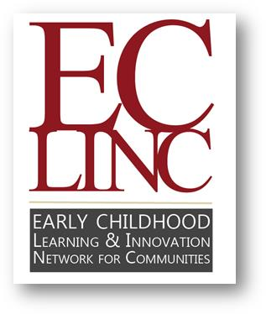

Early Childhood-LINC
A network of nine cities and counties that have come together to:
Improve Results
for young children, prenatally to age 8.
Jointly Tackle the Toughest Challenges
faced by children and families in their communities.
Accelerate the Impact
of community-based, integrated early childhood systems (bringing together health, early care and education, family support and more).

Slide 6


* Knowledge about the impact of early trauma and toxic stress is expanding

Slide 7
* Shifting the Conversation about Toxic Stress
There is a growing understanding that trauma and toxic stress are widespread with far-reaching impacts.
It’s equally important to tackle root causes of toxic stress, help parents and caregivers buffer their children from toxic stress responses, and build protective factors in families and communities
Trauma also manifests at community level.
There are emerging community-level strategies to address community trauma and promote community healing and resilience in these environments.
The conversation needs to be about more than understanding and intervening

Slide 8



Early Childhood-LINC Learning Labs
    Define priority issues
    Share strategies and challenges
    Recommend next steps to inform communities’ own work as well as the field
Learning Lab on Community Approaches to Toxic Stress
Representatives from 6 communities met monthly for 8 months in 2014-2015
Began by defining toxic stress from a community perspective
Developed a framework that puts toxic stress in the context of broader work on well-being

Slide 9

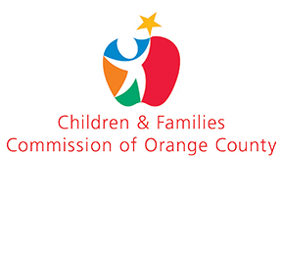

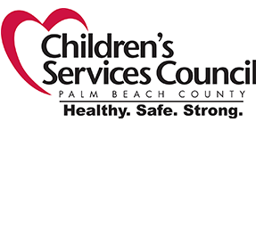


Six Early Childhood-LINC Communities Participated in the Learning Lab:
Alameda County, CA
Orange County, CA
Ventura County, CA
Palm Beach County, FL
Hartford, CT
Lamoille Valley, VT

Slide 10
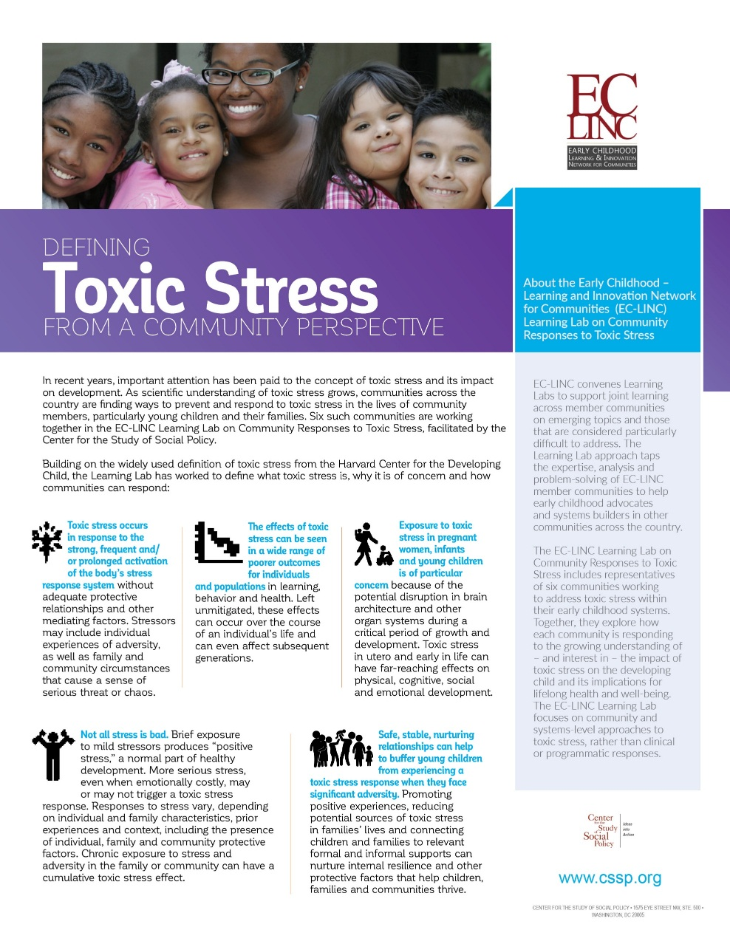
Defining Toxic Stress from a Community Perspective
As scientific understanding of toxic stress grows, communities across the country are finding ways to prevent and respond to toxic stress in the lives of community members, particularly young children and their families.
Building on the widely used definition of toxic stress from the Harvard Center for the Developing Child, the EC-LINC Learning Lab on Community Responses to Toxic Stress has worked to define what toxic stress is, why it is of concern and how communities can respond.
http://bit.ly/cmtystress

Slide 11





Toxic Stress from a Community Perspective
A toxic stress response is the strong, frequent and/or prolonged activation of the body’s stress response system without adequate protective relationships and other mediating factors. Stressors may include individual experiences of adversity, as well as family and community circumstances that cause a sense of serious threat or chaos.
The effects of toxic stress can be seen in a wide range of poorer outcomes for individuals and populations in learning, behavior and health. Left unmitigated, these effects can occur over the course of an individual’s life and can even affect subsequent generations.
A toxic stress response in pregnant women, infants and young children is of particular concern because of the potential disruption in brain architecture and other organ systems during a critical period of growth and development. Toxic stress in utero and early in life can have far-reaching effects on physical, cognitive, social and emotional development.
Not all stress is bad. Brief exposure to mild stressors produces “positive stress,” a normal part of healthy development. More serious stress, even when emotionally costly, may or may not trigger a toxic stress response. Responses to stress vary, depending on individual and family characteristics, prior experiences and context, including the presence of individual, family and community protective factors. Chronic exposure to stress and adversity in the family or community can have a cumulative toxic stress effect.
Safe, stable, nurturing relationships and communities can help to buffer young children from experiencing a toxic stress response when they face significant adversity. Promoting positive experiences, reducing potential sources of toxic stress in families’ lives and connecting children and families to relevant formal and informal supports can nurture internal resilience and other protective factors that help children, families and communities thrive.

Slide 13
* Key questions at the community level
01.
02.
03.
What are we already doing in our community to prevent the conditions that can generate a toxic stress response in parents and their young children?
What level of coordination of these activities is already in place? How can we better collaborate across existing agencies and systems to achieve better outcomes?
What additional services, supports or opportunities would enhance existing efforts?
04.
05.
06.
07.
How might an understanding of toxic stress lead us to change the way we go about our current work?
Where do young children and their families spend their time?
What are the greatest sources of stress in children’s environments or threats to children’s well-being in our community?
Which of the solutions we want to develop can be single-sector in nature and which need to be cross sector?

Slide 14
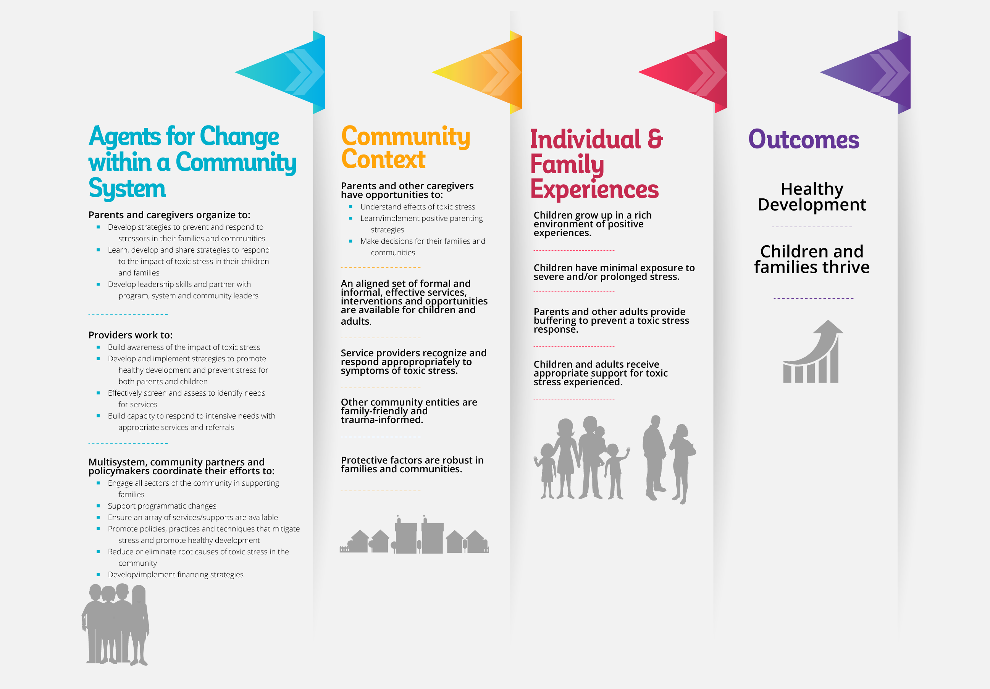
Working Toward
Well-Being:
A Framework of
Community
Approaches to
Toxic Stress

Slide 15
Parents and caregivers organize to:
Develop strategies to prevent and respond to stressors in their families and communities
Learn, develop and share strategies to respond to the impact of toxic stress in their children and families
Develop leadership skills and partner with program, system and community leaders
Parents and caregivers
Service Providers
Multisystem, community partners and policymakers

Slide 16
Providers work to:
Build awareness of the impact of toxic stress
Develop and implement strategies to promote healthy development and prevent stress for both parents and children
Effectively screen and assess to identify needs for services
Build capacity to respond to intensive needs with appropriate services and referrals
Parents and Caregivers
Service providers
Multisystem, community partners and policymakers

Slide 17
Multisystem, community partners and policymakers coordinate their efforts to:
Engage all sectors of the community in supporting families
Support programmatic changes
Ensure an array of services/supports are available
Promote policies, practices and techniques that mitigate stress and promote healthy development
Develop/implement financing strategies
Parents and caregivers
Service providers
Multisystem, community partners and policymakers

Slide 18
Parents and caregivers have opportunities to:
Understand effects of toxic stress
Learn/implement positive parenting strategies
Make decisions for their families and communities
Parents and caregivers
Service providers
Multisystem, community partners and policymakers

Slide 19
An aligned set of formal and informal, effective services, interventions & opportunities are available for children and adults
Service providers recognize, respond appropriately to symptoms of toxic stress
Other community entities are family-friendly, trauma-informed
Protective factors are robust in families and communities
Parents and caregivers
Service providers
Multisystem, community partners and policymakers

Slide 20
Children grow up in a rich environment of positive experiences
Children have minimal exposure to severe and/or prolonged stress
Parents and other adults provide buffering to prevent a toxic stress response
Children and adults receive appropriate support for toxic stress experienced

Slide 21
Healthy development
Children and families thrive

Slide 22
Working Toward
Well-Being:
A Framework of
Community
Approaches to
Toxic Stress

Slide 23
National League of Cities Institute For Youth, Education & Families
Cities & Toxic Stress
June 7, 2016

Slide 24



National League of Cities
Institute for Youth, Education, and Families
Tonja Rucker, PhD
Program Director, Early Childhood Success
Laura Furr
Program Manager, Justice Reform and Youth Engagement

Slide 25
National League of Cities
Institute for Youth, Education, and Families
The National League of Cities (NLC) is the country’s oldest and largest national organization representing the interests of cities.
NLC serves as a resource to and an advocate for the more than 19,000 cities, villages and towns it represents.
The Institute for Youth, Education, and Families (YEF Institute) is a special entity within NLC with over a decade of work working with elected officials to create strong early care and education systems.
YEF Institute’s Mission:
To help municipal leaders take action on behalf of children, youth, and families.

Slide 26
YEF Institute's Commitment to Addressing Toxic Stress
YEF Council focus on toxic stress
  NLC's Council on Youth, Education, and Families (YEF Council) guides and oversees the YEF Institute's work. The membership of this Council, unlike any other NLC committee or council, is composed of not only local elected officials but also youth members and representatives from major national organizations concerned about children and families.
YEF Institute internal working group on toxic stress

Slide 27
YEF Institute’s Early Childhood Work
Early Learning Nation (Bezos Family Foundation)
Educational Alignment for Young Children (W.K. Kellogg Foundation)
Project NOW (Robert Wood Johnson Foundation)

Slide 28
Elements of Educational Alignment for Young Children
Formal partnerships or governance structures
Quality early education
School quality and organization
Alignment of standards, curricula, teaching practices, and assessments
Communication and data sharing
Qualified teachers and administrators
Family Engagement
Transitions to school
Public awareness of the importance of the early education
Funding

Slide 29



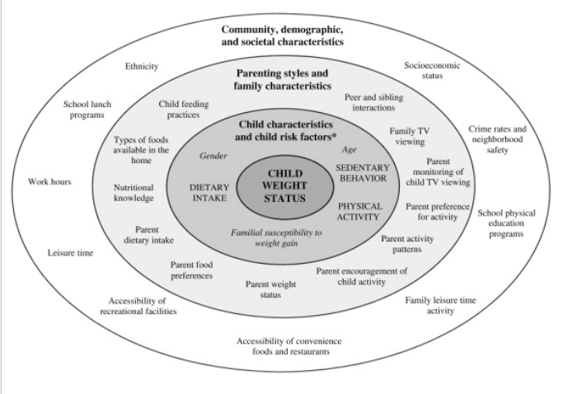


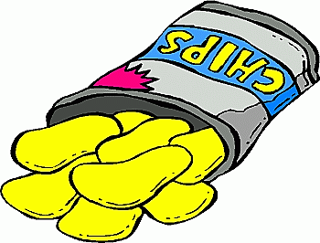
Project NOW
Notes:
Early life experiences as a social determinant of healthy weight

Slide 30
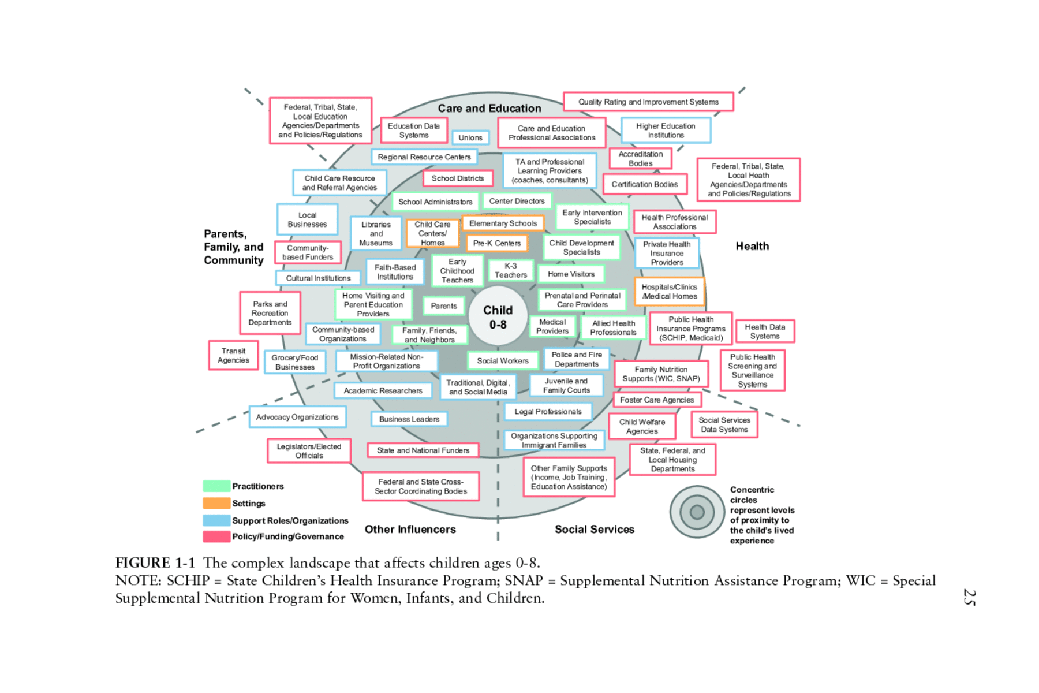

Slide 31






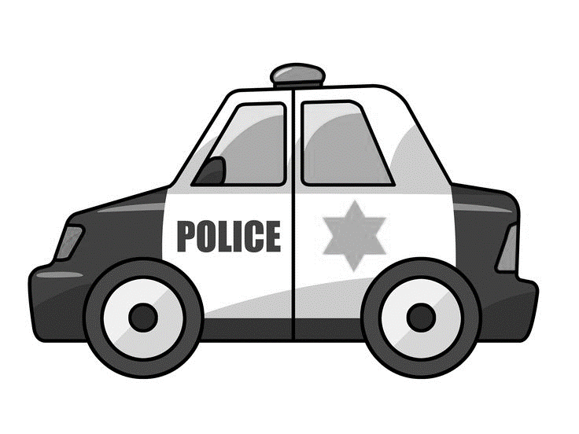
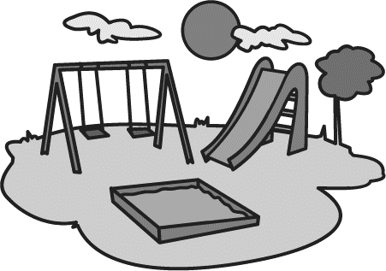
Cities Directly and Indirectly Influence the Lives of Children and their Families

Slide 32

Jacksonville Children’s Commission Training Institute
CWEEP Certification (Child Welfare-Early Education Partnership):
  Child Welfare 101
  Trauma-Informed Care
  Positive Behavior Interventions and Supports (PBIS).
  Partnership with The Jacksonville Children’s Commission, Early Learning Coalition, and Family Support Services.

Slide 33
Tarpon Springs, FL: A Trauma-informed City
Initiative includes public awareness of toxic stress and adverse childhood experiences, trainings for anyone wanting to be trauma-informed in community, and efforts to better understand sources of trauma and stress in community
Peace4Tarpon started as an idea from municipal leadership:
  Former Vice Mayor developed the initiative between 2005 & 2011
  Buy-in from mayor, city manager, and police chief in 2010 got ball rolling
  Initiative now includes partners from the nonprofit and faith communities, health care systems, the local housing authority, and more

Slide 34

City’s Role is Across the Lifespan

Slide 35
YEF Institute’s Justice Reform Initiative
Goal: To support city leaders as they improve outcomes for youth, young adults, and communities by reducing the negative impacts of the justice system
How city leaders have made a difference: reduced arrests and increased services for youth accused of delinquent acts
Expanded opportunities to reduce arrests of young adults

Slide 36
Toxic stress and public safety: the issue
Community violence
Incarcerated parents + concurrent ACEs
Juvenile justice-involved youth
Arrests
Notes:
Repeated exposure to community violence can traumatize children. In 2011, 60% of children were victims of or witnessed violence.
Having an incarcerated parent is an ACE.
Children with an incarcerated parent are more likely than most children to have 4 or more ACEs.
Arresting a child or adolescent causes and can lead to new trauma.
High rates of youth in the juvenile justice system have experienced childhood trauma, especially family violence and having an incarcerated family member, and have experienced it more frequently than other youth.

Slide 37
Toxic stress and public safety: What local leaders can do
Prevention
  Improve overall community wellness and reduce violence.
  Reduce arrests and length of confinement of parents when public safety is not at risk.
Intervention
  Implement trauma-informed arrest policies when a child is present or lives in the home.
  Support families with an incarcerated parent to reduce the other negative impacts on children.
Diversion
  Hold youth accused of delinquent acts accountable with services to meet underlying needs vs. just punishment.
Notes:
Reduce arrests and confinement of parents: implement RAI at arrest or, with partners, instead of money bail, stop arrests for offenses that pose no risk to public safety, provide needed services. Number of localities with the Safety and Justice Challenge are undertaking this.
Trauma-informed arrest policies, i.e Fresno CA. In particular, as with CIT and other current policing reforms, having a mental health clinician on hand or on call.
Financial supports and training, but also supporting healthy relationships between parent and child when appropriate. Visits and calls. Children of Incarcerated Parents Bill of Rights.
JASCs and early diversion; system of services. Making services available to these kids vs. shutting them out.

Slide 38
Mitigating the harm of parental arrest
More than just giving a child a teddy bear.
Additional resources:
International Association of Chiefs of Police (IACP), Bureau of Justice Assistance (BJA) and the Substance Abuse and Mental Health Services Administration (SAMHSA) Safeguarding Children of Arrested Parents
Strategies for Youth and OJP Diagnostic Center First Do No Harm: Model Practices for Law Enforcement Agencies When Arresting Parents in the Presence of Children

Slide 39
Using the Framework: Community Examples and Recommendations

Slide 40
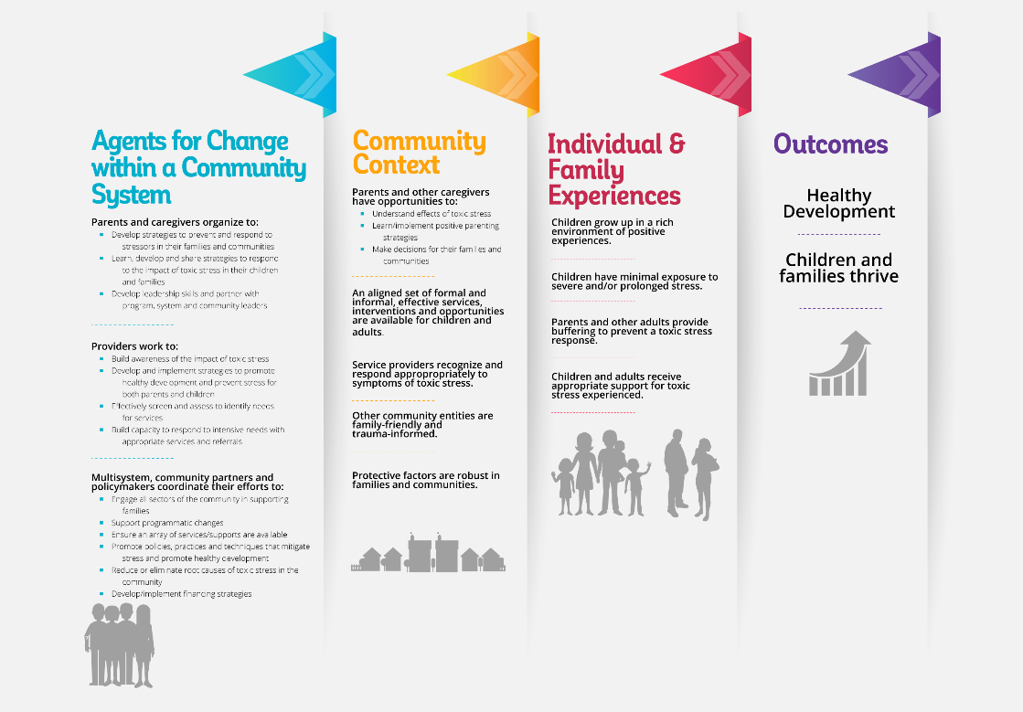
Using the Framework
Anyone can become an agent for change in their own community.
Anyone already working to improve conditions for children and families can find ways to multiply their impact through partnerships at the community and system level.

Slide 41
Using the Framework
A community coalition or public agency might:
consider new partners to invite to the table,
target specific changes they would like to make in the community context
make connections between community partners who do not usually work together
A group of parents or community residents might use it to identify:
aspects of their community context they want to change
actions they can take to get there
who they need to engage among service providers and community leaders

Slide 42
Using the Framework
Professionals working with children and/or families might identify:
areas of the framework where they currently play a role
areas where they could do more
potential partnerships that would allow them to make a greater impact at a community or population level
Providers focused on promoting healthy development and preventing toxic stress can see where their work intersects with providers focused on identifying or intervening with those who have already experienced a toxic stress response – and vice versa.

Slide 44
Parent strategies
Community dialogues leading to community action (Denver)
Parent advocacy (Alameda County)
Family leadership (Boston)

Slide 45
Provider strategies
Pediatric care providers addressing social determinants of health (DULCE)
Mental health consultation to support providers and families in the context of programs
Family support strategies focused on overcoming potential sources of toxic stress
Child welfare system reform: Strengths-based, trauma-informed, 0-3 focus
Trauma training for shelter staff

Slide 46
System and policy level strategies
Trauma-informed coalitions
Universal developmental screening, identification and linkage
Multi-sector preventive interventions – Triple P
Cross-agency learning community

Slide 47
Recommendations
Reach out to parents and caregivers with information about toxic stress, trauma, protective factors and community opportunities they can act on.
Increase the role and authority of parent advisory groups in problem-solving, decision-making and programming at all levels, particularly in decision-making that relates to potential sources of toxic stress in their lives and communities.
Create leadership development ladders for parents and community residents to effect change in their communities, particularly in communities where residents are disproportionally exposed to potential sources of toxic stress.
Seek out and partner with existing groups of parents advocating for trauma-informed care and better conditions for themselves, their children and/or their communities.
Provide information and promote leadership opportunities for parents and caregivers to prevent and address toxic stress and promote well-being

Slide 48
Recommendations
Support and build capacity of service providers to prevent and address toxic stress and promote well-being
Provide child development, trauma and toxic stress training, coaching and mental health consultation for service providers in all systems that serve children and families, across the spectrum from prevention to intervention.
Promote the use of tools and strategies to build resilience and promote healthy development.
Develop an aligned and tiered set of services/supports/opportunities to better identify and meet the full array of needs of young children and their families in any given community.

Slide 49
Recommendations
Fund a convening and connecting role to bring together all stakeholders with an interest in preventing and responding to toxic stress and promoting healthy development.
Assess current assets and needs related to trauma and toxic stress in the community – including child and family service systems, other services and supports, and neighborhood assets and opportunities.
Consider an initial information campaign to heighten community awareness and mobilize action on trauma, toxic stress, healthy development and child and family well-being.
Develop a strategic plan that builds on and better aligns current assets, while also addressing significant gaps in capacity and opportunity.
Develop and enhance support for multi-sector and broad-based collaboration focused on trauma, toxic stress and child and family well-being

Slide 50
Recommendations
Develop and enhance support for multi-sector and broad-based collaboration focused on trauma, toxic stress and child and family well-being
Develop common goals, shared results and metrics, and clearly articulated action steps to more systematically address trauma and toxic stress in young children, families and the broader population.
Seek a balance between resources going into intervention (identifying and responding to those who have already experienced toxic stress) and resources going to efforts that will promote healthy development and prevent more children from experiencing toxic stress.
Identify and work to obtain potential sources of sustainable funding, including the potential of repurposing current funding to better incorporate both preventive and trauma-informed approaches.

Slide 51



* CSSP: Ideas into Action
CSSP translates research and new ideas into strategies for on-the-ground implementation. We use the knowledge from those real experiences to better inform the next generation of ideas, programs and policies.
Connect with Us
twitter.com/CtrSocialPolicy
facebook.com/CtrSocialPolicy

