Slide 1
Understanding the
Strengthening Families
Protective Factors

Slide 2
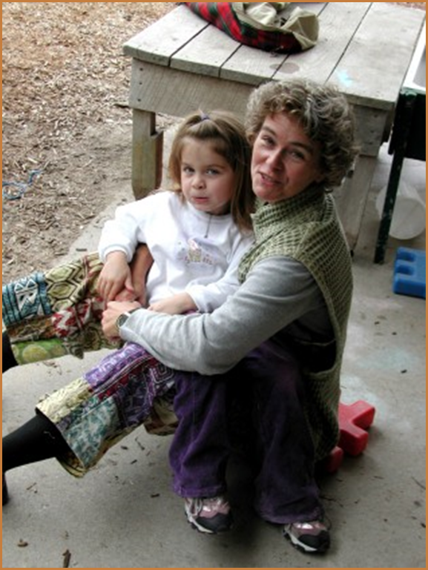
Five Protective Factors
PARENTAL RESILIENCE
SOCIAL CONNECTIONS
KNOWLEDGE of PARENTING and CHILD DEVELOPMENT
CONCRETE SUPPORT in TIMES of NEED
SOCIAL and EMOTIONAL COMPETENCE of CHILDREN
Notes:
STATE: Welcome back. We ended our last module with this slide which listed each of the protective factors. In this section of the training we will be focused on building your understanding of each of the five protective factors.
DIRECT: I want you to keep the piece of paper in front of you where you wrote down why you thought each protective factor was important. As we go I want you to put a star next to what you wrote when you hear things that reinforce what you said – and write down new concepts that add to what you said.

Slide 3
Learning Objectives
Upon completion of this module participants will be able to:
Be able to define and describe each of the five protective factors
Understand how they can use everyday actions to support the families they touch in building their own protective factors
Notes:
STATE: Our goal is to give you an understanding of what each protective factor is—the individual skills and capacities that make up the protective factors – and the everyday actions that help families to build them.
EXPAND: The Protective Factors Framework is universal and applies to all families – but we know that in child welfare, we work with families who face challenges related to the protective factors as well. So we will also discuss what we might see in child welfare-involved families related to each protective factor, and what the caseworker role can be in helping those families in particular to build each one.

Slide 4

Resilience
The human capacity to face, overcome, be strengthened by and even transformed by the adversities of life.
Notes:
STATE: We are going to start by talking about parental resilience. Why is resilience important? We cannot prevent stress or crisis from happening to families—but we can give them the tools they need to respond effectively so crises do not escalate and the fall-out from crises does not negatively impact their parenting and their children. Resilient parents are able to recognize and acknowledge difficulties while maintaining a positive attitude. When parents are resilient, they have more patience with their children day-to-day and are less likely to take their frustrations out on their children and repeat negative patterns they may have learned in their own childhood.

Slide 5
Parental resilience
Managing stress and functioning well when faced with challenges, adversity and trauma
What it looks like
Resilience to general life stress
Hope, optimism, self confidence
Problem solving skills
Self care and willingness to ask for help
Ability to manage negative emotions
Resilience to parenting stress
Not allowing stress to interfere with nurturing
Positive attitude about parenting and child
Notes:
STATE: When we consider a family’s resilience, it is important to think about both general life resilience – the ability to function well at work when things are difficult at home, for example – and parenting resilience – the ability to nurture and support one’s children in times of stress. Parents may be strong in one type of resilience and need support in another. While these two things are connected and reinforce each other they are also distinct.
It is important to remember that resilience is not an innate trait or something you are born with. It is a capacity that involves behaviors, thoughts and actions that can be learned by and developed in anyone. Building and sustaining resilience is a life-long learning process. Another important concept is that our resilience is also sensitive to environment. We have all been in situations and/or with people where we don’t feel like our best selves. Part of this is simple brain science: When we are in situations where we feel threatened, or disrespected, it can cause the part of our brain that deals with fear to activate. When this happens it can make us more likely to be reactive, shutting down our problem solving skills.

Slide 6
Parental resilience
Everyday actions
Demonstrate in multiple ways that parents are valued
Honor each family’s race, language, culture, history and approach to parenting
Encourage parents to manage stress effectively
Support parents as decision-makers and help build decision-making and leadership skills
Help parents understand how to buffer their child during stressful times
Notes:
STATE: Thus, the everyday actions which are connected to building resilience focus on a number of things:
Interacting with parents in a way that is strengths-based, honors and supports them as individuals and as parents
Encouraging parents to recognize and plan for how they will respond to stressors
Helping to build the skills that will help during a crisis by providing ways for parents to learn and practice skills in every day circumstances

Slide 7
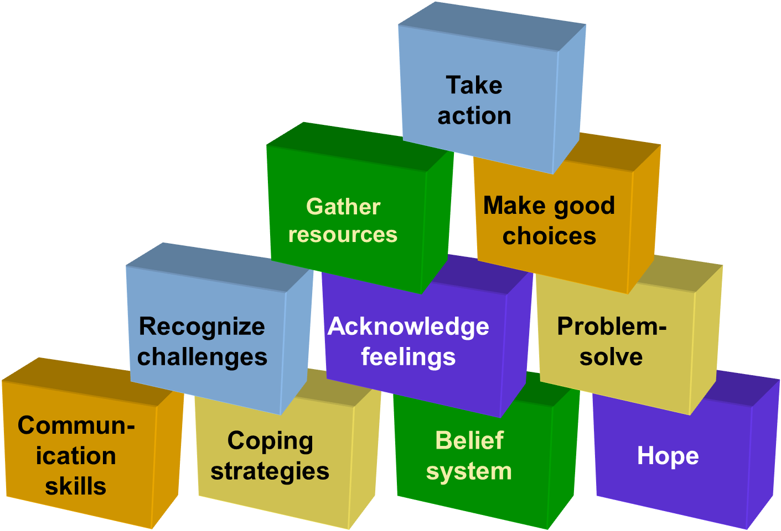
Building blocks of resilience
Prepare for Action
Internal Inventory
Skills and Attitudes
Notes:
STATE: There are many components to resilience. This image is commonly used to give a visual description of what resilience might look like. It shows the skills and attitudes that are the building blocks of resilience.
[CLICK TO BRING UP LABEL] The bottom level shows some characteristics and skills that lay the groundwork for resilience. These are foundational blocks – without them, it is hard to move forward.
[CLICK TO BRING UP LABEL] The 2nd level up shows actions that resilient people are able to take when faced with challenges. These are “internal” actions we move to as a result of our foundational strengths.
[CLICK TO BRING UP LABEL] The 3rd level represents the steps we begin to take based on what needs to get done.
Finally, the top level shows steps people take, based on their assessment of a problem, to get through a stressful situation. Up to this point, most of this reflection has been within ourselves. But by the time we reach the top level, we are involving people outside of ourselves.
Each person may arrange these personal resilience blocks in different configurations. Arrangements that work for some, may not work for others. It is important that individuals and families design their own version of the resilience blocks.

Slide 8
Actively supporting resilience: A caseworker’s role
Reinforce Action
Support skills building
Build on parent strengths
Notes:
STATE: As a caseworker, you can support parents in their development of resilience by first thinking about the building blocks they already have in place and encouraging them to build on those strengths.
[CLICK TO BRING UP LABELS]
This is the same idea that we call “scaffolding” when adults help young children develop new skills by supporting them to achieve things just a notch more difficult than what we already know they can do. Meeting parents where they are, you can help them build up more and more blocks as you support them in building their skills, and reinforce the positive actions they take to resolve conflicts and solve problems.
Optional ACTIVITY 1: Focus on Self—Building Blocks of Resilience

Slide 9
Parental Resilience
For child welfare involved families…
Parents may…
Have their own trauma history
Have co-occurring issues (DV, substance abuse, etc.)
Feel negative about themselves
Worry about seeking help for their child
Be parenting children who have experienced trauma
Be parenting children with special needs
Worry about what could happen to their children in hostile environments
Case worker role
Project a positive and strengths-based approach to the family
Support the family as key decision-makers and validating and supporting good decisions
Make self-care a part of the case plan
Encouraging the parent to explore & address their own past experiences of trauma
Normalize that parenting is stressful and help parent plan proactively for stressful parenting situations
Acknowledge / be aware of societal trends that have had a negative impact
Notes:
STATE: For parents involved with the child welfare system, resilience is particularly important. We know that many of the parents we are working with are living from crisis to crisis. Helping to plan for what they will do in a crisis situation, providing them with tools for dealing with crisis and helping them to identify the processes and strategies for keeping themselves centered and strong in a moment of crisis is important for the ongoing well-being of both the parent and the child. Parental stress is a known risk factor for child maltreatment—resilience is about being able to deal effectively with stress, crisis and adversity. This is why resilience is considered a protective factor against child maltreatment.
Many parents, however, who come into contact with the child welfare system face challenges to their resilience. It is important to note that many of these parents grew up in environments of toxic stress, and because of this, their capacity for resilience may have been compromised. As children, they themselves may have experienced strong, frequent and prolonged adversity without the buffering protection of nurturing adult support. As a result, these parents may display symptoms of depression, anxiety or other clinical disorders that inhibit their ability to respond consistently, warmly and sensitively to their own child’s needs. Parents can be helped to manage clinical symptoms and reactions to their own histories of poor attachments and trauma. In this way, they become stronger and more able to protect their own children from adversity, and to provide the more nurturing care necessary for secure emotional attachment and healthy development in their children. Ask for additional support from your supervisor or others if you feel that a caregiver you are working with is showing signs of stress, depression or mental health issues.
DISTRIBUTE: Handout 2.1a: Parental Resilience
TRAINER’S NOTE: Handout 2.1a is meant to be a key take away for the training. It summarizes information on resilience and provides guidance on questions to ask; and things to look for to better understand family’s resilience as well as describing activities to do with families to build resilience. An alternate exercise would be to allow participants to review the handout and pick one action or activity they could take with a family they are working with.

Slide 10
Social connections
Positive relationships that provide emotional, informational, instrumental and spiritual support
What it looks like
Multiple friendships and supportive relationships with others
Feeling respected and appreciated
Accepting help from others, and giving help to others
Skills for establishing and maintaining connections
Notes:
STATE: Who do you call when you need a breather or break or you just need a listening ear? This second protective factors is about those SOCIAL CONNECTIONS that we all need to thrive.
Several research studies have demonstrated that—for both mothers and fathers—high levels of emotional, informational, instrumental or spiritual support is associated with positive parental mood; positive perceptions of and responsiveness to one’s children; parental satisfaction, well-being and sense of competence; and lower levels of anger, anxiety and depression. Conversely, inadequate, conflicting or dissatisfying social connections can be the source of parental stress.
It isn’t about how many people an individual knows, but the quality of those relationships and the support received from them. When we talk about social connections, we are referring to parents’ healthy, sustained relationships with people, institutions, the community, or a force greater than oneself that promote:
a sense of trust and belonging,
the feeling that one matters or “fits” with other people or organizations,
a sense of belongingness,
reciprocal positive regard,
the potential for shared or complementary values and beliefs, and
opportunities to share joy, pain, and uncertainties.
These connections support us personally as well as in our parenting role. To support strong parenting we want social networks that are infused with healthy, supportive, caring relationships. Supportive social connections help buffer parents from stressors and support nurturing parenting behaviors that promote secure attachments in children. Social isolation is a risk factor consistently associated with disengaged parenting, maternal depression and increased likelihood of child maltreatment.

Slide 11
Social connections
Everyday actions
Help families value, build, sustain and use social connections
Create an inclusive environment
Facilitate mutual support
Promote engagement in the community and participation in community activities
Notes:
STATE: The everyday actions listed here are things that anyone can do to help families build their social connections. There are many things we can do to help parents connect to each other that are really only going to be effective with parents who already have a level of comfort in social situations. Those things can make a big difference for families who may just be isolated because they live far from their extended family, or are the first in their social circle to have children, or have recently moved to a new community.
However, we need to pay special attention to those families that are at the edge of the social fabric—they often don’t have the skills to integrate themselves into social environments and need bridgers to help them. For parents who do not have a history of positive relationships or lack social skills, your role as a service provider can be to help them develop those skills – through modeling and role playing, for example – and then to provide support to help them enter into social interactions with other adults who will be a positive support to them.

Slide 12
Building an Eco-map
Child
Sister
Friend
You
Parent at your child’s school
Friend
Co-worker
Spouse
Co-worker
Notes:
PAUSE with only the title on screen if you will be completing the eco-map activity
[CLICK through animation if you will not be completing the eco-map activity]
STATE: An eco-map is a commonly used tool for mapping social relationships. Like the one shown here, an eco-map a simple visual representation that shows all of the systems at play in an individual’s or family’s life. The eco-map also provides a picture of the important nurturing or conflict-laden connections between the family and the world; demonstrates the flow of resources, or lacks and deprivations; and highlights points of conflict to be mediated, bridges to be built and resources to be explored.
Optional ACTIVITY 2: Using an eco-map to understand social relationships
[CLICK through animation as you go through the activity]

Slide 13
Social connections
For child welfare involved families…
Parents may…
Be socially isolated
Have a history of conflicted relationships
Not have the skills and tools to develop or recognize positive relationships
Case worker role
Model good relational behavior
Help the caregiver develop stronger relational skills
Engage the family’s broader network
Help the family identify supporters in their network who will contribute positively
Encourage the caregiver to expand or deepen their social network as part of the case plan
Encourage caregiver to address barriers to developing healthy social connections such as anxiety or depression
Notes:
STATE: Once again we need to remember that the families we see on a day-to-day basis in child welfare may be struggling with developing and maintaining relationships that support both taking care of self and positive parenting. Some of the special challenges system-involved parents may struggle with are listed on the left.
As the family’s caseworker you can help them to think critically about their social network and how to utilize it more effectively, as well as the skills and tools they need to expand it. Be sure to take the time to understand the family’s existing social network and which parts of that network provide (or could provide) the quality connections a family needs. In some cases, you may also need to coach parents on how to reduce negative influences from existing relationships – by reducing their dependence, limiting contact or, when possible, ending a relationship that is not supporting them in being the parent they want to be.
DISTRIBUTE: Handout 2.1b: Social Connections.
TRAINER’S NOTE: Handout 2.1b is meant to be a key take away for the training. It summarizes information on social connections and provides guidance on questions to ask; and things to look for to better understand family’s social connections as well as describing activities to do with families to build social connections. An alternate exercise would be to allow participants to review the handout and pick one action or activity they could take with a family they are working with.

Slide 14
Knowledge of parenting & child development
Understanding child development and parenting strategies that support physical, cognitive, language, social and emotional development
What it looks like
Nurturing parenting behavior
Appropriate developmental expectations
Ability to create a developmentally supportive environment for child
Positive discipline techniques; ability to effectively manage child behavior
Recognizing and responding to your child’s specific needs
Notes:
STATE: The third protective factor is knowledge of parenting and child development. Knowledge of parenting and child development refers to parents’ understanding of development and strategies to support children’s development, as described on this slide.
It is not a surprise that learning more about parenting and child development would help a parent or caregiver be more effective. In fact, this is often our default response to family problems – providing or requiring parenting classes. We’ll talk in a minute about what other strategies we can use to help parents build their knowledge.
First, it is important to acknowledge that what is considered to be effective parenting is contextual, particularly with respect to culture and circumstances. For example, our systems often assume that poor families have poorer parenting skills. In fact, we know that the majority of poor families protect, nurture, and support their children. Parents raising their children in more challenging contexts may use a more controlling form of parenting, which is necessary to minimize exposure to potentially harmful influences. What defines good parenting may depend on the context.

Slide 15
Knowledge of parenting & child development
Everyday actions
Model developmentally appropriate interactions with children
Provide information and resources on parenting and child development
Encourage parents to observe, ask questions, explore parenting issues and try out new strategies
Address parenting issues from a strength-based perspective
Notes:
STATE: Some everyday actions anyone can take to help parents build their knowledge are listed here.
We as a field have struggled with how to deliver this knowledge in a way that will promote uptake and use of the information. When we talk about this protective factor in Strengthening Families, we stress that parents need information, perspective, and strategies they can use with their own children. The knowledge that parents need is not one-size-fits-all, and opportunities to increase their knowledge may not come from traditional parenting education classes.
We have good reason to believe that parenting classes cannot be our primary tool – research shows us that too many families don’t complete these courses and the change in behavior is low. This may be especially true for those who are required to complete parenting education courses.
Adult learning theory can guide us in our thinking. People are more likely to act on and use information when it is provided right when they are struggling with an issue; and when they have opportunities to not only learn it in a didactic manner—but to see it in action and test out how to use the knowledge themselves.
For this reason, the everyday actions described here are things that can happen in a traditional parenting education class, but can also happen less formally in many other contexts. In fact, the ability of those who come into regular contact with families to provide “just in time” parenting education in informal ways may be a crucial way to get information to parents that they can and will act on.

Slide 16
What knowledge do parents need?
Where do we see inappropriate developmental expectations?
Where do we see a lack of strategies?
Where do we see parents getting frustrated?
Notes:
STATE: We wanted to take a moment to ask you what knowledge you see a need for among the parents you work with – or the parents you know in your personal life or see in the community. What parents need varies by the age of their children, but let’s focus particularly on what knowledge parents need when their children are young. Where do you see gaps?
FACILITATE discussion
BE PREPARED to supplement answers from participants to ensure the following topics come up:
Knowledge related to different developmental domains: Social emotional, physical, cognitive
Understanding what is developmentally normal
Positive behavior management strategies
Particular challenges like chronic crying in infants, toilet training, tantrums

Slide 17

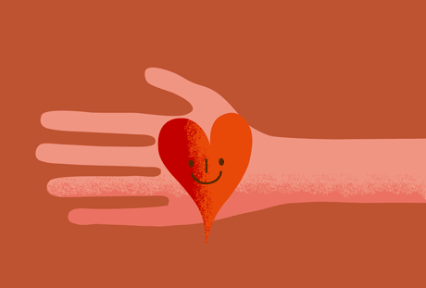



Providing “just in time” parenting education
RANDY TARAN
Filmmaker, Project Happiness
Share852
3
SHARE 852
<IMG CLASS=" FIELD-COVER-MEDIA" SRC="/SITES/DEFAULT/FILES/STYLES/FEATURE_IMAGE_BREAKPOINTS_THEME_EDUTOPIA_DESKTOP_1X/PUBLIC/SLATES/TARAN-EMPATHY.GIF?ITOK=TGMWXTVP" ALT="" />
Express Empathy
Ask Good Questions
Provide Information and Perspective
Develop Strategies
Coach, Model and Mentor
Lift up Successes
Notes:
STATE: Advice we give to parents will be most effective when we are able to provide it “just in time” – right when a need arises or an issue is of particular concern. A parent of an infant who is not sleeping for more than an hour at a time will probably not be receptive to information about much of anything other than how to help their child sleep for longer stretches! And information about how to deal with a toddler biting will not be particularly interesting to parents until the day their toddler bites another child – at which point it becomes very, very important. The context in which we deliver this information also matters.
When we see a parent or caregiver in need of parenting help, our first step should be to express empathy with them and/or their child for whatever they are struggling with. What adult neuroscience tells us is that when individuals feel threatened our limbic system is more likely to be engaged and our pre-frontal cortex less engaged. What this means is that our memory is impaired, we are more likely to fall back on routine and less likely to adopt new behavior. Because parenting is so core to our identity we can feel threatened if we feel our parenting strategies are being criticized. Expressing empathy can be an effective way to diffuse feelings of being threatened and judged.
Next we can ask questions so that our response will be appropriate, and so that the parent knows we are making an effort to understand their situation. Remember, there are many nuances to parenting and child development and without really understanding the parent’s experience we risk providing the wrong information. Asking questions can also be an important teaching tool to help parents think about the different aspects of the situation.
Once we understand the situation we can provide information – through conversation, lending a relevant book, handing them a brochure or referring them to a website, for example. Information helps parents better understand their child’s current development or what to expect, or to see the significance of their role as a parent. Parents are much more likely to accept and use that information when we have first expressed empathy and asked the right questions. Providing information is also a helpful way to help a parent get perspective. Parents may believe that no one else’s child has the same challenging behaviors as their child; or they may not be able to see a light at the end of the tunnel during a particularly challenging phase in their child’s life. We can often help by providing some perspective on the normal variations in child development and challenges faced by other families, or by reminding parents that “this too shall pass.”
Again, adult learning theory tells us that providing information is not enough. I f we want this information to result in behavior change we need to help the parent develop a plan for how they can put these concepts into practice in their day-to-day life. Parents need strategies they can try with their particular children – and it’s very rare that one strategy will be enough. We all need a number of tools ready to try in different situations and depending on how a child responds.
Ideally we also have the opportunity to coach parents in using the technique, model it with their child or another child, and/or serve as a mentor for them to come back to once they have tried to strategies. This type of interactive engagement with the parent around new knowledge helps them to internalize and engage with them. This also provides the way to help parents assess what is working and tweak strategies if needed. Finally by lifting up successes we help parents observe what is working for them thereby reinforcing effective strategies.

Slide 18
Knowledge of parenting & child development
For child welfare involved families…
Parents may…
Have conflicting demands which make participation in parenting classes hard
Have developmental and processing challenges
Be parenting children with atypical behavior
Have negative parenting models
Case worker role
Connect parents to parenting education classes or resources
Model appropriate expectations and parenting behavior
Underline the importance of nurturing care & help the parent value their role
Provide “just in time” parenting education
Help the caregiver identify a series of trusted informants that they can turn to when they need parenting information
Provide information on trauma and its impact on development
Notes:
STATE: Once again, it is important to consider the circumstances of the families we come into contact with in child welfare systems. These parents may face particular challenges in the area of knowledge of parenting and child development, as listed on the left. On the right are actions caseworkers and others can take to support these parents.
DISTRIBUTE: Handout 2.1c: Knowledge of Parenting and Child Development.
TRAINER’S NOTE: Handout 2.1c is meant to be a key take away for the training. It summarizes information on knowledge of parenting and child development and provides guidance on questions to ask; and things to look for as well as describing activities to do with families to build their knowledge of parenting and child development. An alternate exercise would be to allow participants to review the handout and pick one action or activity they could take with a family they are working with.
Optional ACTIVITY 3: Helping Parents Build Knowledge and Skills

Slide 19
Concrete support in times of need
Access to concrete support and services that address a family’s needs and help minimize stress caused by challenges
What it looks like
Seeking and receiving support when needed
Knowing what services are available and how to access them
Adequate financial security; basic needs being met
Persistence
Advocating effectively for self and child to receive necessary help
Notes:
STATE: We all face times when we need support from others. When we have strong networks of social connections we may be able to get most of the support we need from those connections; but even socially connected families sometimes have to reach beyond their informal networks to the more formal set of community supports and services.
Concrete support in times of need refers to having access to supports and services that minimize the stress caused by challenges a family faces.

Slide 20
Concrete support in times of need
Everyday actions
Respond immediately when families are in crisis
Provide information and connections to services in the community
Help families to develop skills and tools they need to identify their needs and connect to supports
Notes:
STATE: The idea that providing concrete supports to families would be helpful is not a surprise. What needs to be the focus is how to provide these supports so that they are used and can have a positive impact on families.
We know that many families do not get the services they are eligible for. Stigma is a significant barrier to families getting many services, including mental health and domestic violence services. There are many ways we can try to address the issue of stigma:
Sending the message that asking for help is a sign of strength
Making sure that when families do ask for help that this information is not shared beyond those who need to be involved
Navigation of service systems is hard for any family. Often families need coaching and support in understanding service systems and how to access the services they need. Families with problems with literacy or for whom English is not the first language may need particular help in navigating services.
Finally services are sometimes provided in a way that undermines families. Sometimes when we try to connect families to services we can get frustrated if they don’t follow through. What we sometime underestimate, however, are the barriers that can make it hard for families to get the services they need. Providers can play a key role in reducing barriers to accessing services by helping families process negative experiences they may have had with service systems; advocate for themselves; and directing families toward providers that are more likely to treat them in a respectful and supportive way.
We will not always be there to help families get the concrete supports they need for families but ideally as we work with them we can help them to develop the internal skills to recognize when they need support, seek it out, and advocate for themselves and their children until they get what is needed.

Slide 21

SUBSTANCE ABUSE SERVICES
MENTAL HEALTH CARE
FOOD
JOB TRAINING
HEALTH CARE
DOMESTIC VIOLENCE SERVICES
SHELTER
SPECIALIZED SERVICES FOR CHILDREN
EDUCATION
CLOTHING
A bridge to services
Notes:
STATE: It is important to remember that no one agency can meet all the concrete needs that families have. But as an individual worker and as an agency, we can strive to improve our own knowledge of the services and supports that are available in the community – and to make better connections with and between those other services and supports. Ideally, any child and family-serving organization in the community can serve as a bridge to all of the other services available.
We can only do that when cross-systems efforts are in place to allow the workers in different systems to get to know what other services are available, what they offer families, and (in an ideal situation) even know someone by name at the other agencies so they can refer families directly to someone who can help – not just to a general phone number.

Slide 22
Concrete Support in Times of Need
For child welfare involved families…
Parents may…
Be mistrustful of services and systems
Face concrete barriers to accessing services
Case worker role
Encourage help seeking behavior
Working with the family to understand their past experience with service systems
Help the family to navigate complex systems
Help the caregiver understand their role as an advocate for themselves and their child
Notes:
STATE: For child welfare involved families, providing concrete supports can serve as an entry point for engagement. However, your ability to engage the caregiver may be influenced by their prior experiences with your agency or other systems. And a caregiver’s ability to take advantage of the services available is impacted by many other factors. Caseworkers can take some of the actions listed on the right to help families access concrete support and increase their likelihood of successfully accessing services in the future.
The focus is not just on providing immediate connections to services, but building the caregiver’s skills in understanding what services are available in order to improve one’s circumstances; understanding how to navigate the system in order to get what you need; not accepting the first “no”; and learning to better manage the associated stress and function well. Through all of this, parents can come to understand and overcome their own barriers to accessing services – and in the process build their resilience.
OPTIONAL ACTIVITY 4: How networked is your community?
DISTRIBUTE: Handout 2.1d: Concrete Supports
TRAINER’S NOTE: Handout 2.1d is meant to be a key take away for the training. It summarizes information on concrete supports and provides guidance on questions to ask; and things to look for as well as describing activities to do with families to build concrete supports. An alternate exercise would be to allow participants to review the handout and pick one action or activity they could take with a family they are working with.

Slide 23
Social & emotional competence of children
Family and child interactions that help children develop the ability to communicate clearly, recognize and regulate their emotions and establish and maintain relationships
What it looks like
For the parent:
Warm and consistent responses that foster a strong and secure attachment with the child
Encouraging and reinforcing social skills; setting limits
For the child:
Age appropriate self-regulation
Ability to form and maintain relationships with others
Positive interactions with others
Effective communication
Notes:
STATE: Social emotional competence is a building block for learning and thriving throughout life. It is the only one of the Strengthening Families protective factors that refers directly to the child, but we know that it is built in the relationships and interactions that young children have with their caregivers – so this protective factor is very much about what parents can do to nurture their children’s social and emotional development, including building strong and secure attachments. As you’ll see on the left, we are looking for characteristics of both parent and child that indicate a child’s social and emotional competence is developing as it should.

Slide 24
Why Social Emotional Competence is Important
Children with a strong foundation in emotional vocabulary:
tolerate frustration better
get into fewer fights
engage in less destructive behavior
are healthier
are less lonely
are less impulsive
are more focused
have greater academic achievement
(Center for the Social Emotional Foundation for Early Learning)
Notes:
STATE: A growing body of research is showing the fundamental importance of early social skills as a platform for many aspects of later development. [Review bullets on slide.]
ASK: What do you think are some of the long-term impacts of having some of the skills listed on this slide? What might be the long-term impact of not having some of these skills?

Slide 25
Social & emotional competence of children
Everyday actions
Help parents foster their child’s social emotional development
Model nurturing care to children
Include children’s social and emotional development activities in programming
Help children develop a positive cultural identity and interact in a diverse society
Respond proactively when social or emotional development needs extra support
Notes:
STATE: Social-emotional competence is a foundational skill for children—and a key protective factor associated with good child outcomes. We know that early childhood mental health issues are more common than we think. Parents need support to facilitate healthy social and emotional development as well as to recognize and respond when a child’s development is not on-track. Everyday actions anyone can take to support this protective factor are listed on the slide. Whether our primary focus is on children or on parents, we all have opportunities to support families in building this protective factor.
ASK: Is there anything on this list that surprises you? Can you give some examples of concrete actions you have taken with families that connect to some of the things on this list?

Slide 26
Children’s Social Emotional Skills to Build
Recognize and Communicate Emotions
Develop Strategies
Empathize
Control Response to Feelings
Notes:
STATE: Supporting parents in building children’s social and emotional competence can sound challenging. But if you are a parent or interact with children at all, there are so many simple things that we can do to help a child build their social and emotional skill base. This slide lists four basic social emotional skills to build:
Recognizing and communicating emotions: It is surprising, but knowing and being able to describe what we are feeling is a skill that we learn. Young children often experience strong emotion without fully understanding or being able to describe what they are feeling. Being self-aware of the emotions they are experiencing and being able to communicate them to others is an important building block for establishing relationships.
Control response to feelings: It is important for children to understand that while their emotions are valid, the need to control their responses. For example while it is okay for a child to be angry or upset, they need to learn how not to hit when they feel this way. At young ages it can be difficult for children to control strong emotions and they may need help either in the form of physical soothing, space to come to terms with their emotions or help channeling an emotion into an acceptable action (e.g. you can’t throw something when you are angry, but you can hit your pillow).
Once children begin to learn to control and manage their own feelings they can begin to think proactively—“what will I do if…” All children will experience disappointment, anger and sadness—having strategies in place for what they will do in these situations lessens the likelihood that these emotions will get beyond them.
Finally it is crucial for children to make the transition from understanding and controlling their own emotions to learning to recognize and empathize with the emotions of others.
OPTIONAL ACTIVITY 5: Social Emotional Skill-building

Slide 27
Social-Emotional Competence of Children
For child welfare involved families…
Children may…
Be struggling with the impact of trauma, loss and separation
Have experienced disruption to core attachment relationships
May not have received the nurturing needed to set a strong foundation for social emotional development
Case worker role
Stay attuned to trauma and how it impacts the child’s relationships
Increase caregiver’s capacity to nurture social-emotional competence
Connect the family to resources that can help support the child’s social-emotional development
Provide families with support in dealing with children’s attachment issues and/or challenging behaviors
Notes:
STATE: As with the other protective factors, we know that the families we work with in child welfare face special challenges to children’s social and emotional competence. The circumstances that brought them into contact with child welfare often reflect less than ideal early experiences for children’s social and emotional development. Furthermore, we know that children with behavioral challenges are more likely to be abused and neglected, so the children and families we serve may face these challenges disproportionately. And finally, involvement in the child welfare system often disrupts the attachment relationships that children do have, particularly when children are placed out of the home.
Our responses to the children and families we work with need to be informed by an understanding of the impact of trauma and toxic stress – which are the topic of a later module in this course. Other things caseworkers can do to support the social and emotional competence of children in the child welfare system are listed on the left.

Slide 28
Social-emotional competence
INTENSIVE INDIVIDUALIZED INTERVENTIONS
SOCIAL EMOTIONAL TEACHING STRATEGIES
POSITIVE RELATIONSHIPS AND SUPPORTIVE ENVIRONMENTS
Adapted from: Fox, L., Dunlap, G., Hemmeter, M. L., Joseph, G. & Strain, P. (2003). The teaching pyramid: A model supporting social competence and preventing challenging behavior in young children. Young Children, 58(4), 48-52
Notes:
STATE: The pyramid on this slide illustrates a comprehensive approach to supporting children’s social and emotional development. At the base, we see positive relationships and supportive environments that support all children in developing social and emotional skills. We can provide those relationships and environments when we have contact with children – but in child welfare, our primary role is to help birth parents, kinship care providers, foster parents and adoptive parents provide these relationships and environments.
At the second level are social-emotional teaching strategies. These are primarily carried out in early care and education programs – high quality child care centers and family child care providers. While we may not have opportunities to use these teaching strategies in our interactions with children, we know that these interventions are one of the main reasons that quality is so important in children’s early care and education placements. A quality early care and education program will provide the support that children need – whether they are typically developing or facing challenges. For that reason, it is imperative that young children involved in child welfare receive these supports through Head Start and other quality programs.
Finally, in the top pf the pyramid, we see the intensive individualized interventions that are necessary when a child’s social-emotional development is not on-track. The good news is that with early intervention and the right support, many children can get back on-track. The bad news is that many children’s needs for these services are not met either because their challenges are not recognized or because the services are not available or not affordable for the family. When children are involved in the child welfare system it is our job to identify any concerns and get them the services they need to address any developmental delays and challenges brought about by trauma or deprivation they have experienced – including the stressful experience of child welfare system involvement.
DISTRIBUTE: Handout 2.1e: Social Emotional Competence.
TRAINER’S NOTE: Handout 2.1e is meant to be a key take away for the training. It summarizes information on children’s social emotional competence and provides guidance on questions to ask; things to look for and activities to do with families to build children’s social emotional competence. An alternate exercise would be to allow participants to review the handout and pick one action or activity they could take with a family they are working with.

Slide 29

Reflections – Taking Care of Yourself
Notes:
STATE: As we think about how to apply the Strengthening Families Protective Factors approach in our practice, it is also important to think about how we can apply it in our own lives. Working in child welfare is not easy, and we need to remember to take care of ourselves. Thinking about our own protective factors is a good way to approach it.
DISTRIBUTE Handout 2.5: Taking Care of Yourself
STATE: Take a few moments to quietly reflect as you read through these questions, and develop a personal plan for giving yourself what you need to deal with the stresses of child welfare case work.
ALLOW 5 minutes for quiet reflection
ASK: Does anyone want to share some of what you included in your self-care plan?
FACILITATE discussion
STATE: Thank you for your attention and participation in this module. I hope you feel more prepared to apply a protective factors approach in your daily practice.

