Slide 1
Introduction to Strengthening Families: A Protective Factors Framework
Notes:
STATE: Welcome to the Strengthening Families training. I am glad to have you with me this morning. My name is ___________. We will be covering a lot of information over the next two days. Before we get started with the training, let’s find out who we all are.
DIRECT: You will see name tents and markers on your tables. Please go ahead and write your name and a strength that you bring to your work with children, youth and families on your name tent. Once you are done take a few minutes to go around the table and introduce yourself to each other, including your name, your agency or role, and the strength that you wrote on your name tent.
ALLOW 2-3 MINUTES; then PROCESS WITH THE GROUP
ASK: Who would like to share something you learned from the conversation at your table? Maybe an organization or role you didn’t expect to be part of this training? Or a strength someone shared that you didn’t know they had?
FACILITATE THE CONVERSATION FOR 2-3 MINUTES
CONTINUE: We have early childhood providers, child welfare workers and administrators [indicate other key roles represented in the room] and others who work children, youth and families.
The commonality among all of us is the genuine desire to do our best to support the developmental needs of young children. We understand that many of you have a vast amount of experience in the field of early childhood development and/or child welfare. We will encourage you to share some of your experience during our time together today. This will allow us to recognize your successes, support you in your challenges and build on your strengths. Our goal is to ensure that you experience even more successes in the work you do with children, families and communities.
CONCLUDE: Whether we’re talking about ourselves or the families we work with, we all need support at different points in our lives. Our ability to collaborate across agencies, departments, divisions, community and resource centers – our willingness to give and receive support among ourselves as professionals – will make all the difference in the lives of children, youth and families. Using the Strengthening Families approach provides a common frame and enhances our ability to support families from a strengths-based perspective.
TRANSITION: We are going to be spending the next two days together so before we delve any further into our discussion, let’s take care of some housekeeping business and review specifics regarding this training.

Slide 2
Learning Objectives
Upon completion of this module the participant will be able to describe the four big ideas behind Strengthening Families:
A protective factors approach
An approach, not a model
A changed relationship with parents
Alignment with developmental science
Notes:
EXPLAIN: The purpose of this training is to build your capacity to work with, support and strengthen young children and their families—especially those young children who have experienced trauma. We will be building this capacity through ideas and concepts from the national Strengthening Families initiative. This initiative is active in over 30 states. It is based on the idea of using everyday interactions with families of young children to help caregivers build protective factors. These protective factors are characteristics that have been shown to support optimal child development while also reducing the likelihood of abuse and neglect. Today, our mission is to achieve the learning objectives described on this slide. By the end of this training, you will be able to: describe the four “big ideas” behind Strengthening Families, identify and define the five protective factors in the Strengthening Families framework, and describe how Strengthening Families is being implemented.
TRANSITION TO THE ACTIVITY (CULTURAL FILTERS or CULTURAL SCAVENGER HUNT) (See pages 14-17.)
PROCESS THE ACTIVITY
Ask: Why do you think it’s important for each one of us to be aware of our own culture and values?
Solicit 2-3 answers; then summarize: Before we spend time on the five protective factors and how we apply them in our work, it’s important to be aware of our own values and how our values influence our perceptions, decisions and interactions with the children, families and communities we serve. For each of us, our view of the world, experiences, relationships, thoughts and reactions are sifted through our personal “cultural filter.” Our filters help provide the context through which we interpret what we experience. Sometimes, however, our filters can get in the way.
ASK: Can anyone give an example of a situation in which their cultural filters have gotten in the way of working with families?
TAKE ONE EXAMPLE.
STATE: Culture can play a large role in determining when we seek advice, what parenting techniques we use and what our expectations are for children’s development. It is important to be aware of this as you think about the knowledge of the parents you encounter in your work. Just because they make different decisions than you would doesn’t mean that they are lacking knowledge – they may be making the right decisions for their child, their family, and their culture.
STATE: As long as children are safe and thriving, it doesn’t matter whether the way they are parented is different from the mainstream. Parents from any cultural background can benefit from learning new information, techniques, and perspective, but the new information must be presented in a way that is respectful of and connects with their traditions and culture.

Slide 3
Strengthening Families: Not Your Ordinary Initiative
Implementing Strengthening Families is about:
small but significant changes in everyday practice
and
the shifts in policies and systems that allow/promote those changes in practice
Implementation funds come from existing dollars
All national implementation tools are available free of charge
Notes:
STATE: Strengthening Families is not “another initiative” that adds to the workload of a program or agency. It is an approach that can be applied to any interaction with children, youth and families.
Implementing Strengthening Families is about small but significant changes in everyday practice, and about the shifts in policies and systems that allow and promote those changes.
In most cases, Strengthening Families has been implemented using existing funding streams. While a few states in the Strengthening Families National Network have found dedicated funding streams to implement Strengthening Families on a large scale, most states have integrated the Protective Factors Framework into existing grants, professional development systems, trainings, and so on. Many implementation activities for Strengthening Families can be carried out at little cost, particularly when partner agencies and systems bring resources such as allocated staff time to the table.
To support this work, implementation tools are available free of charge from the Center for the Study of Social Policy, as well as from many of our national and federal partners.

Slide 4
CSSP Theory of Change
Notes:
STATE: This graphic illustrates the Center for the Study of Social Policy’s theory of change. It puts families and children in the center of a multifaceted model that includes building protective factors for families, reducing risk factors for children, strengthening local communities and connecting all of this to systems change and policy. At each level, this theory of change is infused with a fierce commitment to equity across lines of race, ethnicity and culture.
Strengthening Families and Youth Thrive are integral part of the work of the Center for the Study of Social Policy and this unified theory of change is reflected in its approach to all work with families.

Slide 5
Big Idea #1: A Protective Factors Approach
Protective and Promotive Factors
Risk Factors
Protective Factors: conditions or attributes of individuals, families, communities, or the larger society that mitigate or eliminate risk
Promotive Factors: conditions or attributes of individuals, families, communities, or the larger society that actively enhance well-being
Notes:
STATE: We’re going to start by grounding you in the big ideas that guide the Strengthening Families approach. First, and most important, is the focus on protective factors. Traditionally, child maltreatment prevention and intervention strategies have focused exclusively on risk factors and their elimination. Risk factors refer to the stressful conditions, events or circumstances that increase a family’s chances for poor outcomes, including child abuse and neglect. Risk factors include things like maternal depression, substance abuse, family violence and persistent poverty.
ASK: Can anyone name any problems with focusing primarily on risk?
TAKE A FEW ANSWERS; then SUMMARIZE, INCLUDING THE FOLLOWING POINTS:
STATE:
Not all risks can be changed. For example, we know that young maternal age is a risk factor for many poor outcomes. So is low parental IQ. Neither of these things can be changed.
For many of the risks we are concerned about, we know that many, many individuals succeed and thrive despite the risk. If we focus only on the risk, we stigmatize those individuals who are in the risk category but are functioning well.
A focus on risk may lead us to target families incorrectly. We all know cases of families that fit our risk profiles but are actually doing fine. And we know others who may not seem high-risk on paper but are actually very fragile.
Addressing risk doesn’t necessarily get us to good outcomes.
STATE: The first step in developing Strengthening Families was to thoroughly investigate what the research tells us about reducing child maltreatment – about what is right with families that protects against child abuse and neglect. CSSP worked intensely with researchers and advisors for over a year to identify a set of protective factors that are shown to reduce the likelihood of child abuse and neglect.
Protective factors are the conditions or attributes of individuals, families, communities or the larger society that mitigate risk and promote healthy development and well-being. Put simply, they are the strengths that help to buffer and support families at risk. We now know that changing the balance between risk and protective factors so that protective factors outweigh risk factors is an effective prevention and intervention strategy. Helping children, youth and families build resilience and develop skills, characteristics, knowledge and relationships that offset risk exposure can contribute to both short- and long-term positive outcomes.
Focusing exclusively on risk factors with families can leave families feeling stigmatized or unfairly judged. On the other hand, using a protective factors approach can be a positive way to engage families because it focuses on families’ strengths and what they are doing right. A protective factors approach can also provide a strong platform for building collaborative partnerships with other service providers—like child care—that are not as familiar or comfortable with a risk paradigm as a basis for engagement with families.
Recently, the terminology of promotive factors has also entered the picture. Promotive factors go beyond just protecting against risk or bad outcomes to actively promote a healthy outcome. Research shows that the protective factors identified by Strengthening Families actually serve as promotive factors, as well. This is because the research behind Strengthening Families identifies characteristics of families that increase the likelihood of optimal development for children (a promotive function) while simultaneously reducing the likelihood of child maltreatment (a protective function). When the Protective Factors Framework was first developed, the idea of promotive factors was not yet on the table. Today it can be said that the framework is based on factors that are both protective (of child abuse and neglect) and promotive (of children’s optimal development).
FACILITATE A DISCUSSION
ASK: Does having a risk factor mean that someone will experience a bad outcome?
Answer should come from the group—but underline that the answer is no. Your response might include:
Generally risk factors have been defined because those who have that factor are more likely to experience a bad outcome, but often many of those who have the risk factor do not experience the bad outcome.
Much of what we know about protective factors we have learned by trying to understand why some people succeed despite risk.
ASK: Are there some risks that are hard to change?
Answer should come from the group—but underline that the answer is yes. Your response might include:
If a child is born with a developmental delay, for example.
Because there are risks we cannot change, it becomes particularly important to understand how we can use protective factors to offset risk. Can you give other examples from your work?
ASK: Does focusing on protective factors replace a focus on risk?
Answer should come from the group—but underline that the answer is no. Your response might include:
It is important to understand risk, but when you only focus on risk we get an incomplete picture.
Risk and protective factors are interactive.
We all know families that meet all of the risk criteria—but they are stable because they have protective factors.
Similarly, there are families who may not seem to be high risk based on a risk profile, but we still worry about them because they are isolated, or because the parent does not handle stress well, or the parent has unrealistic expectations for their child.
Understanding both risk and protective factors for a family help us have a better understanding of the support they need.

Slide 6
What we know: Families gain what they need to be successful when key protective factors are robust in their lives and communities
Notes:
STATE: Research confirms what most of us knew intuitively and from experience: families thrive when key protective factors are robust in their lives and communities. What we also discovered is that fewer than 10% of children ages 0-5 are reached by any kind of preventive service, such as home visiting or parent education.
The research also indicates:
Absence of child abuse and neglect, strong families and optimal child development are outcomes that are tied together.
Risk is not predictive—because of the influence of protective factors.
Five specific protective factors are tied to child abuse and neglect, strong families and optimal child development.
You can build these protective factors in many different settings.
The challenge faced by the developers of Strengthening Families was to find a way to help the many people who see children and their families every day to become part of a significant support system for the families they connect with.
TRAINER’S NOTE: A summary of the research behind the initiative is provided below. Do not use if you will be presenting a separate module on the research behind Strengthening Families.
CSSP’s original focus was on early care and education programs, where the largest proportion of young children – and their families – go every day. These familiar places are likely to match a family’s language, culture and traditions – and to have been selected by the family themselves. CSSP’s hypothesis was that if these places, already regularly utilized by families, could be mobilized as prevention agents and early warning responders, then they could drive positive impacts for millions of children. And, by focusing on positive outcomes and healthy development, it would be possible to engage many families much more easily than prevention programs are able to do based on identifying only those families who are “at risk.”
In addition to the extensive literature reviews and lengthy discussions with the advisory committee, CSSP also sought out exemplary programs in order to learn what they might already be doing to build protective factors with families. A national survey of all states, practice surveys to 200 programs, and extended site visits and interviews with 25 selected programs clearly showed us that a wide variety of exemplary programs are already building protective factors with families every day. And, our most powerful, convincing information about the impact of programs on parents came from family members themselves and the community partners who worked closely with these programs.
CSSP also discovered that these early childhood programs – along with after school programs, home visiting programs, family resource centers and other places where families already go and feel comfortable – were eager to discuss what more they could do to reduce stress for the families they serve. The fact that these programs consistently align with the culture and values of the families who utilize them, are in daily contact with families, and strive to promote healthy child development make them ideally suited and trusted coaches for all kinds of parents.
CSSP went through a similar process for Youth Thrive – reviewed research, got input from young people and families; consulted with experts; defined a framework with protective/promotive factors and outcomes; and searched for exemplary programs that demonstrate use of protective factors in their work with youth involved with child welfare systems.

Slide 7
Big Idea #2: An Approach, Not a Model
Research-based and evidence-informed
Applied in any setting that serves young children and their families
Implemented through small but significant changes
Not parallel to, but integrated into existing practice
Cross-sector implementation as core to the approach
Notes:
STATE: The second big idea is that Strengthening Families and Youth Thrive are approaches, not models. Neither one of them is an “evidence-based program.” Rather, they are evidence-informed approaches that can be adapted to many different settings and service delivery models.
Strengthening Families is implemented through small but significant changes in how professionals interact with families. It is not parallel to, but rather integrated within, existing practice. As an approach, Strengthening Families can be used in any setting that serves children, youth and families, and can bring together program-level and systems-level partners from multiple sectors – providing a common language and set of collective outcomes to work toward.

Slide 8
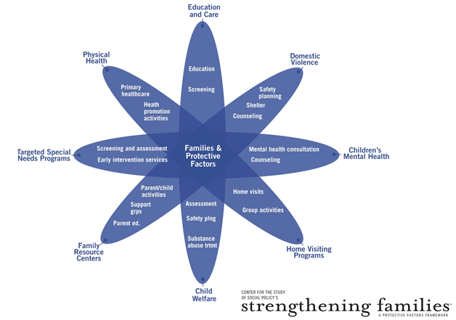
Notes:
STATE: This “daisy” represents common systems that families may interact with throughout their lives. One of the biggest challenges in human services is that even if all of these different systems are providing great services, they may not be communicating with each other, and they rarely use the same language when they speak to families—thereby contributing to confusion and a lack of coordination across systems. Even families that aren’t facing any particular risks may still receive conflicting messages or advice from preschool, school, the doctor’s office and the family resource center. For families that are dealing with challenges – such as chronic illness, behavioral challenges, domestic violence or substance abuse – it can become dizzying to try to deal with inconsistent cross-system messages and demands.
Each of the agencies and organizations that make up these systems are responsible for specialized services that may focus just on children, or just on adults, but all of them can also build capacity for entire families. None can completely achieve their goals for individuals without also focusing on families.
What the protective factors brought to the table was a simple, universal approach to work with families, framing familiar research that already guides each system’s work, in a way that helped create a new way of thinking. The light bulbs went off.
A common framework, using a common language to describe results, can lead to:
better understanding of the role that each service system plays in supporting families,
better partnerships among agencies and among individual workers,
a professional development system that fosters collaboration,
greater appreciation for the role that non-governmental community resources like informal networks, churches, social groups and cultural practices play in supporting family life,
more coherent, positive messages for families that encourage engagement and, most importantly…
cumulative impact when services and opportunities are working to achieve the same results.

Slide 9
Big Idea #3: A Changed Relationship with Parents
Supporting parents’ ability to parent effectively
Involving parents as partners in achieving good outcomes for children
Engaging parents effectively through programs
Engaging parents directly in mutually supportive relationships that build protective factors
Partnering with parents to help design systems and policies that work for children and families
Notes:
STATE: The third big idea is a changed relationship with parents. Strengthening Families represents a shift for many systems that are designed to serve children. Programs and service providers in these systems sometimes see parents as irrelevant to their work, or worse, as obstacles to achieving the outcomes we all want for children. But we know that children grow up in families, not programs – and we cannot achieve good outcomes for children without engaging their parents as partners.
So, what do we actually have in mind when we say “partnering with parents?” Partnering with parents in meaningful ways can be a big shift for the child welfare system and other systems that are designed to serve and/or protect children. We have to shift our perspectives to see parents as the primary agents of change for their families, and to find the ways that we, as service providers, can help them be the best parents they can be.
Once parents experience being treated as partners in getting to good outcomes for their children, we can invite them to partner in other ways as well. We are all more receptive to an invitation when we feel it is coming from a place of respect. When we engage them effectively, parents are our most valuable partners in ensuring that programs, services, and policies meet the needs of families.
One of the most challenging factors in building and sustaining partnerships with parents in the child welfare system is that social workers are taught that “setting and maintaining boundaries” between service providers and clients is critical if you wish to “survive” and maintain “authority.” Unfortunately, well-intended efforts to follow this principle often create impenetrable walls between service providers and families – which leads to adversarial relationships.
Strengthening Families does not suggest that caseworkers and other service providers do not need to maintain boundaries with the families they serve. However, Strengthening Families does suggest that healthy boundaries can be maintained in the context of a respectful and supportive partnership between a parent and a professional—both of whom want the best for the children.

Slide 10
Big Idea #4: Alignment with Developmental Science
Paying attention to what the research tells us:
Critical periods of development – early childhood and adolescence
Importance of nurturing relationships in early childhood
Effects of trauma on development, behavior and outcomes
Providing tools and guidance to align practice with what we know about child development
Notes:
STATE: We talked earlier about the fact that Strengthening Families is a research-based approach. At that time we were focused on the research that led to the Protective Factors Framework. (And we will go into more detail about the research behind Strengthening Families in the next training module.)
But, in a larger sense, Strengthening Families is about giving professionals who work with children, youth and families the tools and guidance they need to align their practice with the best available knowledge about child development. Strengthening Families is highly informed by groundbreaking scientific findings that help to shift and deepen our understanding of development.

Slide 11
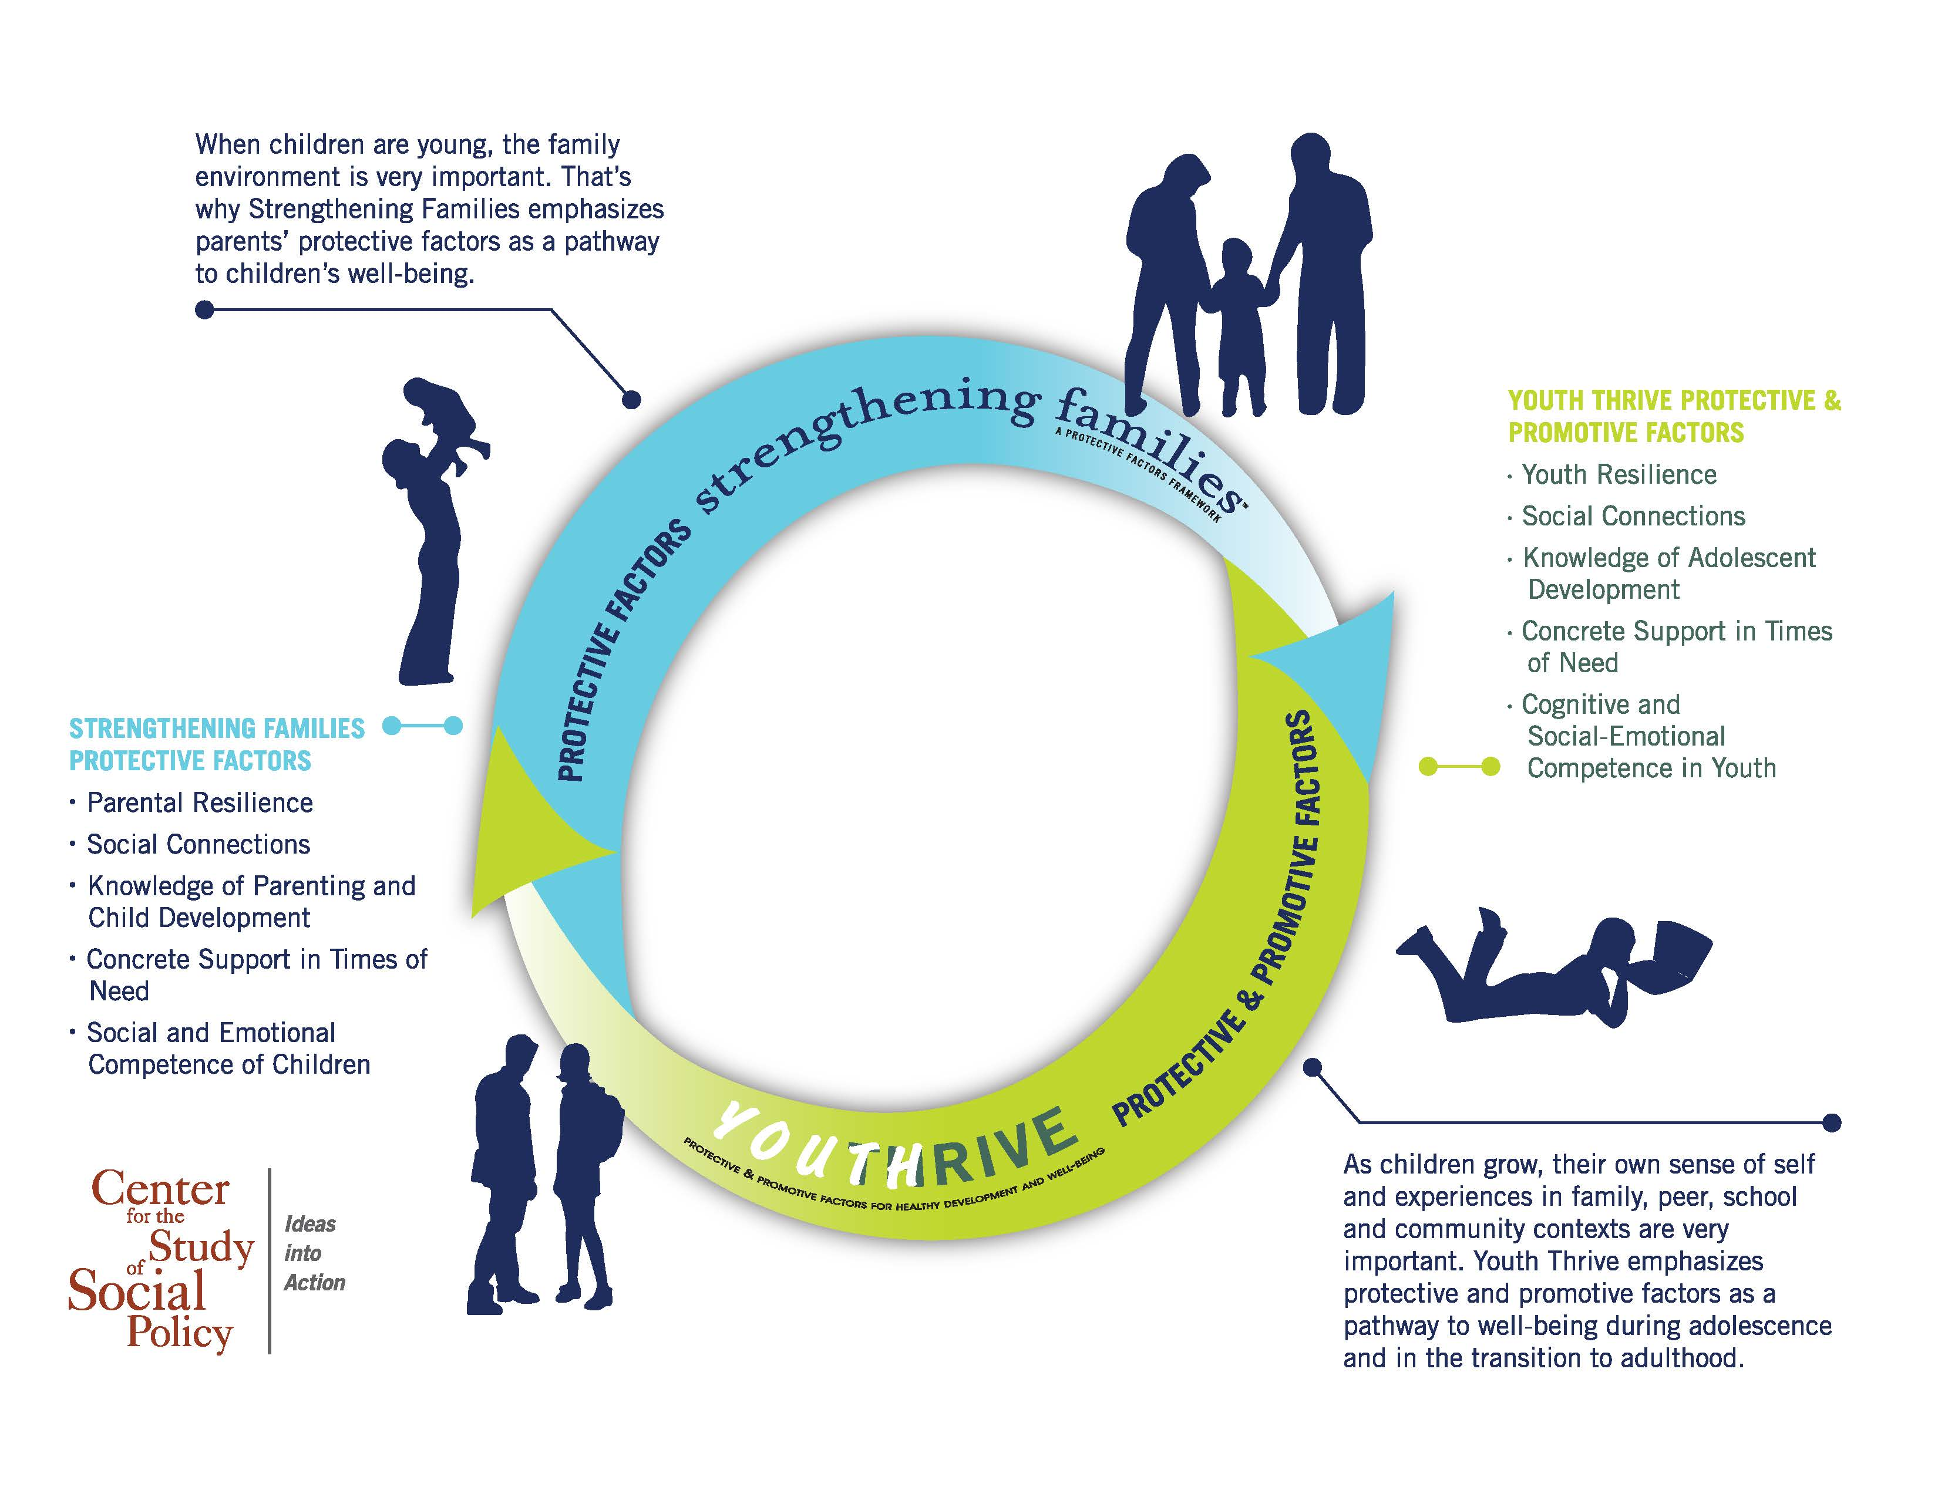
A Protective/Promotive Factors Frame Across Development
Notes:
STATE: Brain development research points us to early childhood (the first three years in particular) and adolescence as critical periods of development. Strengthening Families focuses on early childhood while the parallel Youth Thrive initiative focuses on protective and promotive factors for youth.
Looking at early childhood in particular, Strengthening Families emphasizes the importance of nurturing and responsive relationships with caregivers. A fast-growing body of research underscores the effects of traumatic experiences on children and youth – effects that can carry into the rest of a young person’s life. We know now that the presence of a buffering adult can be critical in helping children come through stressful experiences without experiencing negative effects on their development. But we also know that typical system responses to children’s traumatic experiences can actually exacerbate those negative effects – for instance, through practices such as removing children from the home unnecessarily, or punishing children for “misbehavior” when they react to their traumatic experiences.
Strengthening Families and Youth Thrive both help professionals shift their practices to better align with developmental science, be more responsive to trauma, pay attention to developmental issues and support parents and caregivers in nurturing the children in their care.

Slide 12
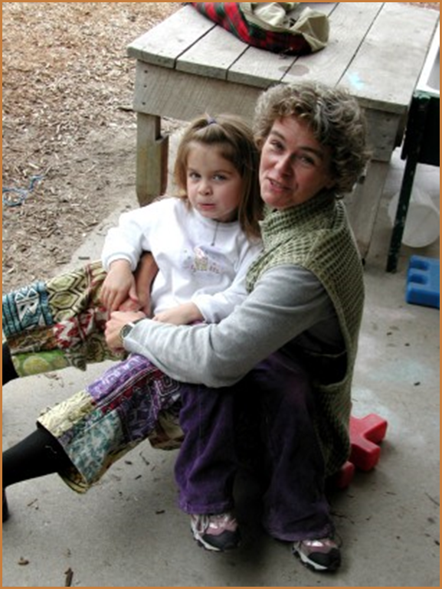
Five Protective Factors
PARENTAL RESILIENCE
SOCIAL CONNECTIONS
KNOWLEDGE of PARENTING and CHILD DEVELOPMENT
CONCRETE SUPPORT in TIMES of NEED
SOCIAL and EMOTIONAL COMPETENCE of CHILDREN
Notes:
STATE: To fully understand Strengthening Families you need to understand the protective factors that are at the heart of the framework. The five protective factors are listed here. In the next module we will go into detail about what each of these protective factors look like and how we can support families to build them.
[IF CONTINUING INTO MODULE 2…] DIRECT: In a moment we are going to take a 15 minute break. When we come back we are going to dive in to learning more about each protective factor. Before you leave, however, I want to ask each of you to take out a sheet of paper and quickly write down why you think each of these protective factors is important.
ALLOW 2 MINUTES FOR PARTICIPANTS TO WRITE THEIR THOUGHTS; then THANK PARTICIPANTS FOR THEIR ATTENTION and REMIND THEM ABOUT THE LOCATION OF RESTROOMS/TIME TO RETURN FROM BREAK

