Slide 1
Local Financing Strategies for Early Childhood: Examples from Two Communities

Slide 2
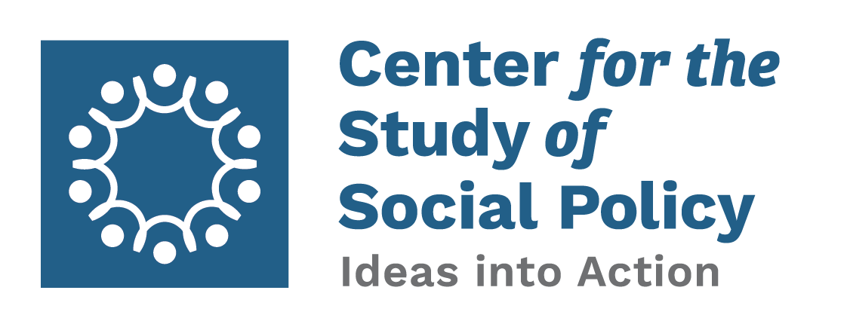
Children’s Services Councils - Florida
Randy Palo
Director of Program
Children’s Services Council of Palm Beach County
www.CSSP.org | info@CSSP.org | 202.371.1565

Slide 3
Children’s Services Councils (CSCs)
Florida is the only state in the nation with a law enabling communities to create a local government with the sole purpose of investing in children’s services.
9 counties have created Councils; 8 with independent taxing authority
Florida Children’s Council Website- flchildrenscouncil.org

Slide 4
CSCs - Process
State law allows creation of CSC (FL Statute 125.901)
Local government entity created by County Commission (Special Taxing District)
Taxing authority approved by voter referendum

Slide 5
CSCs – How It Works
Funding Source – Separate Property Tax
10 Member Board*
5 appointed by Governor
5 Ex-Officio (School Superintendent, Judge, Child Welfare System Administrator, County Commissioner, School Board Member)
Independent Decisions - not recommendation to other person or board
Investments in prevention and early intervention

Slide 6
CSCs – How To Start
Organize a group of child/family advocates
Collect data to show local needs, issues, trends
Identify champions with influence – business leaders, politicians, education leaders
Form Campaign Committee
Public Relations – Speakers Bureau
Fundraising
Volunteers
Legal

Slide 7
CSCs – Prepare for Vote
Gauge support among elected officials
Have similar issues worked in the past? – Why/Why Not
Gauge general public support
Develop several selling points
Return on investment – Business community
Safety and security – Seniors
Others based on above research
Communicate to all populations
Avoid opposition

Slide 8
Building Sustainability: An Early Childhood Millage
Annemarie Valdez
President and CEO
First Steps Kent
Kent County, Michigan
www.CSSP.org | info@CSSP.org | 202.371.1565

Slide 9
Overview
Kent County is home to Grand Rapids, the second largest city in the state of Michigan, and one of the fastest growing regions of the United States
On November 6, 2018 Kent County voters passed a ballot initiative that created new dedicated, sustainable funding for early childhood programs through a millage (property tax)
The millage increases taxes levied on all taxable property in Kent County by $0.25 for every $1,000 of taxable value from 2019 until 2024
A Kent County homeowner with an average home value of $150,000 will pay about $18.75 per year, or $1.56 per month.
Millage is expected to generate approximately $5.7 million a year over six years for a total of $34.2 million

Slide 10
Bold Actions
Convened the community to create the first Kent County Community Plan for Early Childhood
Published Kent County Early Childhood Indicators – Baseline Data (prepared by the Community Research Institute at GVSU) in 2011.
Released a report – Kent County Gap Analysis, 2012 - illuminating service gaps/investment needs.
Measured voter perceptions to determine understanding of and support for early childhood
Developed and are implementing a strategic communications/advocacy plan.
Served as key influence in Michigan’s recent ‘historic’ expansion of the Great Start Readiness Program – publicly funded preschool for vulnerable 4 year olds.
Launched demonstration projects when a gap was identified, there was no willing organizational home, and/or a neutral entity was required. These three demonstration projects have served more than 20,000 children, parents and caregivers: Children’s Healthcare Access Program, Early Learning Communities, and Welcome Home Baby

Slide 11
Considering an Early Childhood Millage
2015 poll showed there could be support, but voters needed better understanding
First Steps Kent hired local communications firm to implement aggressive education and public will building campaign
Reached out to other communities where other early childhood tax initiatives passed

Slide 12
Key Strategies
Sustained Effort from 2011-Present
2017 Gap Analysis
Likely Voter Polling
Creation of Millage Subcommittee
Targeting November 2018 Election

Slide 13
The Need
Thousands of Kent County’s 44,500 kids under age 5 are not receiving vital, evidence-based services
Federal, state, and private funds were not sufficient to fill the gap
Our community lacked local, dedicated funds to support early childhood development and health

Slide 14
Ready by 5 Early Childhood Proposal’s Bold Goals
Babies are born healthy
Children are healthy, thriving and developmentally on track from birth to 3rd grade
Children are developmentally ready to succeed in school at time of Kindergarten entry
Children in every Kent County community are supported and prioritized

Slide 15
Proposed Allocation of Millage Funds
Navigation & Referral and Medical Home Support: $500,000-1 million to serve 2,000-5,000 children
Developmental Screenings: $1-1.5 million to serve 10,000-20,000 children
Home Visiting: $1.5-2.5 million to serve 750-2,000 children
Play & Learn Groups:$500,000-1 million to serve 500-2,000 children
Program Evaluation & Improved Data Systems:$500,000- 1 million
Oversight & Allocation- $250,000-350,000

Slide 16
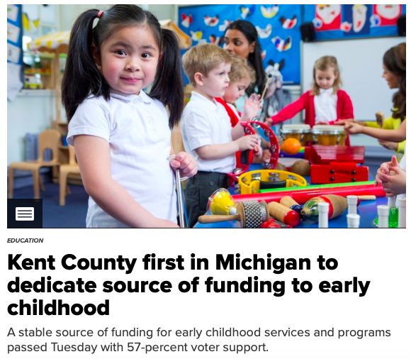
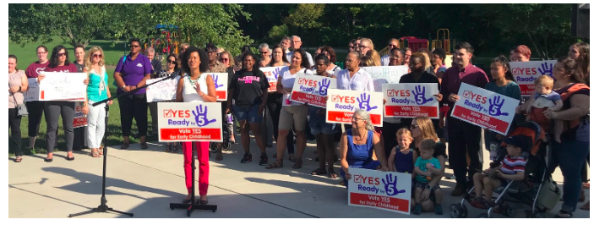
Importance of Media
Earned Media
Launch Event
Op-Eds
WGVU Newsmakers
Election Day

Slide 17
Key Lessons
Trust Your Firm
Build Strong Coalition of Funders and Supporters
Build Realistic Campaign Budget & Stick to It
Engage Grassroots & Grasstops

