Slide 2
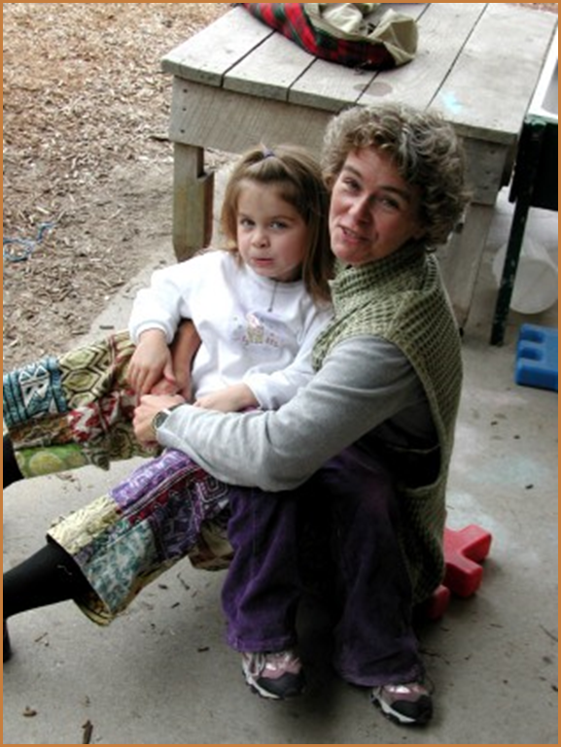
Five Protective Factors
Parental resilience
Social connections
Knowledge of parenting and child development
Concrete support in times of need
Social and emotional competence of children
Notes:
The Strengthening Families framework is based on five protective factors. These characteristics of families PROTECT against risk factors and poor outcomes for both children and families and PROMOTE strong families and optimal development for children. Each protective factor summarizes many research studies that illustrate how each characteristic works to achieve the positive outcomes we want for all families.

Slide 3
Parental resilience
Managing stress and functioning well when faced with challenges, adversity and trauma
What it looks like
Resilience to general life stress
Hope, optimism, self confidence
Problem solving skills
Self care and willingness to ask for help
Ability to manage negative emotions
Resilience to parenting stress
Not allowing stress to interfere with nurturing
Positive attitude about parenting and child
Notes:
One resilience researcher, Dr. Mark Katz summarizes resilience as “strength in the face of adversity”
Resilience is the lifelong process of enduring and growing through crisis and change. No one can prevent stress or crisis from happening to families at some point in time. A variety of strategies can help families find the tools they need to respond effectively so a crisis does not escalate, and the fall-out from a crisis does not negatively impact their parenting.
Sometimes we hear resilience referred to as “bouncing back” – but it is also the ability to bounce forward, to use moments of stress and crisis to effectively motivate yourself, reorganize your priorities and actions and move on.
In the Strengthening Families framework, we think about two different components of resilience – the ability to function well under stress in general as well as the ability to parent well in times of stress. Caregivers may exhibit greater resilience in one area than in the other. We need to think about both as we look at how we can support parents in building their resilience.

Slide 4
Parental resilience
Everyday actions
Demonstrate in multiple ways that parents are valued
Honor each family’s race, language, culture, history and approach to parenting
Encourage parents to manage stress effectively
Support parents as decision-makers and help build decision-making and leadership skills
Help parents understand how to buffer their child during stressful times
Notes:
People sometimes think of resilience as innate, but research shows that it is highly influenced by one’s environment. We have all heard about the concept of learned helplessness: when people get the message that they can’t succeed or they are prevented from succeeding, it saps the will to even try to succeed. Helping families build resilience is the reverse of this concept: providing an environment that is positive and validating, and encouraging the skills and internal resources that help individuals to cope effectively when things are difficult.
Everyday actions by service providers and programs can create trust and confidence with families, which in turn fosters the resilience families need to be the parents their children need.

Slide 5
Social connections
Positive relationships that provide emotional, informational, instrumental and spiritual support
What it looks like
Multiple friendships and supportive relationships with others
Feeling respected and appreciated
Accepting help from others, and giving help to others
Skills for establishing and maintaining connections
Notes:
Everybody needs a network of friends, colleagues, family, and professionals who provide a wide variety of support and companionship along the way to being a great parent. Research shows again and again that it isn’t how many people that an individual knows, but the quality of the relationships people have and the support they feel.
Isolation and few or tenuous relationships can be indicators of a risky situation. To support strong parenting, families need a network that provides a strong dose of the characteristics in this slide.

Slide 6
Social connections
Everyday actions
Help families value, build, sustain and use social connections
Create an inclusive environment
Facilitate mutual support
Promote engagement in the community and participation in community activities
Notes:
To support families in developing and sustaining their network, programs and services can help by:
Reaching out to families that seem to be at the edge of the social fabric. Sometimes they need new skills to integrate themselves into a network or “bridgers” to help them.
Creating an environment with norms of inclusion, positive support, sharing.
Developing opportunities for families that facilitate and encourage mutual support.

Slide 7
Knowledge of parenting & child dev’t
Understanding child development and parenting strategies that support physical, cognitive, language, social and emotional development
What it looks like
Nurturing parenting behavior
Appropriate developmental expectations
Ability to create a developmentally supportive environment for child
Positive discipline techniques; ability to effectively manage child behavior
Recognizing and responding to your child’s specific needs
Notes:
It is not a surprise to anyone that knowledge about parenting and child development helps a parent parent more effectively. The multitude of web pages, blogs, books, and TV experts touting science based information as well as sometimes wacky opinions is evidence of how much parents need and want help. The trick is to find and use the best possible information.
This protective factor helps to define what parenting looks like when families have good information and skills to help their children at every stage of development. It is especially important when parents are committed to change the parenting patterns they experienced as children – and need alternatives for their own children.

Slide 8
Knowledge of parenting & child dev’t
Everyday actions
Model developmentally appropriate interactions with children
Provide information and resources on parenting and child development
Encourage parents to observe, ask questions, explore parenting issues and try out new strategies
Address parenting issues from a strength-based perspective
Notes:
Delivering accurate, evidence based knowledge in a way that parents can hear it and use the information effectively is not always easy. While there are some excellent parent education classes available most studies show they do not work for all families. Adult learning theory provides insight on how to develop a broader range of strategies for conveying parenting information:
Information is provided when people are struggling with an issue and need it urgently
Learning doesn’t depend on didactic material but on seeing the ideas in action and having ample opportunities to test out how to use the knowledge in real life
The context for learning and the person who delivers the information is supportive, comfortable and trusted by the learner.
What this points to is the important role that those who see and interact with families on a day to day basis as the conduit for parenting information.

Slide 9
Concrete support in times of need
Access to concrete support and services that address a family’s needs and help minimize stress caused by challenges
What it looks like
Seeking and receiving support when needed
Knowing what services are available and how to access them
Adequate financial security; basic needs being met
Persistence
Advocating effectively for self and child to receive necessary help
Notes:
Every family has basic needs that help them provide the best environment for their children, including food, shelter and medical care. Sometimes families need more specialized services or fall into a crisis that prevents them from being able to provide the basics for their children.
Not knowing where to turn in a crisis or how to find help can be extraordinarily stressful for families – and cause significant trauma for children. The stress in turn can be a barrier to a parent ability to be persistent in the face of daunting circumstances.
Stigma and shame about needing mental health services, substance abuse or domestic violence services often prevent families from seeking out the kind of help that may be necessary for the family to move forward.

Slide 10
Concrete support in times of need
Everyday actions
Respond immediately when families are in crisis
Provide information and connections to services in the community
Help families to develop skills and tools they need to identify their needs and connect to supports
Notes:
Programs and service providers can help in a crisis by reaching out to families in distress and providing ongoing avenues for the resources or services families need.
Helping families get what they need should be done in a way that builds confidence and skill for families to get what they need in the future. Helping families ask for help, understand their rights, and navigate sometimes frustrating and complex service systems can be a learning experience as well as an immediate help. An important aspect of receiving concrete support is also gaining a new perspective on “giving back” once the crisis is over.

Slide 11
Social & emotional competence of children
Family and child interactions that help children develop the ability to communicate clearly, recognize and regulate their emotions and establish and maintain relationships
What it looks like
For the parent:
Warm and consistent responses that foster a strong and secure attachment with the child
Encouraging and reinforcing social skills; setting limits
For the child:
Age appropriate self-regulation
Ability to form and maintain relationships with others
Positive interactions with others
Effective communication
Notes:
Social and emotional competence is the foundation of every child’s development. It comes through the ongoing interactions between the child and the adults in her life, beginning with parents and other family members. The adult’s capability to foster the child’s ability to talk, regulate their behavior and interact positively with others is key to the child’s development.
Nurturing and attachment in the earliest days and months of a baby’s life is the beginning point for social and emotional competence that develops over time. The social emotional competence of young children serves as an important base as the child develops their own protective factors throughout life.

Slide 12
Social & emotional competence of children
Everyday actions
Help parents foster their child’s social emotional development
Model nurturing care to children
Include children’s social and emotional development activities in programming
Help children develop a positive cultural identity and interact in a diverse society
Respond proactively when social or emotional development needs extra support
Notes:
Practitioners and service providers have many opportunities to facilitate parents’ positive, developmentally appropriate interactions with their children, beginning with taking care to model the nurturing care that works best and including activities that promote social and emotional development in the program.
Noticing children’s development -- and acting quickly to engage their families -- when social and emotional development appears to need extra support should be a primary role of practitioners working with young children.

