Slide 1
Introduction to Strengthening Families: A Protective Factors Framework
Notes:
In this presentation:
“Not your ordinary initiative”
The Four Big Ideas Behind Strengthening Families
Use summary slide or slides about each Big Idea, depending on audience/length of presentation
Slides on each protective factor: What it looks like and everyday actions
Strengthening Families logic model
The Strengthening Families National Network
Implementation of Strengthening Families by field, over time
Resources on the website
Suggested handouts to accompany this presentation:
Protective Factors Research briefs
Core Meanings one-pager
Core Functions one-pager
SF overview one-pager

Slide 2
Strengthening Families: Not Your Ordinary Initiative
Implementing Strengthening Families is about:
small but significant changes in everyday practice
and
the shifts in policies and systems that allow/promote those changes in practice
Implementation funds come from existing dollars
All national implementation tools are available free of charge
Notes:
Strengthening Families is not “another initiative” that adds to the workload of a program or agency. It is an approach that can be applied to any interaction with children and families.
Implementing Strengthening Families is about small but significant changes in everyday practice, and about the shifts in policies and systems that allow and promote those changes.
In most cases, Strengthening Families has been implemented using existing funding streams. While a few states in the Strengthening Families National Network have found dedicated funding streams to implement Strengthening Families on a large scale, most states have integrated the Protective Factors Framework into existing grants, professional development systems, trainings, and so on. Many implementation activities for Strengthening Families can be carried out at little cost, particularly when partner agencies and systems bring resources such as staff time to the table.
To support this work, implementation tools are available free of charge from the Center for the Study of Social Policy and many of our national and federal partners.

Slide 3
Four big ideas behind Strengthening Families
Focus on protective factors
An approach, not a model
A changed relationship with parents
Alignment with developmental science
Notes:
1. A protective and promotive factors approach
The first step in developing Strengthening Families was thoroughly investigating what the research tells us about reducing child maltreatment – about what is right with families that protects against child abuse and neglect. CSSP worked intensively with researchers and advisors for over a year to develop a synthesis of protective factors that reduce the likelihood of child abuse and neglect.
Protective factors act as a counter weight to risk factors. They buffer the impact of what the researchers call “toxic stress”. Risk factors, it turns out, are not very predictive of future events. And we cannot get to good outcomes for children only by focusing on reducing risk.
The protective factors in the Strengthening Families framework both protect against risk and promote positive outcomes.
2. An approach, not a model
Strengthening Families is not a scripted, structured program or model designed to be implemented in a specific setting.
It is not an “evidence-based program” but rather, an evidence-informed approach that can be adapted to many different settings and service delivery models.
It is an approach that can be applied in any setting that serves young children and their families. Strengthening Families is implemented through small but significant changes in how professionals interact with families. It is not parallel to, but integrated into existing practice.
Cross-sector implementation is core to the approach. Strengthening Families brings together program-level and system-level partners from multiple sectors that serve children and families – providing a common language and set of outcomes to work toward.
3. A changed relationship with parents
Strengthening Families represents a shift for many systems that are designed to serve children. Programs and service providers in these systems sometimes see parents as irrelevant to their work, or worse, as obstacles to achieving the outcomes we all want for children. But we know that children grow up in families, not programs – and we cannot achieve good outcomes for children without engaging their parents as partners.
Working from a protective factors approach, workers and service providers will support parents’ ability to parent effectively and involve them as partners in achieving good outcomes for children. Programs also have a role to play in engaging parents in mutually supportive relationships that build protective factors.
Programs that work in this way will also engage parents as partners, leaders and decision-makers at the program level.
Parents who have had positive experiences shaping the programs that serve their children can then be engaged in helping design systems and policies that work for children and families.
4. Alignment with developmental science
Strengthening Families is committed to paying attention to what the research tells us, and helping programs and workers align their practice with what developmental science tells us will be most effective.
Critical periods of development – therefore we have the Strengthening Families framework for early childhood and the parallel Youth Thrive framework for adolescence
Looking at early childhood in particular, Strengthening Families emphasizes the importance of nurturing and responsive relationships with caregivers.
A fast growing body of research underscores the effects of traumatic experiences on children and youth – effects that can carry into the rest of a young person’s life. We know now that the presence of a buffering adult can be critical in helping children come through stressful experiences without negative effects on their development. But we also know that typical system responses to children’s traumatic experiences can exacerbate those negative effects – such as removal from the home, or punishment for “misbehavior” when children react to their experiences.
Through Strengthening Families and Youth Thrive, we provide tools and guidance to help those who work with children and families align their practice with what we know about development.

Slide 4
Focus on protective factors
Big Idea #1
Protective and Promotive Factors
Risk Factors

Slide 5
What we know: Families gain what they need to be successful when key protective factors are robust in their lives and communities
Notes:
What we knew intuitively and from the research is that families thrive when key protective factors are robust in their lives and communities.
What we also discovered is that fewer than 10% of children 0-5 are reached by any kind of preventive service such as home visiting or parent education.
The research also indicated:
Child abuse and neglect, strong families and optimal child development are outcomes that are tied together.
Risk is not predictive—because of protective factors.
Five specific protective factors are tied to child abuse and neglect, strong families and optimal child development.
You can build these protective factors IN MANY DIFFERENT SETTINGS.
The challenge faced by the developers of Strengthening Families was to find a way to help the many people who see children and their families every day to become part of a significant support system for the families they connect with.
In the end we are interested in protective factors because they are correlated with many of the outcomes that we care about.
CSSP’s original focus was on early care and education programs, where the largest proportion of young children – and their families – go every day. These familiar places are much more likely to match a family’s language, culture and traditions – and have been chosen by the family in the first place. Their hypothesis was that if these places chosen by families could be mobilized to be prevention agents and early warning responders, impact could be had on millions of children. And by focusing on positive outcomes and healthy development, which could engage more families much more easily than prevention programs based on identifying “at risk” families.
Besides the extensive literature reviews and the lengthy discussions with the advisory committee, exemplary programs were sought out to learn what they might already be doing to build protective factors with families. A national survey of all states, individual 27 page surveys with 200 programs, and extended site visits and interviews with 25 programs showed us dramatically that a wide variety of exemplary programs are already building protective factors with families every day. Our most powerful, convincing information about the impact of programs on PARENTS were family members themselves and the community partners who worked closely with these programs.
They also discovered that these early childhood programs along with after school programs, home visiting programs, family resource centers and other places where families already go and feel comfortable, were eager to think with them about what more they could do to reduce stress for the families they serve. Their consistency with the culture and values of the families who come there, their daily contact, and mission of healthy child development make them ideally trusted coaches for all kinds of parents.

Slide 6
Risk factors are not predictive factors because of protective factors
Dr. Carl Bell, University of Illinois

Slide 7
Family Protective Factors
Parental resilience
Social connections
Knowledge of parenting and child development
Concrete support in times of need
Social and emotional competence of children
Notes:
Here is a quick review of the protective factors themselves. Remember, these is not a complete list of all the characteristics that can be protective factors in the lives of families. But it is a list of critical ones that we all have the opportunity to influence with the families we work with.

Slide 8
Protective & Promotive Factors
Youth resilience
Social connections
Knowledge of adolescent development
Concrete support in times of need
Cognitive, social and emotional competence of youth

Slide 9
An approach, not a model
Big Idea #2
Integrated into existing practice
Small but significant changes
Research-based and evidence-informed
Cross-sector coordination
Applied in many settings
Notes:
Research-based and evidence-informed
Applied in any setting that serves young children and their families
Implemented through small but significant changes
Not parallel to, but integrated into existing practice
Cross-sector implementation as core to the approach

Slide 10
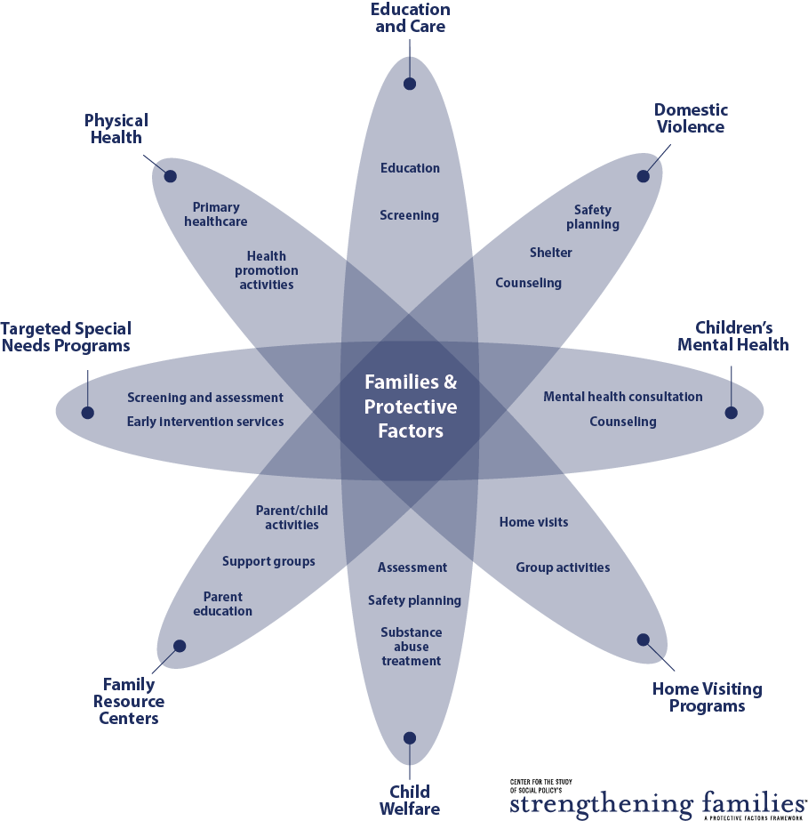
community

Slide 11
A family support system: What does it look like?
Light touch family support in the settings families are in every day
Connections to and support from dedicated family support resources
Navigation supports to help make the connections
Connections to more intensive services when needed
Common language and commitment to helping families build protective factors

Slide 12
A changed relationship with parents
Big Idea #3
Engaging with their children
Influencing policies
Shaping programs and services
Notes:
Supporting parents’ ability to parent effectively
Involving parents as partners in achieving good outcomes for children
Engaging parents effectively through programs
Engaging parents directly in mutually supportive relationships that build protective factors
Partnering with parents to help design systems and policies that work for children and families

Slide 13
Children don’t grow up in programs…
They grow up in families and in communities.
Dr. Urie Bronfenbrenner, Cornell University

Slide 14
Alignment with developmental science
Big Idea #4
Importance of early childhood and adolescence
Role of nurturing relationships in brain development
Effects of trauma and adversity
Notes:
Paying attention to what the research tells us:
Critical periods of development – early childhood and adolescence
Importance of nurturing relationships in early childhood
Effects of trauma on development, behavior and outcomes
Providing tools and guidance to align practice with what we know about child development

Slide 15
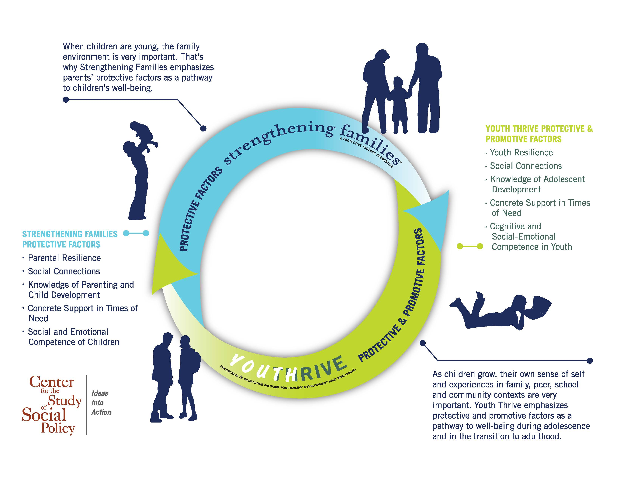
A Protective/Promotive Factors Frame Across Development
Notes:
The protective factors are applicable across the life span of children birth-25. CSSP has developed two Initiatives that apply this work- Strengthening Families which has a focus on building the protective factors of parents with children birth-8 and Youth Thrive which focus on building the protective factors of youth 11-26 and provides supports to parents.

Slide 16
Family Protective Factors
Parental resilience
Social connections
Knowledge of parenting and child development
Concrete support in times of need
Social and emotional competence of children
Notes:
Here is a quick review of the protective factors themselves. Remember, these is not a complete list of all the characteristics that can be protective factors in the lives of families. But it is a list of critical ones that we all have the opportunity to influence with the families we work with.

Slide 17
Parental resilience
Managing stress and functioning well when faced with challenges, adversity and trauma
What it looks like
Resilience to general life stress
Hope, optimism, self confidence
Problem solving skills
Self care and willingness to ask for help
Ability to manage negative emotions
Resilience to parenting stress
Not allowing stress to interfere with nurturing
Positive attitude about parenting and child
Notes:
One resilience researcher, Dr. Mark Katz summarizes resilience as “strength in the face of adversity”
Resilience is the lifelong process of enduring and growing through crisis and change. No one can prevent stress or crisis from happening to families at some point in time. A variety of strategies can help families find the tools they need to respond effectively so a crisis does not escalate, and the fall-out from a crisis does not negatively impact their parenting.
Sometimes we hear resilience referred to as “bouncing back” – but it is also the ability to bounce forward, to use moments of stress and crisis to effectively motivate yourself, reorganize your priorities and actions and move on.
In the Strengthening Families framework, we think about two different components of resilience – the ability to function well under stress in general as well as the ability to parent well in times of stress. Caregivers may exhibit greater resilience in one area than in the other. We need to think about both as we look at how we can support parents in building their resilience.

Slide 18
Parental resilience
Everyday actions
Demonstrate in multiple ways that parents are valued
Honor each family’s race, language, culture, history and approach to parenting
Encourage parents to manage stress effectively
Support parents as decision-makers and help build decision-making and leadership skills
Help parents understand how to buffer their child during stressful times
Notes:
People sometimes think of resilience as innate, but research shows that it is highly influenced by one’s environment. We have all heard about the concept of learned helplessness: when people get the message that they can’t succeed or they are prevented from succeeding, it saps the will to even try to succeed. Helping families build resilience is the reverse of this concept: providing an environment that is positive and validating, and encouraging the skills and internal resources that help individuals to cope effectively when things are difficult.
Everyday actions by service providers and programs can create trust and confidence with families, which in turn fosters the resilience families need to be the parents their children need.

Slide 19
Social connections
Positive relationships that provide emotional, informational, instrumental and spiritual support
What it looks like
Multiple friendships and supportive relationships with others
Feeling respected and appreciated
Accepting help from others, and giving help to others
Skills for establishing and maintaining connections
Notes:
Everybody needs a network of friends, colleagues, family, and professionals who provide a wide variety of support and companionship along the way to being a great parent. Research shows again and again that it isn’t how many people that an individual knows, but the quality of the relationships people have and the support they feel.
Isolation and few or tenuous relationships can be indicators of a risky situation. To support strong parenting, families need a network that provides a strong dose of the characteristics in this slide.

Slide 20
Social connections
Everyday actions
Help families value, build, sustain and use social connections
Create an inclusive environment
Facilitate mutual support
Promote engagement in the community and participation in community activities
Notes:
To support families in developing and sustaining their network, programs and services can help by:
Reaching out to families that seem to be at the edge of the social fabric. Sometimes they need new skills to integrate themselves into a network or “bridgers” to help them.
Creating an environment with norms of inclusion, positive support, sharing.
Developing opportunities for families that facilitate and encourage mutual support.

Slide 21
Knowledge of parenting & child dev’t
Understanding child development and parenting strategies that support physical, cognitive, language, social and emotional development
What it looks like
Nurturing parenting behavior
Appropriate developmental expectations
Ability to create a developmentally supportive environment for child
Positive discipline techniques; ability to effectively manage child behavior
Recognizing and responding to your child’s specific needs
Notes:
It is not a surprise to anyone that knowledge about parenting and child development helps a parent parent more effectively. The multitude of web pages, blogs, books, and TV experts touting science based information as well as sometimes wacky opinions is evidence of how much parents need and want help. The trick is to find and use the best possible information.
This protective factor helps to define what parenting looks like when families have good information and skills to help their children at every stage of development. It is especially important when parents are committed to change the parenting patterns they experienced as children – and need alternatives for their own children.

Slide 22
Knowledge of parenting & child dev’t
Everyday actions
Model developmentally appropriate interactions with children
Provide information and resources on parenting and child development
Encourage parents to observe, ask questions, explore parenting issues and try out new strategies
Address parenting issues from a strength-based perspective
Notes:
Delivering accurate, evidence based knowledge in a way that parents can hear it and use the information effectively is not always easy. While there are some excellent parent education classes available most studies show they do not work for all families. Adult learning theory provides insight on how to develop a broader range of strategies for conveying parenting information:
Information is provided when people are struggling with an issue and need it urgently
Learning doesn’t depend on didactic material but on seeing the ideas in action and having ample opportunities to test out how to use the knowledge in real life
The context for learning and the person who delivers the information is supportive, comfortable and trusted by the learner.
What this points to is the important role that those who see and interact with families on a day to day basis as the conduit for parenting information.

Slide 23
Concrete support in times of need
Access to concrete support and services that address a family’s needs and help minimize stress caused by challenges
What it looks like
Seeking and receiving support when needed
Knowing what services are available and how to access them
Adequate financial security; basic needs being met
Persistence
Advocating effectively for self and child to receive necessary help
Notes:
Every family has basic needs that help them provide the best environment for their children, including food, shelter and medical care. Sometimes families need more specialized services or fall into a crisis that prevents them from being able to provide the basics for their children.
Not knowing where to turn in a crisis or how to find help can be extraordinarily stressful for families – and cause significant trauma for children. The stress in turn can be a barrier to a parent ability to be persistent in the face of daunting circumstances.
Stigma and shame about needing mental health services, substance abuse or domestic violence services often prevent families from seeking out the kind of help that may be necessary for the family to move forward.

Slide 24
Concrete support in times of need
Everyday actions
Respond immediately when families are in crisis
Provide information and connections to services in the community
Help families to develop skills and tools they need to identify their needs and connect to supports
Notes:
Programs and service providers can help in a crisis by reaching out to families in distress and providing ongoing avenues for the resources or services families need.
Helping families get what they need should be done in a way that builds confidence and skill for families to get what they need in the future. Helping families ask for help, understand their rights, and navigate sometimes frustrating and complex service systems can be a learning experience as well as an immediate help. An important aspect of receiving concrete support is also gaining a new perspective on “giving back” once the crisis is over.

Slide 25
Social & emotional competence of children
Family and child interactions that help children develop the ability to communicate clearly, recognize and regulate their emotions and establish and maintain relationships
What it looks like
For the parent:
Warm and consistent responses that foster a strong and secure attachment with the child
Encouraging and reinforcing social skills; setting limits
For the child:
Age appropriate self-regulation
Ability to form and maintain relationships with others
Positive interactions with others
Effective communication
Notes:
Social and emotional competence is the foundation of every child’s development. It comes through the ongoing interactions between the child and the adults in her life, beginning with parents and other family members. The adult’s capability to foster the child’s ability to talk, regulate their behavior and interact positively with others is key to the child’s development.
Nurturing and attachment in the earliest days and months of a baby’s life is the beginning point for social and emotional competence that develops over time. The social emotional competence of young children serves as an important base as the child develops their own protective factors throughout life.

Slide 26
Social & emotional competence of children
Everyday actions
Help parents foster their child’s social emotional development
Model nurturing care to children
Include children’s social and emotional development activities in programming
Help children develop a positive cultural identity and interact in a diverse society
Respond proactively when social or emotional development needs extra support
Notes:
Practitioners and service providers have many opportunities to facilitate parents’ positive, developmentally appropriate interactions with their children, beginning with taking care to model the nurturing care that works best and including activities that promote social and emotional development in the program.
Noticing children’s development -- and acting quickly to engage their families -- when social and emotional development appears to need extra support should be a primary role of practitioners working with young children.

Slide 27
Notes:
This graphic summarizes how implementation of the Strengthening Families approach leads to the outcomes we are working toward: strengthened families, optimal child development and reduced likelihood of child abuse and neglect – as shown in the box farthest to the right.
The second box from the right (light blue) shows the protective factors that families are supported to build when they experience program and worker practice as described in the stacked boxes. Shifts in program culture, policies and everyday practice will support parents in building these protective factors, just as workers’ knowledge, skills, approach to parents and everyday actions will. (Workers can make these changes on their own – and often do – but those efforts will be much more successful when their organizations make shifts that support and enable those changes.)
The rust-colored box on the left describes the functions that are carried out by leaders – at any level – to influence the shifts in program and worker practice that help families build their protective factors and achieve better outcomes.
We believe the future of Strengthening Families is in creating a “new normal” for child and family serving organizations and systems, so that they see their work as building protective and promotive factors to reduce the potential for child maltreatment, to bolster resilience and mitigate the impact of traumatic events when they occur, AND to create the best possible environment for development of children and youth.

Slide 28
Notes:
This graphic shows all the everyday actions in one place, for your reference.
Of course, it is important to remember that the protective factors are all interrelated, and any of these everyday actions could support a family in building multiple protective factors.

Slide 29
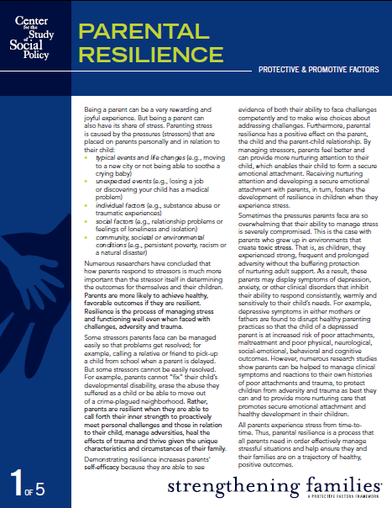
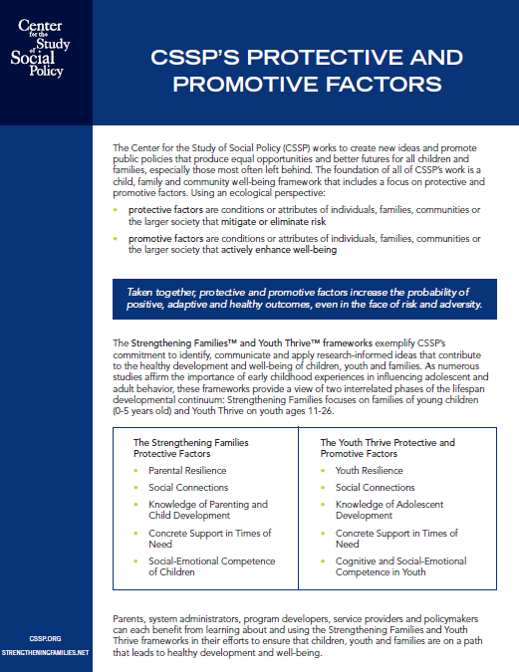
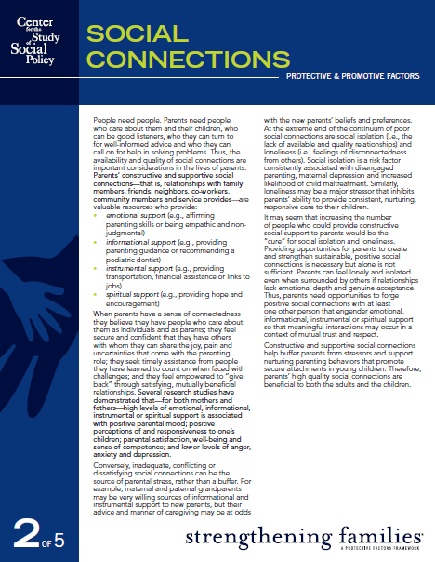
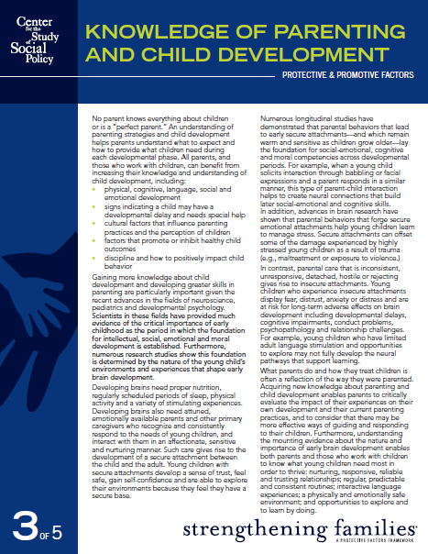
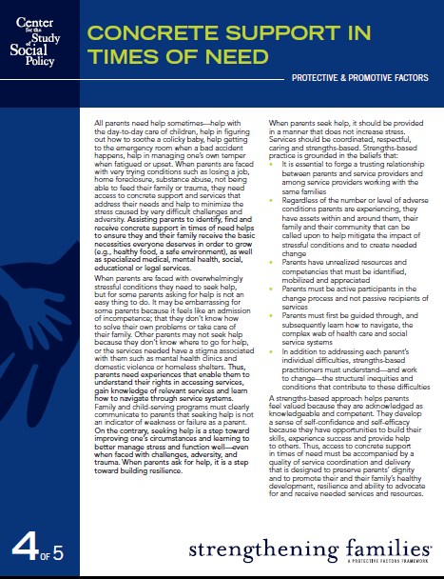
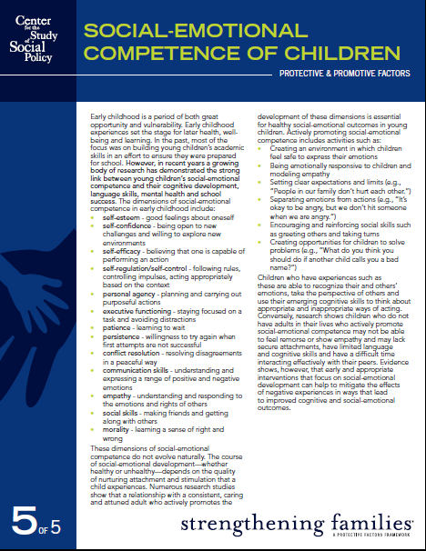
Many resources available at www.strengtheningfamilies.net

Slide 30
https://www.facebook.com/pages/Center-for-the-Study-of-Social-Policy
https://twitter.com/CtrSocialPolicy
www.cssp.org
www.strengtheningfamilies.net

