Slide 1
Tools to Support
Strengthening Families
Implementation
Notes:
INTRODUCE: Welcome back! The Strengthening Families team has continuously worked to develop tools to support implementation of the Strengthening Families approach and the Protective Factors Framework. The website at www.strengtheningfamilies.net has a wealth of tools and resources that can easily be adopted and adapted for any program or service sector. All of the materials on the website are available for free.
Now, let’s take a more in-depth look at these tools and examine ways they can help you build Strengthening Families into practice.

Slide 2
Materials Describing the Strengthening Families Approach and the Protective Factors
Notes:
STATE: The first set of tools we’ll talk about describe the Strengthening Families approach in a way that is accessible and comprehensible at all levels of implementation.

Slide 3
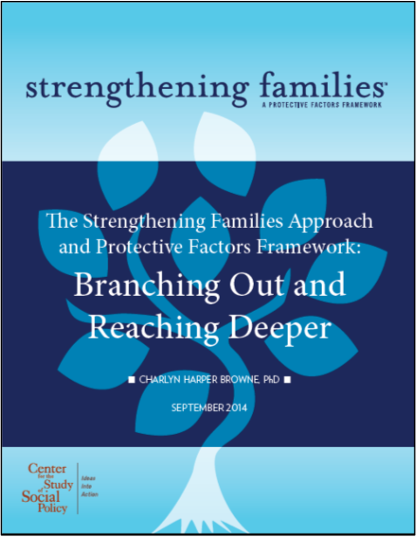
The Strengthening Families Approach and Protective Factors Framework: Branching Out and Reaching Deeper
A synthesis of the ideas and research that further informs the Strengthening Families Approach and Protective Factors Framework
http://www.cssp.org/reform/strengtheningfamilies/about/the-research-behind-strengthening-families
Notes:
STATE: If you are looking for a thorough explanation of the science that informs Strengthening Families, look no further than the 2014 publication, “The Strengthening Families Approach and Protective Factors Framework: Branching Out and Reaching Deeper.”
EXPAND: The purpose of this report is to provide a synthesis of the neurobiological, behavioral and social science research that informs the Strengthening Families approach. This synthesis also reflects CSSP’s theory of change, which affirms that, to make real difference, we must build all domains of people’s social ecology—including the individual, family, relational, community, societal and policy realms.

Slide 4
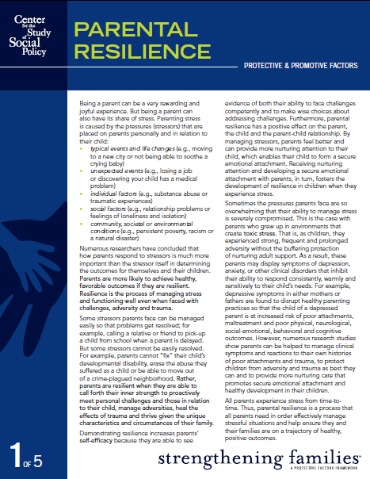
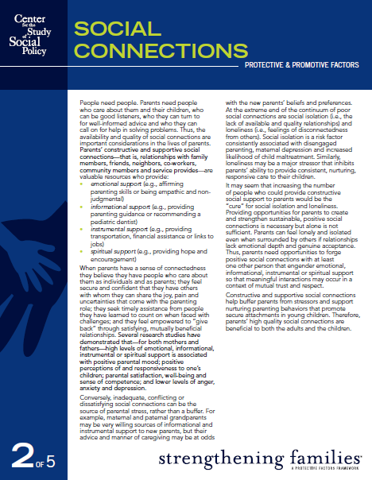
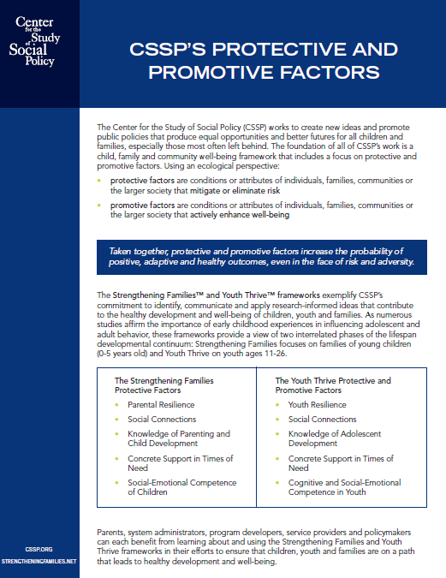
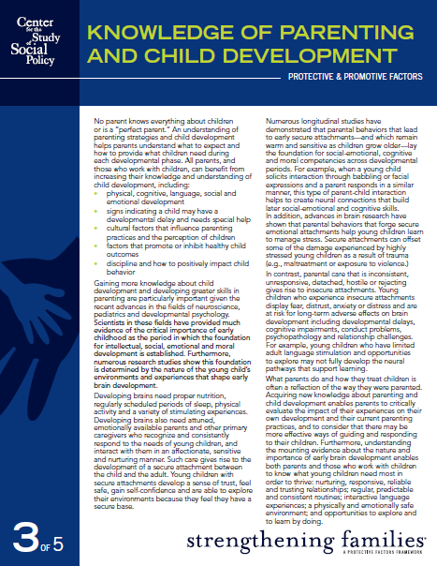
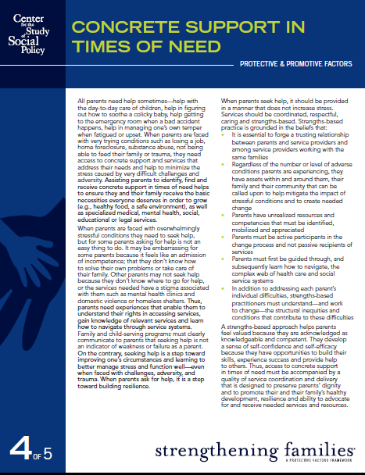
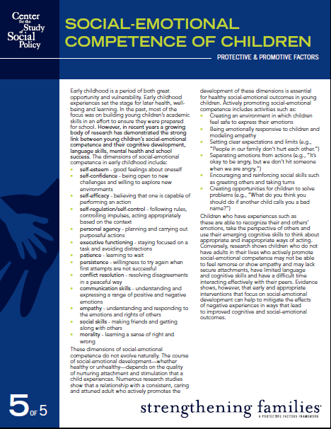
Research briefs about the protective factors
http://www.cssp.org/reform/strengthening-families/2013/SF_All-5-Protective-Factors.pdf
Notes:
STATE: Additionally, research briefs are available about each of the protective factors—parental resilience, social connections, concrete supports, knowledge of parenting and child development and social and emotional competence of children. These briefs provide clear definitions of the protective factors and outline the research informing each protective factor construct. They summarize what you learned in the earlier modules of this course and can be very useful as handouts to let others know what Strengthening Families is all about.

Slide 5
Core meanings of the protective factors
Distills the information from the research briefs
Concrete definition of each protective factor
http://www.cssp.org/reform/strengthening-families/2013/
Core-Meanings-of-the-SF-Protective-Factors.pdf
Notes:
STATE: For an even more concise overview of the protective factors, our “Core Meanings of the Protective Factors” document further distills the information from the research briefs, providing a quick overview of each protective factor’s conceptualization.
EXPAND: This document was originally developed to help researchers and evaluators who were looking for a very succinct listing of the constructs within each of the protective factors so that they could identify indicators to measure them. It turned out that many others were also interested in the core meanings, so they are now available on the website.

Slide 6
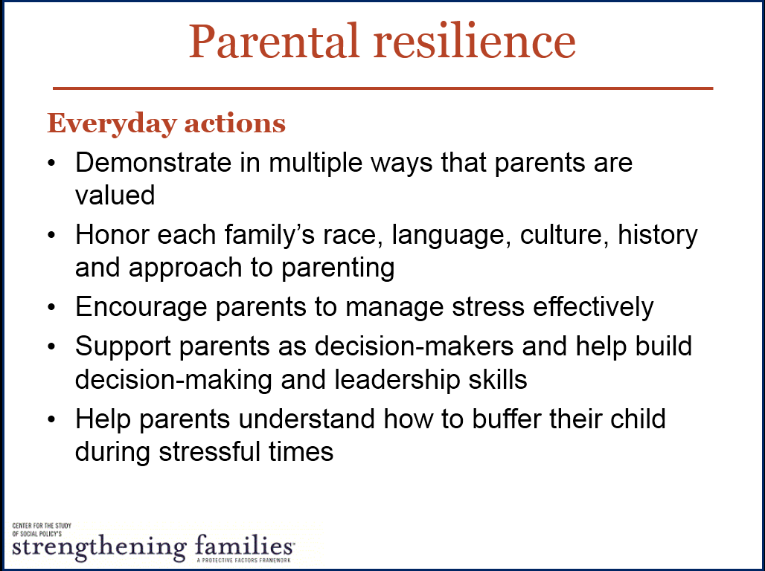
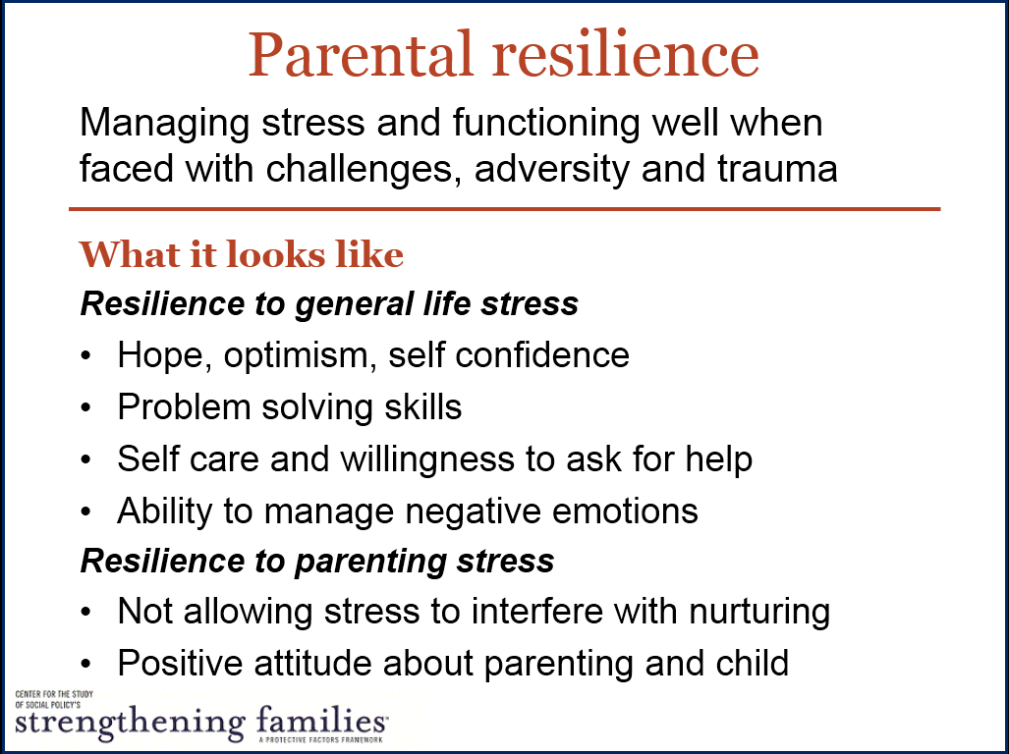
Core slides about the protective factors
http://www.cssp.org/reform/strengthening-families/
2014/SFProtectiveFactorsExpanded.pptx
Notes:
EXPLAIN: As you can see, this is an example of slides you can use to introduce colleagues and clients to the protective factors. Again, slides are available on strengtheningfamilies.net and provide:
An overall definition of each protective factor,
The core meanings of each protective factor based on our updated literature review and research briefs, and
Everyday actions that can be taken in any setting where we interact with children and their families.

Slide 7
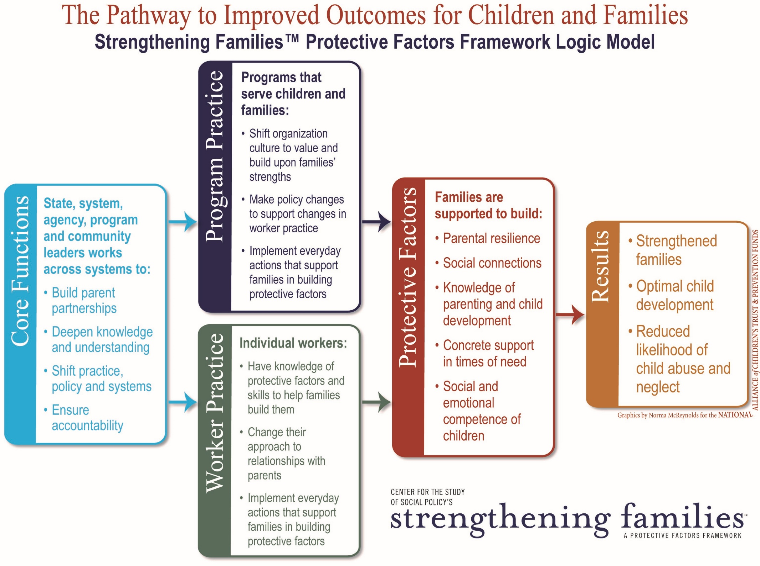
Notes:
STATE: Another tool for implementation is the Strengthening Families Logic Model. Our logic model serves to explicitly detail how the Strengthening Families approach leads to better outcomes for children and families.
EXPLAIN: Specifically, the logic model helps our partners to:
Clarify strategies,
Identify appropriate outcome targets,
Align efforts across sectors,
Guide the writing of grant proposals,
Set priorities and estimate timelines,
Identify necessary partnerships, and
Negotiate roles and responsibilities.
STATE: This graphic summarizes the logic model’s conceptualization of how the Strengthening Families approach leads to:
Stronger families,
Optimal child development, and
Reduced likelihood of child abuse and neglect – as shown in the box farthest to the right.
EXPLAIN: Additionally, if you look at the second box from the right (rust colored), you can see a visual representation of the protective factors. Families build these protective factors when programs and workers shift practice skills to align with the Strengthening Families approach, as described in the stacked boxes.
EXPAND: Shifts in program culture, policies and everyday practice, paired with workers’ improved knowledge, skills, approach to practice and everyday actions, will support parents. Note that while workers can–and often do–make these changes on their own, their efforts will be much more successful when organizations work to formally support the Strengthening Families approach, as well.
EXPLAIN: From the light blue box on the left, you can see the specific functions that are carried out by leaders – at any level – to influence these kinds of shifts in program and worker practice.
SUMMARIZE: By following this logic model, we can help families build their protective factors and achieve better outcomes. We believe the future of Strengthening Families lies in creating a “new normal” for child- and family-serving organizations, helping workers:
Build protective and promotive factors to reduce the potential for child maltreatment,
Bolster resilience and mitigate the impact of traumatic events, and
Create the best possible environment for the development of children and youth.

Slide 8
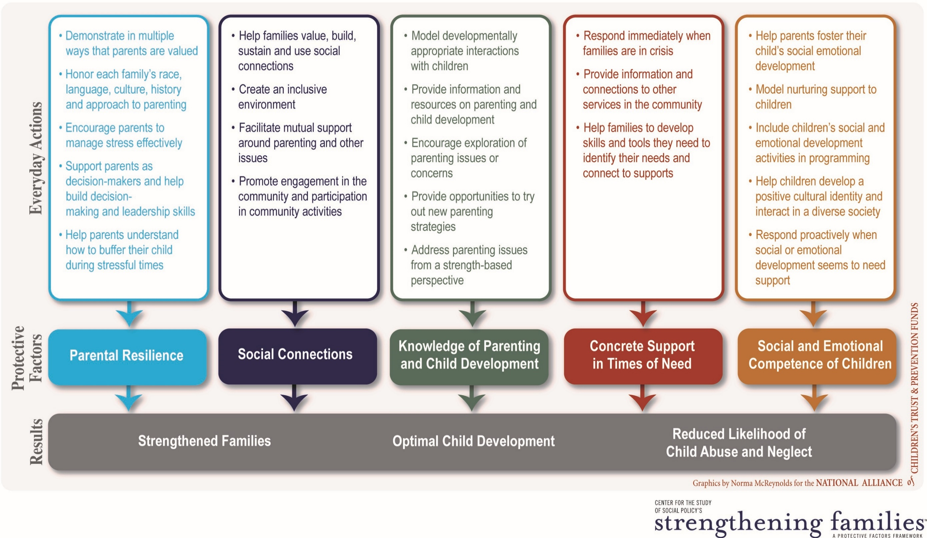
Notes:
EXPLAIN: As you can see here, each protective factor section includes a set of “Everyday Actions.” Everyday Actions describe a variety of experiences and resources that programs can provide to help families build and strengthen a particular protective factor. Each Everyday Action is also accompanied by a list of concrete, actionable, observable and measurable items that programs can adopt.

Slide 9
The Toolkit for child welfare practitioners
Scripted Curriculum
Practice tools for workers
Supervisors’ coaching tool
Resources for families
Notes:
INTRODUCE: Over the past four years, CSSP has been working with a number of child welfare jurisdictions in:
Philadelphia, PA
North Carolina
Connecticut
Utah
Arlington, VA
Through this work we have been able to build a set of tools to support child welfare practitioners in implementing a Strengthening Families approach.

Slide 10
The Scripted Curriculum
Eight Modules:
Introduction to CSSP’s Protective and Promotive Factors Frameworks
Understanding the Strengthening Families Protective Factors
Youth Thrive
Trauma and Brain Development
Making Small But Significant Changes in Child Welfare Practice
Taking a Community Approach to Strengthening Families
The Research Behind Strengthening Families
Tools for Implementation
Notes:
EXPLAIN: The scripted curriculum was designed as a resource for those training or doing professional development with child welfare workers around Strengthening Families. To provide the most complete set of resources for the field the scripted curriculum was designed to be a standalone tool which includes:
Scripts and tips for trainers
Hand-outs for participants
Activities to be used in training
EXPAND: While the curriculum was designed so it can be used as a standalone training we recognize that most jurisdictions have existing training for child welfare workers. One very powerful way to use the materials and tools within the scripted curriculum is to integrate them into existing trainings already being provided for child welfare workers. We encourage such adaptation as we think it is much more powerful, for instance, for workers to learn about how they can use the protective factors to design case planning objectives and activities while they are learning to use the jurisdiction’s case planning tools.

Slide 11
Tools to support small but significant shifts in child welfare practice
Skills, Tools, Processes, Resources
Engaging
Assessing
Planning
Decision Making
Intervening
Monitoring and Case Closure
Notes:
STATE: Through work with states and jurisdictions that are integrating a protective and promotive factors approach into their child welfare practice, CSSP has developed a suite of tools for caseworkers and other staff to use at various points throughout a family’s involvement in the child welfare system. The graphic in this slide shows the child welfare practice wheel – a generalized practice wheel that shows the core practice skills caseworkers need. Let’s look at the tools available for each of these core practice areas.

Slide 12
Practice Tools For Child Welfare Workers
Engaging
Simple Activities to do with Families to Build Protective Factors
Understanding Family Protective Factors—What to Ask and What to Look For
Applying Strengthening Families in Teaming
Assessing
Decision Making
Notes:
STATE: Simple Activities to do with Families to Build Protective Factors document is a collection of activities caseworkers can implement at any point in their work as they engage with families. These activities can be very useful in establishing a relationship – when we are first engaging families in services – and in ongoing relationship building and maintenance.
STATE: To support use of a protective factors approach when assessing families, Understanding Family Protective Factors—What to Ask and What to Look For provides caseworkers with concrete characteristics to look for and questions to ask. Some jurisdictions have incorporated protective factors content into their formal assessment tools – but any caseworker can use these questions and indicators in informal assessment of families as well.
STATE: Teaming is a strategy frequently used to support decision-making for a family, and is very much in line with a protective factors approach. Applying Strengthening Families in Teaming highlights how protective factors can be strengthened through three different types of family team meetings.

Slide 13
Practice Tools For Child Welfare Workers
Planning
Using Protective Factors to Develop Objectives and Activities for Case Plans
Building Protective Factors in Case Work Visits
Using Protective Factors as a Lens to Monitor Progress toward Case Closure
Intervening
Monitoring/ Closure
Notes:
STATE: Using Protective Factors to Develop Objectives and Activities for Case Plans contains, for each protective factor, a sample of a case objective and sample tasks and activities that could be incorporated in case planning. This is intended as an example of the types of objectives and activities that can be developed. In real life, objectives and activities will be developed in partnership with parents.
STATE: Casework visits are a unique opportunities to engage with caregivers and children in ways that support them to build their protective factors through the way caseworkers interact with the caregiver and child in ways that reinforce what is going right and gently provide support, advice and encouragement when caregivers or children are struggling. The Building Protective Factors in Case Work Visits guidance tool helps workers to think about the things they can do in every visit.
STATE: Just as we monitor other aspects of case progress, we also want to stay attuned to changes in the family’s protective factors. In the end, as families transition out of their engagement with child welfare system, we want to be able to demonstrate that:
The family made progress on their own protective factors goals
The family can reliably draw upon their protective factors in ways that help prevent a repeat of the issues that brought them to the system
The family has a plan in place for how to continue to nurture their protective factors once they are no longer involved with the system
The Using Protective Factors as a Lens to Monitor Progress toward Case Closure tool can be used in multiple ways:
In early engagement with parents to discuss and agree on the type of growth in protective factors that could be used to indicate progress
In family team meetings or other conversations with partners who are also supporting the family
To help staff in documenting growth in family strengths for court reports and other case progress reports
To support decisions about case closure

Slide 14
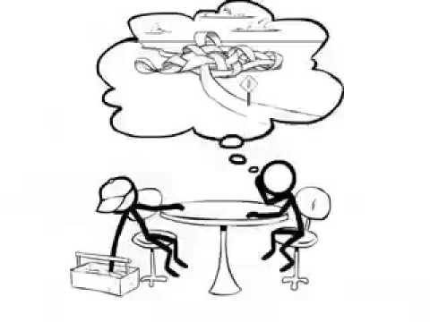
Supervisors’ Coaching Tool
Integrated tool for both Strengthening Families and Youth Thrive
General Coaching worksheet
For each protective factor
  Worker skills
  What to look for in the case plan and on-going activities with families and youth
  Suggested coaching activities
Notes:
STATE: While training is critical to introduce workers to the protective and promotive factor concepts, real uptake happens only when that knowledge is reinforced, and workers are supported in putting the ideas into practice in their day-to-day casework.
The supervisor’s coaching tool is designed to be used as a part of regular supervision sessions. It provides supervisors with key questions on each of the protective and promotive factors. It can be used to guide discussion with caseworkers about specific families on their caseload and how to use a focus on protective and promotive factors within the case plan to reach their goals. Specifically, it helps identify:
Worker skills
What to look for in the case plan and on-going activities with families and youth
Coaching activities to build workers skills for each protective and promotive factor

Slide 15
Resources for Families
Booklet for families
  Family friendly descriptions of the protective factors
  Protective Factors “Tune-up” Activities for parents
Café Tools (Described later)
Protective Factors Guide for Kinship Caregivers and Resource Families
  Understanding how trauma and stress impacts children
  Using protective factors to help you provide nurturing care
Notes:
EXPLAIN: In addition, there are a number of resources that can be used directly with families:
The booklet for families is written from a parent perspective. It provides family friendly descriptions of each of the protective factors as well as simple activities that a family can do to build each protective factor. States like Connecticut have used parent tools around the protective factors as an engagement tool for families as they first come into contact with child welfare services. The goal is to initiate engagement with families through the strength-based lens of the protective factors.
Later in this module we are going to describe in more detail “Cafe Models” being used to engage parents in intimate, parent-to-parent conversations about protective factors. In Philadelphia, Cafés are being used in a structured way by the child welfare agency to ensure that families connected to the child welfare system are connected to other families and their communities in ways that explicitly address their protective factors.
The Protective Factors Guide for Kinship Caregivers and Resource Families is designed to help caregivers who are caring for a child who has been removed from their parents understand how stress, trauma, and removal from their home and caregivers can impact a child. The guide encourages families to think about how they use the protective factors to support themselves so that they can best nurture the child in their care. The guide provides information on the protective factors and a worksheet for families and case workers to discuss to ensure that families are receiving the support they need.

Slide 16
The Strengthening Families Self-Assessments for Child- and Family-Serving Programs
Notes:
INTRODUCE: The next set of tools I’d like to cover are the Strengthening Families Self-Assessments for child- and family-serving programs.
EXPLAIN: Strengthening Families Self-Assessments help measure the presence of exemplary practices in field settings. Child- and family-serving programs can use these Self-Assessments to evaluate how well their current activities, services and program policies support families to build protective factors.
SUMMARIZE: In other words, the Strengthening Families Program Self-Assessments outline how the protective factors can be supported through small but significant changes in everyday program practice.

Slide 17
About the Self-Assessments
Key implementation tool for programs adopting a Strengthening Families approach
Helps programs identify “small but significant changes” that enhance their ability to build protective factors
Created based on a national study of exemplary practice
Designed to be used flexibly and to lead you to a concrete action plan
Helps programs identify strengths & areas to focus
Not an evaluation tool but a tool for continuous improvement
Notes:
EXPLAIN: The Strengthening Families Program Self-Assessments:
Were created based on a one-year study of exemplary practice and revised over time with input from professionals in each of the fields where Strengthening Families is used,
Represent core tools for shifting program practices toward a Strengthening Families approach,
Are designed to identify strengths and develop action plans around key areas of focus,
Identify the everyday actions workers can take to support families in building protective factors, and
Drive programmatic improvement through the facilitation of systematic reflection and action planning.

Slide 18
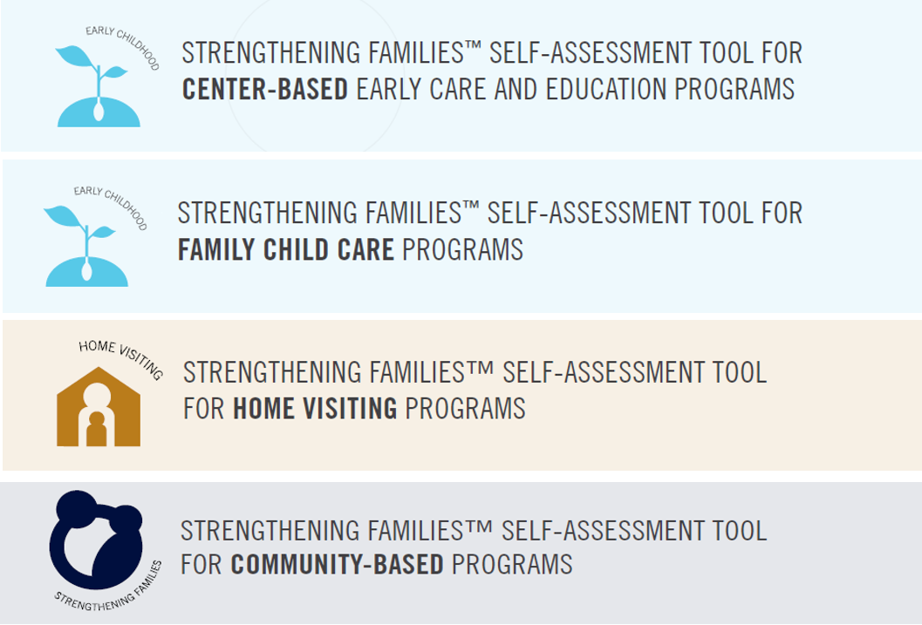
Four versions for different types of programs
Notes:
STATE: Originally, only two versions of the Self-Assessment were available:
One for any kind of child- and family-serving program
One for family child care providers.
EXPLAIN: However, our network participants soon identified a need for versions of the self-assessment specific to other kinds of programs. We worked to meet this need, and the Strengthening Families Self-Assessments are now available for all four program types listed on this slide—center-based early care and education programs, family child care programs, home visiting programs and community-based programs.
EXPAND: While there is significant overlap in content across these separate program versions, there are also specific strategies aligned with the particular context of each setting. The Self-Assessment tools are applicable to programs of any size, budget or structure. Almost all of the strategies described can be implemented without the need to:
Create new staff positions,
Make significant changes to existing facilities, or
Use additional financial resources.
ADD: The two self-assessments for early care and education providers (center-based and family programs) are designed to support use as part of a quality rating and improvement system (QRIS). In these assessments, items are organized into tiers that represent different levels of program implementation efforts:
The Baseline Tier, which reflects practices that all programs can implement very easily,
The Mid-Level Tier, which reflects practices that require more attention to parent engagement, and,
The High Tier, which reflects practices requiring high levels of focus on parental engagement and support.
TRANSITION: With the family child care tool, we tried to be attentive to the capacity of family child care providers by not expecting more than most programs can reasonably accomplish. Here, the “High Tier” is most appropriate for providers that are themselves receiving systemic support.
EXPAND: In addition, the center-based tool includes a fourth tier, “Comprehensive Service Programs,” for those centers that offer a more inclusive range of supports and services to children and families in addition to providing early care and education. This tier is highly applicable to programs like Head Start and comprehensive family support centers that include an early care and education component.

Slide 19
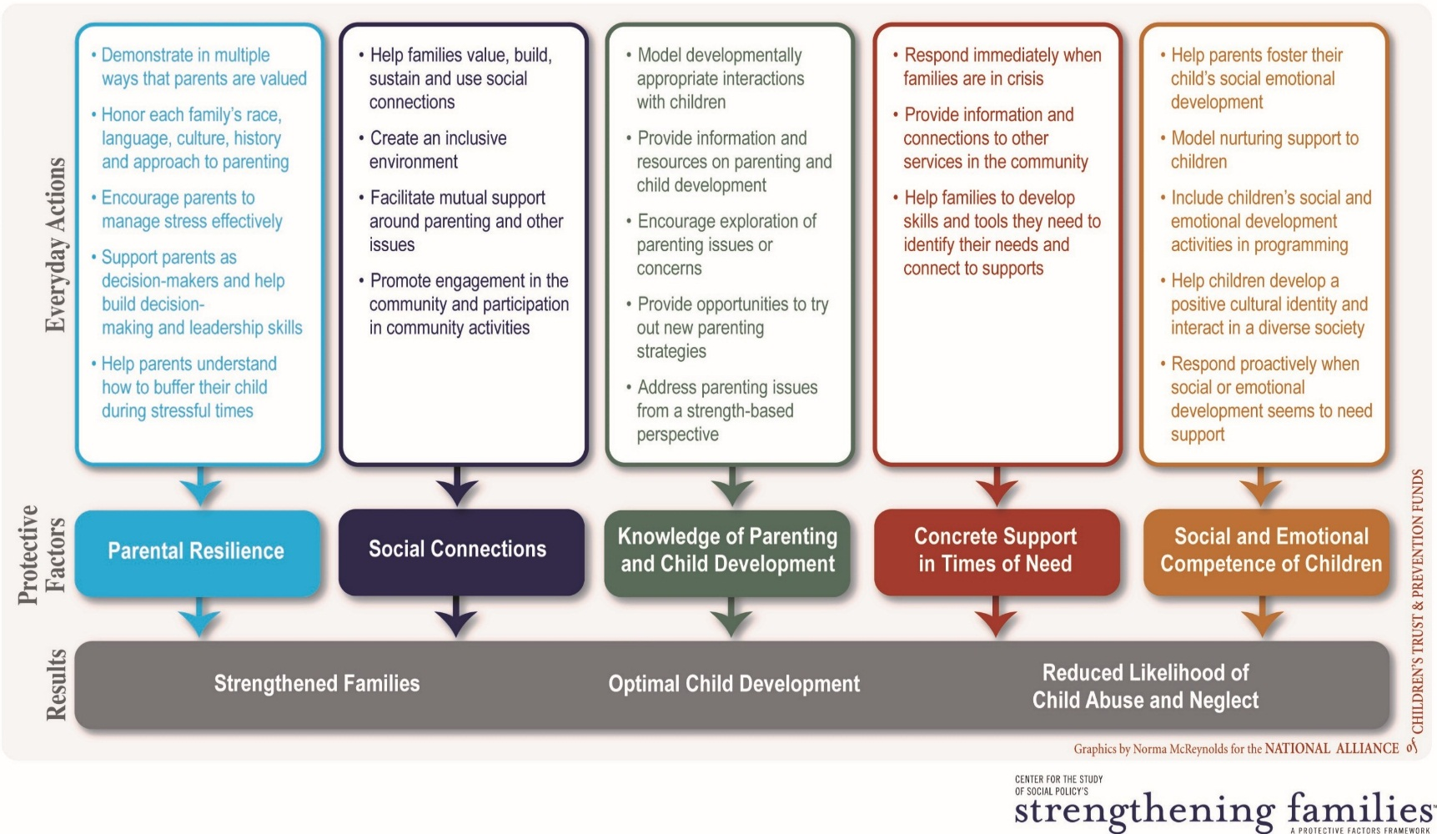
Organized around protective factors and the everyday actions that help families build them
Five Protective Factor Sections
+
“Special Circumstances” Sections
Notes:
INTRODUCE: Each Self-Assessment is organized into five sections based on the five protective factors. Each Self-Assessment also includes tailored “Special Circumstances” sections, related, for example, to specific program needs like supporting children’s transitions or responding to possible child abuse.
STATE: The Self-Assessments are designed to be completed by a team including frontline staff, management and program participants or parents of children in the program. Team members may complete the self-assessment separately and then come together to discuss their ratings of the program’s current use of each of the concrete strategies related to the everyday actions that support families to build each protective factor. Alternatively, the team can complete the self-assessment through a group process without completing individual copies in advance. The important thing is that there is room for respectful conversation about items where members of the team have different perspectives about how well the program is doing.
EXPAND: Once the self-assessment is complete, the team can select specific areas for improvement and develop an action plan to make some small but significant changes in their practice or in program policies.

Slide 20

Online Strengthening Families
Data System
Notes:
INTRODUCE: Next, I’d like to turn your attention to the online Strengthening Families Evaluation Portal. This set of tools is provided by CSSP’s national partner, Mosaic Network, Inc. It is available for programs to use free of charge to complete their self-assessments and collect parent and staff surveys. State and regional organizations can pay a fee to have administrative access to data entered by programs.

Slide 21
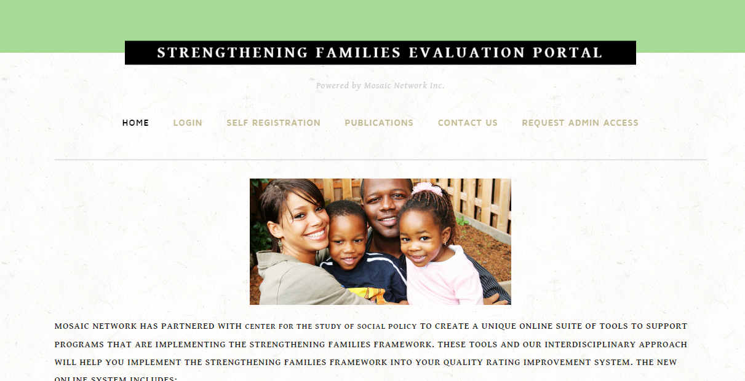
Strengthening Families Evaluation Portal
http://www.strengtheningfamiliesevaluation.com
Registration
Self-Assessments
Action Planning
Parent & Staff Surveys
Reports
Notes:
STATE: The Strengthening Families Evaluation Portal allows programs to:
Create an account,
Enter their self-assessment data,
Develop an action plan based on their Self-Assessment results, and
Collect and/or enter parent and staff surveys.
A variety of reports can be generated within the system to help programs analyze and document their Self-Assessment results. At the state level, administrators can also track aggregate data across programs.

Slide 22
Parent and Staff Surveys
PARENT SURVEY (Protective Factors Survey)
Measures changes in parental protective factors
Developed by the FRIENDS National Resource Center and the University of Kansas
Four national field tests to establish reliability and validity
STAFF SURVEY
Looks at changes in staff attitudes, behaviors and skills
Developed by a collaborative team from 7 states—with review and input from evaluators in 3 states
Has not been extensively tested
Notes:
EXPLAIN: As I mentioned before, the Strengthening Families Evaluation Portal also includes two additional survey tools: the Protective Factors Survey and a staff survey.
EXPAND: The Protective Factors Survey measures changes in parents’ self-reported protective factors. It has been extensively tested for reliability and validity, and is designed to be used as a pre and post-test to measure change over time. The Staff Survey is used within practice settings to measure changes in staff attitudes, behaviors and skills.

Slide 23
Tools to Measure Protective Factors
Notes:
INTRODUCE: Next up, let’s take a look more closely at two tools used to measure protective factors: The Parents’ Assessment of Protective Factors and the Protective Factors Survey.

Slide 24
Parents’ Assessment of Protective Factors
Individualized, strengths-based measure to assess the presence, strength and growth of parents’ self-reported beliefs, feelings and behaviors that are regarded as indicators of the Strengthening Families protective factors
36 statements; parent indicates the degree to which the statement is like the parent or what the parent believes
Intended for parents of young children from birth to 8 years old
Developed through the Quality Improvement Center on Early Childhood; released by CSSP in 2014
Notes:
STATE: The Parents’ Assessment of Protective Factors, or PAPF, is a strengths-based measure used to assess the presence, strength and growth of parents’ self-reported beliefs, feelings and behaviors that are linked to the protective factors. The tool is available in both English and Spanish. A user guide and scoring sheet are also available on the Strengthening Families website. The PAPF was developed through the federal Quality Improvement Center on Early Childhood and was released in 2014.

Slide 25
Parents’ Assessment of Protective Factors
The Parents’ Assessment of Protective Factors yields valid and reliable results that can be used to:
  prompt specific shared conversations with a parent about building or reinforcing their protective factors;
  engage a parent as a partner in developing and implementing a service plan; and
  mobilize a parent’s resources to meet their unique, individualized needs in order to strengthen the parent’s capabilities and provide a family environment that promotes optimal child development and reduces the likelihood of negative child and family outcomes.
Notes:
STATE: The Parents’ Assessment of Protective Factors has been tested for validity and reliability. It is not designed to be used as a screening or diagnostic tool, but is a useful tool in engaging a parent in conversation, engaging a parent in developing a service plan, or working with a parent to use their strengths and resources to meet their family’s needs.

Slide 26

The Protective Factors Survey (PFS)
An evidence-based, (reliability and validity tested) 20-item caregiver-completed tool used to help measure changes in family protective factors.
Developed through a partnership with FRIENDS and The University of Kansas with input from multiple experts in the field, parent leaders, prevention workers and hundreds of families.
Being widely used in states across the country.
Provides feedback to agencies for continuous improvement and evaluation purposes. It is not intended for individual assessment, placement or diagnostic purposes. Agencies should rely on other instruments for clinical use.
http://friendsnrc.org/protective-factors-survey
Notes:
STATE: The FRIENDS National Resource Center created the Protective Factors Survey (PFS) as an evidence-based, reliability and validity tested, 20-item, caregiver-completed tool to help measure changes in family protective factors. While not intended for individual assessment, placement or diagnostic purposes, the PFS does provide feedback to agencies for continuous improvement and evaluation purposes.
EXPLAIN: The survey results are designed to provide agencies with several pieces of important information, including:
A snapshot of the families they serve,
Changes in current levels of family protective factors, and
Areas where workers can focus on increasing family protective factors.

Slide 27
When PFS scores were high…
Positive correlations
Effective coping was high
Physical and emotional health was good
Positive emotions were high
Optimism was high
Negative Correlations
Child abuse and neglect potential was low
Stress was low
Depression was low
Negative emotions were low
Pessimism was low
Notes:
EXPAND: The FRIENDS National Resource Center has analyzed PFS data from several states and found the correlations listed here. Programs can look for similar correlations among their own participants. As I mentioned before, the PFS is available for use on the Strengthening Families Evaluation Portal.

Slide 28

Online Training
Notes:
INTRODUCE: Yet another available tool is a free online training provided by The National Alliance of Children’s Trust and Prevention Funds. Again, this is a tool provided by a national partner of CSSP which has been a great resource for programs, states and communities implementing Strengthening Families.

Slide 29
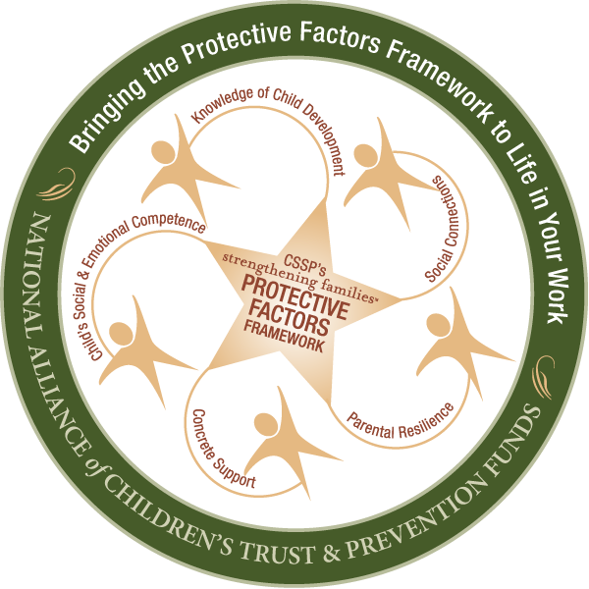
Bringing the Protective Factors
Framework to Life in Your Work
Online training to support implementation of the Strengthening Families™ Protective Factors Framework in multiple settings
Systems may use for awarding CEUs, credit
Free of charge
7 courses,
each about
2 hours in length
  Introduction to the Framework (also useful as a stand-alone orientation)
  A course on each of the 5 Protective Factors
  A wrap-up course that moves users from knowledge to action
Find at www.ctfalliance.org/onlinetraining
Contact onlinelinetraining@ctfalliance.org
Notes:
EXPLAIN: The Alliance offers this 7-part, 14-hour Strengthening Families training for free online. As a free service, this is a valuable tool for introducing the basics of Strengthening Families within an agency, organization or system.
STATE: The Alliance also offers a training of trainers for an in-person version of this in-depth curriculum. More information about the online and in-person training is available at www.ctfalliance.org/training.

Slide 30
Café Conversations
Notes:
INTRODUCE: Finally, a key element in many states’ and communities’ implementation of Strengthening Families has been the use of café-style conversations among parents and caregivers. Cafés are a method of facilitating meaningful, reflective conversations that promote leadership and collaboration. These gatherings, derived from the World Café model, bring community members together for a series of structured conversations that directly or indirectly address protective factors. Through participation in cafés, parents and caregivers build leadership and relationships as well as the protective factors that help to strengthen their families.

Slide 31
Taking a Parent-to-Parent Approach: Parent Café and Community Café
Reframing protective factors using parent friendly language
Using a World Café Approach to build a comfortable, parent-led space
Tying to a larger parent leadership and engagement infrastructure
Harvesting to inform systems and structures
Notes:
EXPLAIN: Both the Parent Café and Community Café models were developed based on the Strengthening Families framework, and both are implemented in partnership with parent leaders. Cafés are an accessible way to build parent leadership into existing practices and infrastructures. In Community Cafés and Parent Cafés, parents are introduced to the protective factors using less formal language, and have conversations about how to strengthen their own families and communities. Each café ends with a “harvest” where the ideas discussed are gathered so that they can be put to use in a system, organization, or community.

Slide 32
The basis: World Café
A method for “engaging people in conversations that matter”
Includes a set of design principles and a basic strategy for engaging people in small-group conversations
Cafés designed for parents to build protective factors are just one of many ways the World Café method has been adapted and used around the world
For more: http://www.theworldcafe.com/about.html
Notes:
EXPLAIN: As I mentioned previously, cafés designed to build protective factors are based on the World Café approach—a set of design principles and a basic strategy for engaging people in small-group conversations. Cafés designed for parents to build protective factors are just one of many ways the World Café method has been adapted and used around the world.

Slide 33
Parent Café
Developed by parent leaders as part of Strengthening Families-Illinois in 2007, and is now housed with Be Strong Families
Provide a safe, non-judgmental opportunity for parents and caregivers to: build their protective factors, talk about what it means to keep their children safe and families strong and build parent leadership
Parent Café training, a fidelity framework, “Parent Café in a Box” and evaluation tools are available from Be Strong Families at http://www.bestrongfamilies.net/build-protective-factors/parent-cafes/
Notes:
EXPLAIN: The Parent Café model was developed by parent leaders as part of Strengthening Families-Illinois in 2007, and is now housed with Be Strong Families. Parent Cafés provide a safe, non-judgmental opportunity for parents and caregivers to build their protective factors while engaging in conversations about what it means to keep their children safe and families strong, while also building parent leadership. Parent Cafés are structured around questions related to each of the five Strengthening Families protective factors.

Slide 34
Community Café
Developed by parent volunteers in Washington State and is now supported by a volunteer Community Café Leadership Team
Designed to respond to community needs and concerns as well as reflect the local community culture
Café questions may or may not directly address the protective factors, but hosts use the Protective Factors Framework as a guiding framework
Through Community Cafés, parents and caregivers build their leadership, resilience, social connections and other protective factors
Leadership Team offers an online orientation kit as well as orientation and guidance at http://thecommunitycafe.com/
Notes:
EXPLAIN: The Community Café model was developed by parent volunteers in Washington State and is now supported by a volunteer Community Café Leadership Team. Community Cafés are designed to respond to community needs and concerns as well as reflect the local community culture. Café questions may or may not directly address the Strengthening Families protective factors, depending on the topic selected by the organizers – but hosts use the Protective Factors Framework as a guiding framework. Through the process of organizing, hosting and/or participating in a Community Café, parents and caregivers build their leadership, resilience, social connections and other protective factors.

Slide 35
Café overview and fidelity checklist
http://www.cssp.org/reform/strengtheningfamilies/practice/body/CAFE-OVERVIEW-2015.pdf
Notes:
EXPLAIN: In 2014, CSSP invited the developers of Parent Café and Community Café, as well as people implementing both models and other forms of café conversations, to come together to identify the common ground and core elements of any café that would help to build protective factors and parent leadership.
CLICK to bring up the second image
CONTINUE: No matter what model you are using, the “fidelity checklist” generated by that group is a helpful guide for creating an effective café experience. The document is available on CSSP’s website.

Slide 36


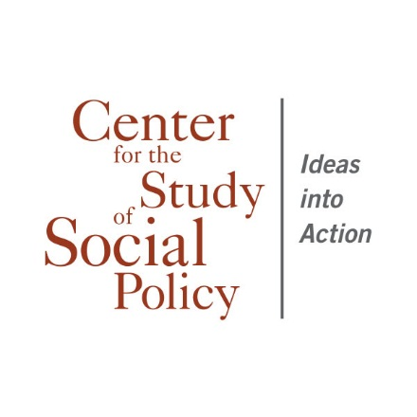
https://www.facebook.com/pages/Center-for-the-Study-of-Social-Policy
https://twitter.com/CtrSocialPolicy
www.cssp.org
www.strengtheningfamilies.net
Notes:
ASK: Now, before I wrap up, are there any questions about anything I have covered?
SUMMARIZE: Thank you for your participation today! Each tool we covered in this module is designed to facilitate your implementation of Strengthening Families. We are confident that these tools will be helpful resources as you implement the Strengthening Families Approach and Protective Factors Framework

