Slide 1
Trauma and Brain Development:
A Protective Factors Approach
Notes:
INTRODUCE: Welcome back! In this section we will be covering trauma, toxic stress and their impact on development. New research in this area has truly revolutionized our understanding of children’s behaviors, brain development and response systems—particularly in the face of traumatic experiences. During this session, we will cover a variety of topics related to trauma-informed care. As you will see, these topics have important ramifications for children and families’ well-being.

Slide 2
Learning Objectives
In this module we will learn about:
Early childhood brain development
The significance of a nurturing adult
Adolescent brain development
How stress affects children and youth
The cascading impact of child abuse and neglect
Signs and symptoms of trauma
A protective factors approach for caregivers
Notes:
STATE: By the end of today’s training, you will be familiar with:
Early childhood brain development
The significance of a nurturing adult
Adolescent brain development
How stress affects children and youth
The cascading impact of child abuse and neglect
Signs and symptoms of trauma
A protective factors approach for caregivers

Slide 3

Key Understandings in
Developmental Neuroscience
Much evidence points to the central importance of prenatal and early postnatal (birth-3 years of age) brain development
Early experiences affect the quality of brain architecture
Brain development is life-long
Adolescence is a time of profound change in brain structure and function
Notes:
STATE: A growing body of neuroscience informs our work in a number of ways. First we have become increasingly aware that the majority of brain growth and synaptic development takes place before a child turns three years old. We also know and will talk more about the fact that early experiences can have a profound experience on brain architecture. While the early years are important for establishing a strong foundation for development, we also need to remember that our brains continue to develop and be shaped throughout our life, and that in adolescence in particular we see specific changes in the brain which profoundly impact behavior.

Slide 4
Early childhood: What we know and see in child welfare
Highest rates of abuse and neglect for children under 4
Children under age 1 are 20% of the child welfare population and most likely age group to die from abuse or neglect
High rates of adverse childhood experiences – compounded by removal from families in this critical stage of development
Multigenerational trauma is an underlying issue
Most children in child welfare will return or stay with their biological families
Notes:
STATE: It is important to continue to guide our work based on what the research tells us about children in child welfare systems.. Some key points to consider are that:
Children under age four experience the highest rates of child maltreatment, and, even more specifically, infants under age one account for a full 20% of the child welfare population in the United States.
Infants are particularly vulnerable to child abuse and neglect, and are the age group most likely to be killed as a result.
Many children who are removed from their families experience “double trauma,” not only because of the abuse or neglect they brings them into the child welfare system, but also from the often terrifying transition of being removed from their home.
Children who experience trauma are also more likely to have parents who have experienced trauma themselves—making trauma an “intergenerational issue.”
Most children who are removed from their parents’ custody are actually returned to their biological families at a later point.
SUMMARIZE: Clearly, we can’t just assume that removing a child from his or her home will “solve” the problem of traumatic experiences.

Slide 5
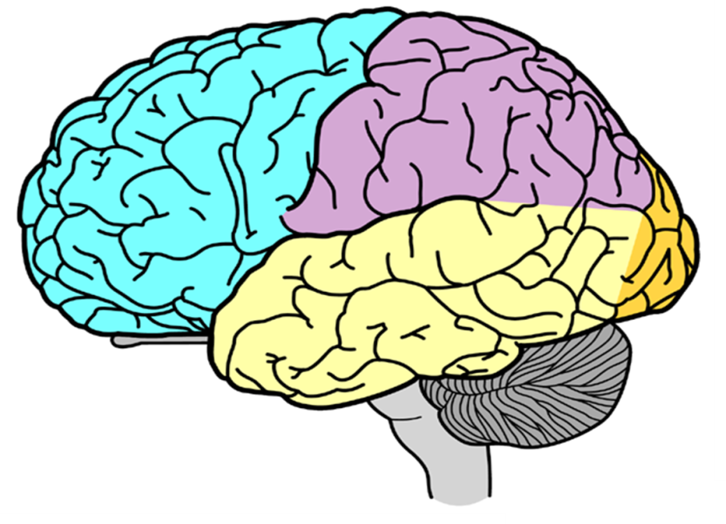
The importance of starting early
“Early childhood is both the most critical and the most vulnerable time in any child’s development. In the first few years, the ingredients for intellectual, emotional, and moral growth are laid down. We cannot fail children in these early years.”
Brazelton, T. B., & Greenspan, S. (2000). The irreducible needs of children: What every child must have to grow, learn, and flourish. Cambridge, MA: Perseus Books.
Video: “Experiences Build Brain Architecture”
http://www.youtube.com/watch?v=VNNsN9IJkws
Notes:
EXPLAIN: When we talk about promoting healthy brain development, it is crucial that we look at preventative efforts focused on early childhood.
READ: As Brazelton and Greenspan wrote in 2000, “Early childhood is both the most critical and the most vulnerable time in any child’s development. In the first few years, the ingredients for intellectual, emotional and moral growth are laid down. We cannot fail children in these early years.”
INTRODUCE: For children, optimal brain development is highly dependent on access to a nurturing caregiver. Early brain development has a reciprocal relationship with certain experiences based in caregivers’ ability to provide:
Consistent attention,
Nurturing care, and
Reinforcement of learning.
EXPAND: However, when children do not have these supports, or are consistently exposed to neglect or abuse, they can develop lasting cognitive and emotional deficits.
SHOW the linked video from the Harvard Center on the Developing Child – or encourage participants to watch it on their own later

Slide 6

Adolescent Brain Development
Major Gap in Timing
Limbic System
Prefrontal
Cortex
Notes:
STATE: One of the key takeaways from the research is that adolescence represents the second great wave—after the first few years of life—of brain growth and development. Contrary to long standing belief—the brain is not fully cooked at age 3. While early experiences affect the quality of the brain’s architecture, adolescence presents another period where experiences and support can help with the rewiring of the brain and the creation of new neural pathways. It’s a period of remarkable opportunity.
So, if you’ve ever wondered why adolescents act the way they do—this slide is your answer! It’s all about the brain! The prefrontal cortex, which controls such things as impulse control, setting priorities, decision making, self-control, self-regulation—matures gradually and isn’t fully developed until around age 26. At the same time there are rapid changes in limbic system which controls such thing as:
emotionality
reward/pleasure seeking
processing social information
So this gap in timing of gradual prefrontal cortex maturation and more rapidly developing limbic system is responsible for the kind of bewildering and often infuriating behavior that has vexed parents since the beginning of time.

Slide 7
The Science of Neglect
Because responsive relationships are both expected and essential, their absence is a serious threat to a child’s development and wellbeing.
Chronic neglect is associated with a wider range of damage than active abuse, but it receives less attention in policy and practice.
The negative consequences of deprivation and neglect can be reversed or reduced through appropriate and timely interventions.
The Science of Neglect; Harvard Center on the Developing Child
Notes:
STATE: While media and other attention tends to focus on the problem of abuse, what the research shows is that chronic neglect can have more lasting and harmful effects than physical abuse. This is because the interaction between a child and a caregiver is such a fundamental developmental building block. The good news, however, is that the impact of neglect can be mitigated by a combination of therapeutic interventions and highly supportive care.

Slide 8
The Science of Neglect; cont.
Studies on children in a variety of settings show conclusively that severe deprivation or neglect:
Disrupts the ways in which children’s brains develop and process information
Alters the development of biological stress-response systems
Is associated with significant risk for emotional and interpersonal difficulties
Is associated with significant risk for learning difficulties and poor school achievement
The Science of Neglect; Harvard Center on the Developing Child
Notes:
EXPLAIN: As you can see, a relationship with a caring adult is incredibly important. Infants and young children can’t buffer themselves from stress or other environmental concerns—they need nurturing, consistent care.

Slide 9
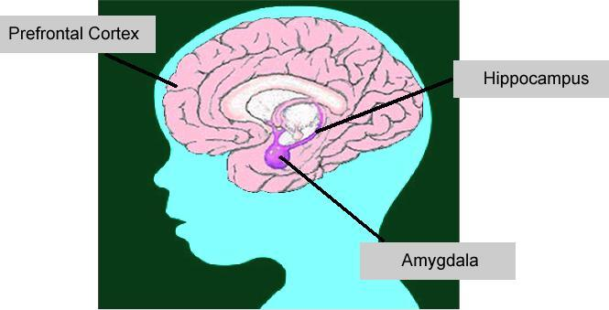
Stress and Young Children
Video: “Toxic Stress Derails Healthy Development”
www.youtube.com/watch?v=rVwFkcOZHJw
Notes:
INTRODUCE: The stress response refers to how stress influences the body and the brain: moving from basic body signals of "fight or flight", to feelings, thinking, and actions.
This slide illustrates the areas of the child’s brain that are responsible for responding to stress.
The amygdala stores charged emotional memories, such as fear or terror, and has been shown to become very active when there is a traumatic threat.
The hippocampus is a small area of the brain in the cerebral cortex and part of the limbic system. The hippocampus plays a critical role in learning and memory.
The prefrontal cortex is very important because it plays a major role in the brain’s “executive functioning” and is associated with judgment, organization, planning, inhibition of aggressive behavior, decision-making and empathy.
EXPAND: Normally, the amygdala, hippocampus, and prefrontal cortex work together to help the body handle stress. A healthy, normal level of stress is actually positive— it allows the child to learn how to process and respond to events and builds these brain areas.
SHOW the linked video from the Harvard Center on the Developing Child – or encourage participants to watch it on their own later

Slide 10
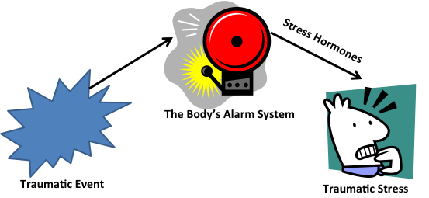
The body’s alarm system
Notes:
TRANSITION: When a child is under stress or experiences a traumatic event, the amygdala acts like an “alarm system,” overriding the hippocampus’ ability to process and the prefrontal cortex’s ability to think. When stress hormones suffuse our body we experience increased heart rate, hyper-vigilance, confusion, rapid breathing, numbness, chills, fear, terror — often described as "fight or flight". This allows us to react quickly and automatically in dangerous situation. However, this amygdala-hippocampus-prefrontal cortex system can fall apart when a child experiences extreme, repeated, or unrelieved stress or trauma.
ASK: What happens when we hear an alarm go off? [Take a few quick answers.]
Now what happens when that same alarm just keeps on going off over and over again? [Take a few answers.]
STATE: Stress is like our body’s alarm system. It is supposed to help us respond quickly in ways that will help keep us safe. But when we experience too much stress without break—it’s like an alarm that keeps on going off—eventually we can’t respond to it the way we should.

Slide 11
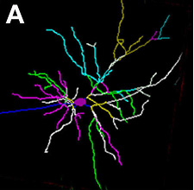
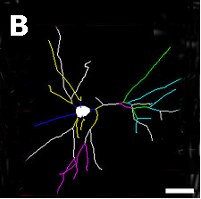
Toxic Stress and Brain Architecture
Normal
Typical -
neuron with many connections
Chronic
stress
Neuron damaged by toxic stress – fewer connections
Prefrontal Cortex and
Hippocampus
Source: C. Nelson (2008)
Bock et al Cer Cort 15:802 (2005)
Notes:
EXPAND: Stress hormones—particularly dopamine, norepinephrine, and epinephrine—are released into the body in response to the traumatic event. If enough of these stress hormones are released for a long enough period of time, they cause the child to experience traumatic stress. Traumatic stress is marked by lasting changes to the body’s stress response system. This may include a consistent “alert” mode, whereby the child becomes hyper-vigilant and his or her resting heart rate remains heightened even after the threat has been removed. In other cases, in response to prolonged exposure to stress hormones, the body adapts and becomes less responsive. Stress hormones also suppress the frontal brain region’s enduring ability to support memory, concentration, inhibition and rational thought.
SUMMARIZE: Over time, if a child is chronically exposed to toxic stress, this brain-neurotransmitter system becomes permanently dysregulated, meaning that the system can be stuck perpetually in overdrive—leading to consistently over-activated feelings of stress, alarm, anxiety and fear.

Slide 12
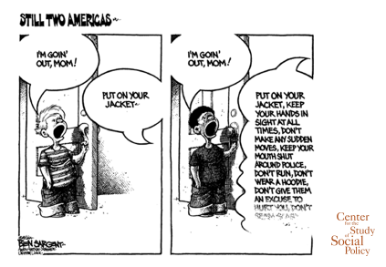
Chronic Environmental Stress
Notes:
EXPLAIN: It’s important to remember that chronic stress isn’t just caused by abuse or neglect. As this cartoon illustrates, chronic stress can also come from the environment. This is why children who are faced with continuous racism, oppression or environmental safety concerns, like war or violent gang activity, can also experience traumatic stress responses.

Slide 13
ACE Study: Findings
Adverse childhood experiences are much more common than had been previously recognized.
As the number of adverse childhood experiences increase, the risk for health and behavioral problems in adolescence and adulthood increases, for example:
  Alcohol and other substance abuse, dependence, or addiction
  Depression; anxiety disorders; suicidality
  Heart disease; pulmonary disease; liver disease
  Perpetrating or experiencing intimate family violence
  Sexual promiscuity and unintended pregnancies
Felitti, V. J. (Winter, 2002). The relation between adverse childhood experiences and adult health: Turning gold into lead. The Permanente Journal, 6(1), 44-47.
Notes:
TRANSITION: One study that really pinpoints the effects of toxic stress is the Adverse Childhood Experiences, or ACE, study conducted by the Centers for Disease Control and Prevention (CDC) and Kaiser Permanente.
EXPLAIN: The ACE Study is one of the largest investigations ever conducted to assess associations between childhood maltreatment and later-life health and well-being. The study identified specific experiences that put children at risk for negative outcomes in adulthood. The specific experiences identified include things like domestic abuse, emotional abuse, sexual abuse, parental drug use, physical abuse and criminal behavior in the household.
EXPAND: The ACE Study suggests that these identified experiences are major risk factors for the leading causes of later illness and death, as well as poor quality of life. In addition it showed a very strong correlation between the number of ACEs experienced in childhood, and adult outcomes. These outcomes were found across many domains, including:
Physical health
Mental health
Risk behaviors
Socioeconomic status
It’s also important to note that when children experience three of more of these ACE factors together, their risk for issues in adulthood increases exponentially.

Slide 14
ACES are very prevalent
Original Kaiser Study – 17,000 individuals
  Almost two-thirds of study participants reported at least one ACE
  More than one of five reported three or more ACEs
2009 BRFSS Studies – 26,229 adults from 5 states
  59.4% of respondents reported having at least one ACE
  8.7% reported five or more ACEs
Notes:
TRANSITION: One Interesting side bar to the ACE study is how common ACEs are. Both of the studies listed on this slide were of normal adult populations.
EXPAND: One thing to consider is—though the research shows that ACEs are associated with a host of negative outcomes, not all of the individuals who experience ACEs are destined to have these negative outcomes. Which brings us back to the question of what helps individuals to succeed despite difficult or stressful circumstances.

Slide 15
What defines toxic stress?
Severe
Repeated
Unrelieved
Notes:
STATE: The Harvard Center on the Developing Child states that “a toxic stress response can occur when a child experiences strong, frequent, and/or prolonged adversity—such as physical or emotional abuse, chronic neglect, caregiver substance abuse or mental illness, exposure to violence, and/or the accumulated burdens of family economic hardship—without adequate adult support.”
Why exactly are children so dependent on caregivers as stress buffers? Because their brains simply aren’t developed to the point where they can “take care of themselves,” or respond to stress with more “adult” coping mechanisms.
EXPAND: Our bodies and brains are designed to be resilient—to bounce back. When children are very young, however, the importance of relationships with primary caregivers as a mechanism for helping the body learn how to reset after stressful circumstances. Studies of infants show how touch and eye contact from a known caregiver can help to soothe the stress response systems.
Even when stress is severe or repeated, research shows that, responsive relationships with caring adults as early in life as possible can prevent or reverse the damaging effects of toxic stress response.

Slide 16
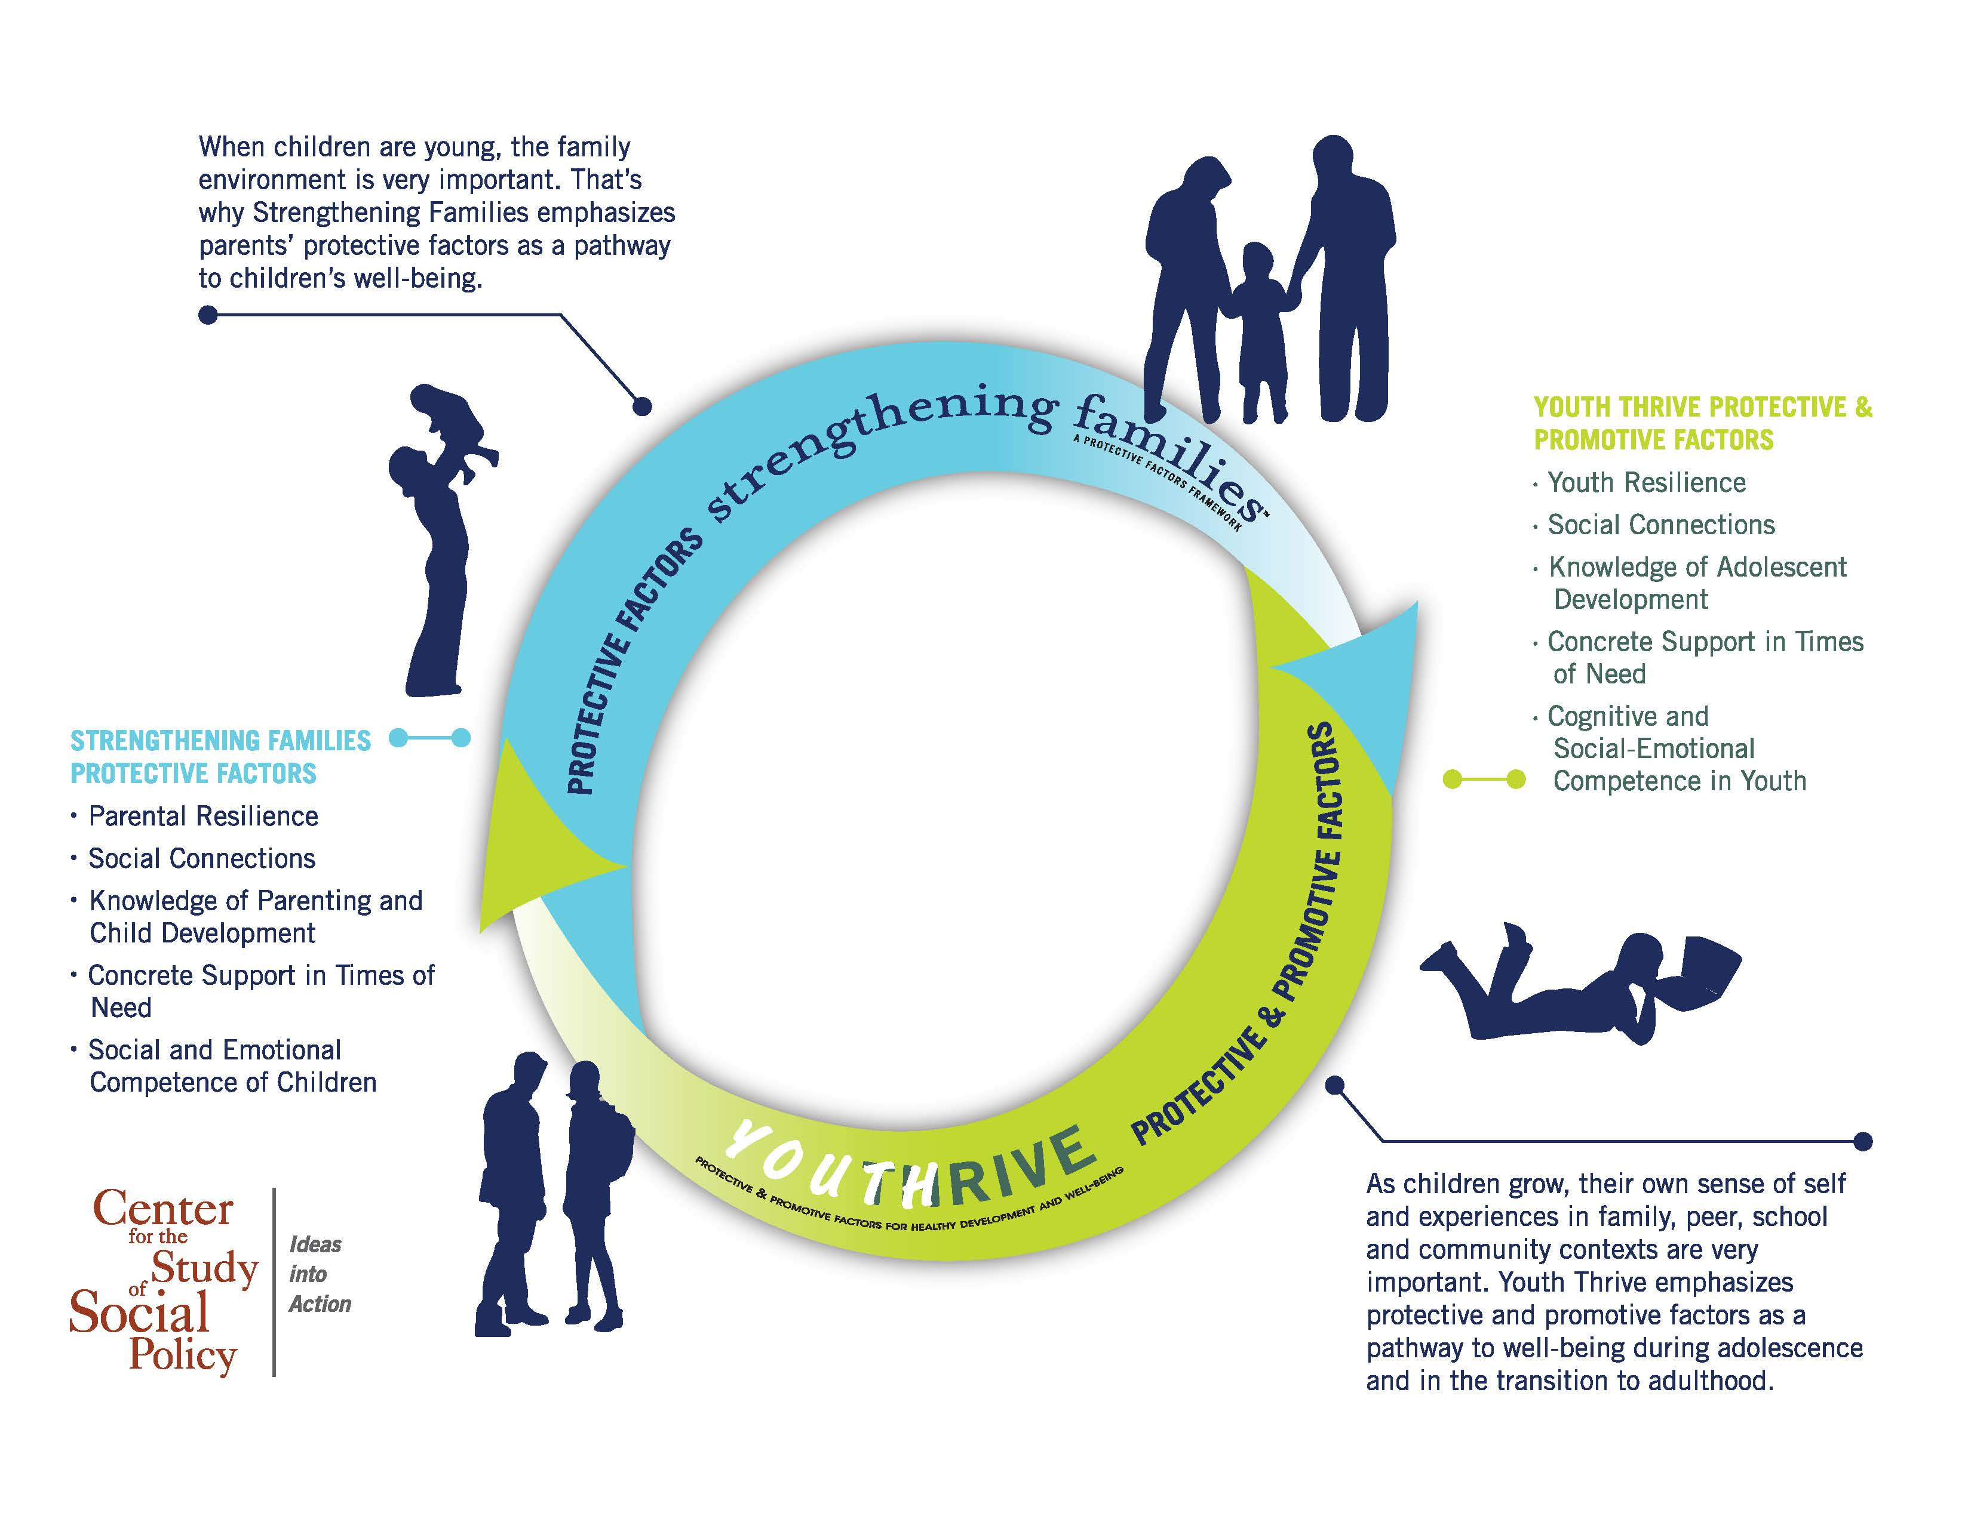
A Protective/Promotive Factors Frame Across Development
Notes:
EXPLAIN: When working with children that have been touched by child abuse and neglect we have a two-fold agenda.
We know the children have experienced trauma and we want to help them heal from that trauma. This means:
Specific therapeutic interventions as well as a focus on the child’s own protective factors. We focus on their social and emotional competence when they are young, and expand to a fuller set of protective factors as they grow older. In a later module we will learn more about Youth Thrive—CSSP’s new initiative focused on building protective factors for children from 11 to 25.
We also want to support their caregivers in building and developing their own protective factors as a way of supporting their ability to provide nurturing and supportive care to the child—because consistent nurturing care is one of the best pathways for young children to recover from toxic stress.

Slide 17
For children involved with the child welfare system it is important to:
  Meet their developmental needs
  Have developmental supports for them that are informed by an understanding of the impact of trauma on development
  Be intentional about how to support the capacity of families and caregivers to keep children safe and support their early development
Notes:
STATE: It is important that we continually work to support children involved in child welfare with a trauma-informed approach. This means providing safe, reliable, consistent, developmentally appropriate supports for all children—and their families and caregivers.

Slide 18
Abusive or Neglectful Parenting
Insecure Attachments, Emotional Dysregulation, Negative Internal Working Models
DISRUPTING THE
Cascading Impact of CAN on Relationships
Poor Social Functioning, Disturbed Peer Relationships
Maladaptive Coping Strategies
Samuels, B. (2012). Looking the future: An agenda for the Children’s Bureau’s next 100 years. Presentation from 18th National Conference on Child Abuse and Neglect. Washington, DC: Children’s Bureau, Administration on Children, Youth and Families, Administration for Children and Families, U.S. Department of Health and Human Services.
Psychological Distress
Adult Peer Dysfunction
Notes:
EXPLAIN: It is important to note the cascading, cyclical pattern of impact that child abuse and neglect can have on an individual’s relationships across the lifespan.
As we alluded to earlier, abuse and neglect experienced in childhood can lead to insecure attachments, emotional dysregulation, negative internal working models, externalizing behaviors, anxiety and a wide range of other negative symptoms.
These symptoms of trauma can lead a child to develop maladaptive coping strategies, subsequently increasing the likelihood of entering into disturbed peer relationships or exhibiting poor social functioning.
Because the child is less likely to develop positive relationships and social supports, he or she becomes more likely to feel isolated, unsupported or stigmatized by peers… Leading to psychological distress.
This distress can carry over into adulthood, where it manifests itself in continued adult peer dysfunction.
EXPAND: This adult dysfunction can carry over into parental dysfunction—leading to an intergenerational cycle of trauma, whereby families can find themselves “stuck” in abusive, neglectful cycles.
[CLICK to begin slide animation]
EXPLAIN: But, we know that with the right kind of interventions and supports, these impacts can be avoided or ameliorated. If we can identify children, youth or parents struggling with these issues, we can disrupt this chain of events. Trauma-informed care, therapeutic supports and increases in protective factors can put a child or a family on a healthier trajectory.

Slide 19
The Vicious Circle of Trauma and CAN
Abusive/ Neglectful Parenting
Challenging Behavior
Parental Frustration
Childhood Trauma
Notes:
EXPLAIN: This endless circle of trauma can also compound within one family unit’s experiences. While this cycle can begin at any stage of the wheel shown, let’s walk through one example starting with a child’s exposure to abuse or neglect.
When a child is exposed to abuse or neglect, he or she is likely to become traumatized.
In response to the trauma, the child subsequently becomes more likely to present challenging behaviors.
The child’s acting out often serves to frustrate and escalate the parent.
Once frustrated, the parent then becomes more likely to respond to the child’s challenging behavior with abusive/neglectful parenting—further traumatizing the child.
As you can see, the circle continues—becoming increasingly problematic with each cycle.
Sadly, for children involved in the child welfare system, we often see this cycle perpetuated not just within the family unit, but in foster care and kinship care placements. When children are removed from home, they may exhibit challenging behaviors that frustrate their new caregivers, which can then result in further traumatization through abuse, neglect, and/or removal to a new placement where the cycle begins again with the child carrying an even greater trauma burden.
[CLICK to animate the slide and add arrows pointing out of the cycle]
EXPLAIN: Once again, though, we know that we can break this cycle. We can help parents and other caregivers to understand children’s trauma responses and respond in healing ways, rather than punishing what they see as misbehavior – and exit this vicious cycle. We can help parents develop strategies to manage their own frustration and respond in supportive ways. We can get children the social-emotional supports they need to heal from trauma and reduce their challenging behaviors. There are many ways out of this vicious circle, most of which start with a greater understanding of children’s trauma responses.

Slide 20

SIGNS AND SYMPTOMS OF TRAUMA :
BIRTH TO 3 YRS OF AGE
              Eating disturbance
              Sleep disturbances
              Somatic complaints
              Clingy/separation anxiety
              Feeling helpless/passive
              Irritable/difficult to soothe
              Constricted play, exploration, mood
              Repetitive/post-traumatic play
              Developmental regression
              General fearfulness/new fears
              Easily startled
              Language delay
Notes:
STATE: In order to end these cycles, it is crucial that we identify trauma early on. We must work to break cycles of trauma before they are solidly cemented into lifelong—or even inter-generational—patterns of harm.
EXPLAIN: To break these cycles through early identification and intervention, it is important to know and recognize symptoms of possible trauma in individuals of all ages. On this slide you can see some common signs of trauma exhibited by children under the age of three. These signs are:
[READ LIST ON SLIDE]
NOTE: While these signs do not always signify that trauma definitely happened, it is important to be aware of them as common indicators. More generally, it is important to be aware that strange or unexplained changes in children’s behavior may be indicative of a trauma experience—particularly if the changes entail one of the listed symptoms.

Slide 21

SIGNS AND SYMPTOMS OF TRAUMA :
3 – 5 YRS OF AGE
              Avoidant, anxious, clingy
              General fearfulness/new fears
              Helplessness, passive, low frustration
              Restless, impulsive, hyperactive
              Physical symptoms (headache, etc.)
              Difficulty identifying what is bothering them
              Inattention, difficulty problem solving
              Daydreaming or dissociation
              Irritability
              Aggressive behavior
Notes:
STATE: Moving to the next stage, for children between the age of five and seven, common signs and symptoms of trauma include:
[READ LIST ON SLIDE]

Slide 22
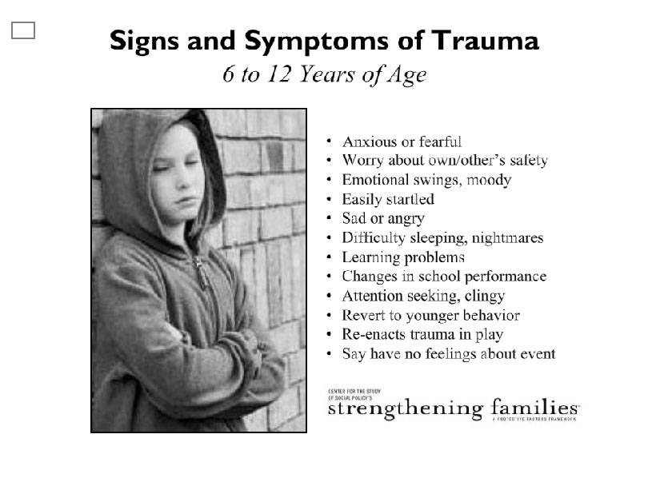
SIGNS AND SYMPTOMS OF TRAUMA :
6 to 12 YEARS OF AGE
              Anxious or fearful
              Worry about own/other’s safety
              Emotional swings, moody
              Easily startled
              Sad or angry
              Difficulty sleeping, nightmares
              Learning problems
              Changes in school performance
              Attention seeking, clingy
              Revert to younger behavior
              Re-enact trauma in play
              Say have no feelings about event
Notes:
STATE: For children between the age of six and twelve, common signs and symptoms of trauma include:
[READ LIST ON SLIDE]

Slide 23
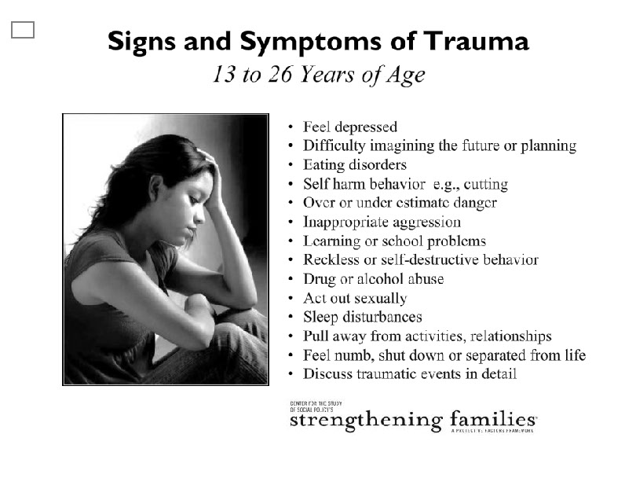
SIGNS AND SYMPTOMS OF TRAUMA
13 to 26 YEARS OF AGE
              Feel depressed
              Difficulty imagining future or planning
              Eating disorders
              Self-harm behavior, e.g. cutting
              Over or under estimate danger
              Inappropriate aggression
              Learning or school problems
              Reckless or self-destructive behavior
              Drug or alcohol abuse
              Act out sexually
              Sleep disturbances
              Pull away from activities, relationships
              Feel numb, shut down or separated from life
              Discuss traumatic events in detail
Notes:
STATE: Finally, for individuals between the age of thirteen and 26, common signs and symptoms of trauma include:
[READ LIST ON SLIDE]
TRANSITION: Again, knowing these signs and symptoms is an important part of developing a trauma-informed view of care. Without being able to identify a child’s trauma experience, adults can view a child who acts out as:
Having anger management problems,
Being willful, naughty or uncontrollable,
Trying to be manipulative,
Purposefully “pushing buttons,” or,
In need of punitive consequences to motivate better behavior.
With a trauma-informed view, however, we can better recognize that a child acting out may in fact be responding to trauma, and, as such, is probably:
Emotionally dysregulated,
Scared,
In perpetual flight, fight, freeze mode as a result of chronic stress,
Employing adaptive coping patterns,
Seeking to get needs met the only way he or she knows how,
Lacking positive coping and self-regulation skills, or,
Acting from a negative worldview, or “learned helplessness.”

Slide 24
A protective factors approach for caregivers of young children who have experienced trauma
Caregivers may experience specific challenges when parenting children who have experienced trauma
  More externalizing behaviors and “testing” of caregivers
  Fewer positive responses to caregivers
  May not respond well to typical disciplinary approaches
Seeing these challenges through a protective factors lens can help us to identify necessary supports
NOTE: Caregivers may include birth parents, foster parents, adoptive parents, kinship caregivers and other adults (e.g., child care provider, grandparent)
Notes:
STATE: A trauma-informed lens to care can help us to help caregivers respond to a child’s trauma signs and symptoms. Whether they are in a parenting role or another caregiving role, adults who care for children who have experienced trauma are likely to face specific challenges. The Protective Factors Framework can help us to understand what those challenges are and identify potential supports.
TRANSITION: Let’s take a look at how a child’s manifestation of trauma can impact the presence or strength of each individual protective factor, and the caregiver’s ability to build each protective factor, both in their own lives and the lives of their children. For each protective factor, we will also look at what we can do to support these caregivers to provide the best possible care for their children.

Slide 25
Parental resilience – Through a trauma lens
Because trauma can impact a child’s affect and responsiveness, caregivers may not get the positive feedback which helps to build parental resilience
Stress in the parenting relationship may undermine personal resilience as well
Particularly for caregivers who feel some responsibility for the trauma their children have experienced, resilience is challenged
Caregivers may need extra support building confidence in their parenting skills and focusing on self-care in the face of children’s post-traumatic behavior
Notes:
STATE: There is an important concept in child development called serve and return – it is about the interaction between children and their caregivers. When a caregiver smiles, a baby smiles back, which elicits a response from the caregiver. We’ve discussed how trauma can impact a child’s affect and responsiveness. This means that a traumatized child might not always give a caregiver the positive, loving feedback that helps build parental resilience. This stress can undermine personal resilience as well, since it’s often hard to feel good on a personal level when you’re not receiving positive feedback from a loved one.
NOTE: Some of the caregivers we work with feel responsible for the trauma their child experienced, which presents additional challenges for the parent – and for us, if we are concerned about the child. Often, we need to provide support to a parent or other extended member who could have protected or buffered the child but didn’t for whatever reason. In the child welfare system, we will often be working with parents who have been reunited with their children after abusing or neglecting them. These parents may be especially lacking in their sense of being an effective parent – which is only compounded if the child’s behavior becomes more challenging after the traumatic experience. These parents need special support to build that resilience up at the same time as we help them build the other protective factors that will help them make better decisions in the future.
EXPAND: As support providers, we must recognize that parenting a child who has experienced trauma can be extremely difficult and stressful for caregivers. However, it is incredibly important that caregivers don’t “give up” on their child at a time when the child needs them most. To prevent caregiver burnout, we need to provide caregivers with extra support in effectively building their confidence around their parenting skills. It is also helpful to assist caregivers in developing self-care strategies to help them remain personally resilient in the face of the child’s challenging post-traumatic behavior.

Slide 26
Social connections – Through a trauma lens
Caregiver may have difficulty engaging social network when others don’t understand trauma and its impacts on behavior
Caregiver may have difficulty making or keeping relationships with parenting peers or others who could support their caregiving because of children’s externalizing and internalizing behaviors
Caregivers may need support to develop new social connections and mutual support networks among parenting peers in similar situations
Caregivers may need tools for educating their extended family and other social connections about trauma
Notes:
STATE: When children’s post-traumatic behavior becomes particularly challenging, caregivers may have subsequent difficulties with their own social relationships. The caregiver can feel isolated because other parents might not understand the child’s behavior or might not appreciate trauma-informed caregiving strategies. All of this can impede the caregiver from engaging in and/or maintaining a positive social network with supportive peers.
EXPLAIN: To prevent these experiences of social isolation, it’s important to help caregivers understand how to frame the child’s trauma and create empathy for the child’s behavior when communicating with other adults. By bridging the trauma-knowledge gap, a caregiver becomes more likely to build positive, supporting social connections with others.
EXPAND: In addition, caregivers of children who have experienced trauma can often benefit from connecting with others who are in similar circumstances. We can support them in finding and building relationships with others, through support groups or informal introductions, and encourage them to find ways to support each other in their parenting.

Slide 27
Knowledge of parenting and children development – Through a trauma lens
Caregivers who are not aware of trauma and its impacts may misinterpret child’s behavior and respond in unproductive ways
Advice available about typical child development and behavior is unlikely to help
Caregivers may not be able to draw on their own past parenting experiences to help them with this particular child
In addition to more universal knowledge about child development, caregivers may need extra support understanding how trauma impacts development and the extra nurturing children need when they have experienced trauma
Notes:
STATE: As mentioned earlier, in terms of knowledge of parenting and child development, caregivers that are not aware of trauma and its impact may misinterpret the behavior of traumatized children. These caregivers are unlikely to find solutions if they turn to standard parenting advice or rely on their past parenting and child care experiences.
EXPAND: In addition to more universal knowledge about child development, caregivers in these cases may need extra support in understanding how trauma impacts a child. Specifically, caregivers need to be taught how to appropriately interpret children’s symptoms and be prepared to provide sensitive, nurturing care.

Slide 28
Concrete support in times of need – Through a trauma lens
Caregiver may need access to specific therapeutic supports to help the child with healing
Caregiver may need formal or informal respite care arrangements that can accommodate the child’s special needs
Manifestations of trauma may disrupt daily events and have negative impacts on ability to work, get child care, etc.
Notes:
STATE: Caregivers may need additional concrete supports to help their child with healing, as well as to other supports to address issues like externalizing behaviors. We can support the caregiver by referring them to a trusted agency and making a warm hand-off between the caregiver and provider at the time of the referral.
CONTINUE: Another concrete support many caregivers may need is respite care arrangements. As mentioned in the context of social connections, a parent’s typical social supports may not be equipped to provide the right kind of care to the child – or may not be willing to care for a child who is acting out. Through mutual support networks or formal programs, caregivers should have at least one trusted alternate caregiver so that they can get a regular break, accomplish things they need to do and take care of themselves.
EXPAND: This is particularly true when the child’s manifestations of trauma disrupt the caregiver’s daily routine. For example, a child’s behavior problems can make it difficult to find or maintain child care; frequent calls from the school and need for therapy and medical appointments can make it difficult for the caregiver to work on a regular schedule. Additional concrete supports may be needed for the caregiver in these circumstances.

Slide 29
Social and emotional competence of children– Through a trauma lens
Supporting children’s social and emotional development is more complex and challenging for children who have experienced trauma
Young children who have experienced trauma will need extra support for their social and emotional development
Caregivers must understand how trauma impacts social and emotional behavior and be equipped with appropriate strategies
Notes:
STATE: Supporting children’s social and emotional development is more complex and challenging in cases where the child has experienced trauma.
EXPAND: Young children who have experienced trauma will need extra support for their social and emotional development. It is key that caregivers understand how trauma impacts this development and are prepared to respond accordingly. We can work with the caregivers to educate them about trauma and its impact on children’s social and emotional development.

Slide 30

Reflections
Notes:
STATE: Today we have talked a lot about how a trauma-informed lens can help us to help caregivers respond to a child’s trauma signs and symptoms. It is also important for us, as service providers and as individuals, to reflect on our own experiences of trauma and adversity. I encourage you to take some time, maybe tonight or in the coming weeks, to think about how the experiences you had as a child have shaped your development and your life today. You might want to talk through this with a partner, sibling or friend. If some of the topics we covered today made you uncomfortable or brought up issues you don’t feel ready to handle on your own, find a professional you can talk to. Just as you would advise a parent you’re working with to seek help – please do the same for yourself when you need to.
PROMPT: To wrap up this module, let’s take a few minutes to discuss these questions with others at your table:
What have you learned about brain development and how it is affected by trauma?
What have you learned about how a family’s protective factors may be affected by a child’s experience of trauma?
How can you apply this knowledge?

