Slide 1
Session 1:
How to Have an Effective Meeting
Laying the Foundation for Facilitation
Date:

Slide 2
Agenda
Welcome & Check-In
Training Group Agreements / Ground Rules
Review Training Goals
Active Learning & Practice
Training Reflections
Evaluation & Closing
Notes:
Welcome – 9:05am
Introductions – Icebreaker – 9:08am
Training Ground Rules – 9:25am
Training Goals – 9:35am
Why do we have meetings – 9:40am
Meeting 1 video and discussion: 9:50am
Meeting planning: 10:00am
Planning practice 1: 10:30am
Developing Agenda: 10:45am
Meeting 2 Video: 11:05am
Results based agenda/Practice #2 – 11:15am
What is a Facilitator – 11:45am
Remember a Facilitator…
Training Reflections/Evaluations – 11:50am
Goodbye and Invite to next training – 12:00pm
**Time pacing may change based on break schedule and/or other activities**

Slide 3

TRAINING AGREEMENTS
Be open
Show respect
Listen to each other
One person speaks at a time
Silence Cell Phones
Participate
Share experiences
Keep discussion confidential
Give feedback in writing where possible
Notes:
Share the above training agreements with the group for consideration. Invite them to add, remove or amend the agreements as the group sees fit.

Slide 4

Training Goals
Learn the purpose of meetings
Learn the basics of meeting planning (and practice)
Learn the major parts of a results based agenda (and practice)
Learn why there is a need for a Facilitator and what a Facilitator does

Slide 5

Why Do We Have Meetings?

Slide 6
WHY ARE WE MEETING?
Information
Gain information/knowledge
Solicit input from group
Brainstorm with group
Solve Problems
Address an issue
Bring closure to an issue
Improve Communication
Strengthen working relationships by sharing feelings and/or dealing with interpersonal tension
Build Community
Promotes camaraderie
Strengthens bonds among people who work together
Build Capacity
Participants receive training to gain new or improved skills
Decision-Making
Participants collaborate to make a decision
Notes:
Community at Work, Sam Kaner, Facilitators Guide to Participatory Decision Making

Slide 7

Meeting Case Studies
Meeting 1:
https://youtu.be/32WjO7IiHpI
Notes:
Play full video approx. 2 minutes

Slide 8

What to consider when meeting planning:
Decide why there is a need to meet
Determine what you want to achieve by the end of the meeting
Decide how you will achieve your meeting goals
Decide who needs to be there
Discuss logistics
Plan with other interested parties
Develop an effective agenda**
Notes:
You can use today’s training session as an example for slides 8-12. As you discuss each slide, you can demonstrate the different concepts by using your planning practice for this training session as an example.

Slide 9
Planning phase:
3 Steps for Planning the meeting
Assessment & Design
Gather information about the group such as purpose and need
Summarize and verify information with key members
Draft meeting objectives, process design (how you are going to get there), agenda.

Slide 10
Establishing Meeting Objectives
Do you want a decision?
Do you want an agreement?
Do you want to generate ideas?
Are you getting status reports?
Are you communicating something?
Are you raising awareness?
Are you making plans?
Are you coordinating something?

Slide 11
Planning phase:
3 Steps for Planning the meeting
Feedback & Refinement
Ask for group leadership/member feedback and approval on design plans, including objectives.
Listen and identify gaps in what members/leadership wants and needs.
Develop final objectives, process design and annotated agenda (facilitation guide).

Slide 12
Planning phase:
3 Steps for Planning the meeting
Final Preparation
Clarify all roles and responsibilities.
Check suitability of the meeting location.
Provide feedback on logistics, member communication, etc.
Identify all materials and supplies needed.
Develop and prepare all materials and handouts.

Slide 13
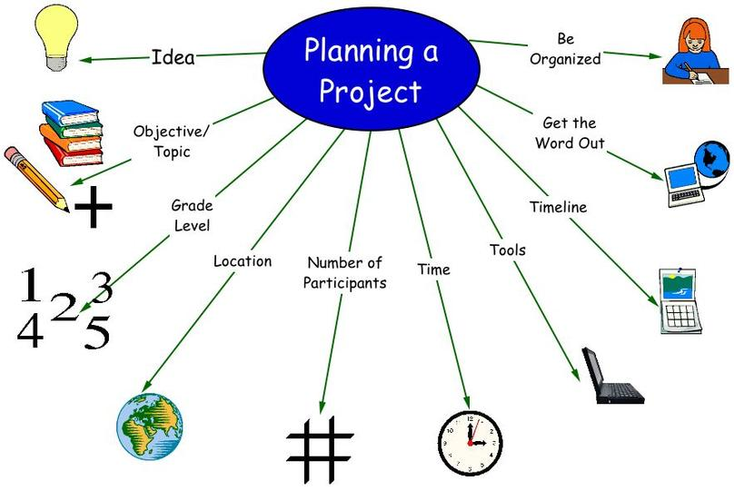
Time to Practice!
Notes:
Use scenario and Questions for Practice 1

Slide 14
Agenda Preparation Considerations:
Priorities – What MUST be covered
Results – What do we NEED to accomplish at the meeting
Sequencing – In what order will topics be covered
Timing – How much time is needed for each topic

Slide 15
Developing an Effective Agenda
Topics
What topics do you need to address?
Outcomes
For each topic, what outcome do you want to see?
Processes
What activity(ies) will best support the group to achieve each desired outcome?
Notes:
What is an agenda? Why do we create agendas? What’s on an effective agenda? Discuss agendas as facilitation guides, especially when agendas have been co-designed with others. Use sample agenda as a reference point for slides 15, 16, and 18.

Slide 16
Process Designing
When Designing Processes
Presenting and Reporting
Comments and Questions
Extensive Discussion
Agreement and Alignment
Ownership & Commitment
Consider the
Level of Involvement
Needed
Determine/ Design the Activity
Determine Time Estimate
Highest Time Commitment
Least Time Commitment
Adapted from: Community at Work 2007, Sam Kaner, Facilitators Guide to Participatory Decision Making, 2nd Ed.
Notes:
Planning alternates between expanding and culling ideas.
Visioning and brainstorming help participants expand their thinking.
Ranking, cost-benefit analysis, and comparing related concepts help participants winnow their thinking.
When critical issues must be addressed, participants might use a problem solving process
Without a sequential structure to guide thinking and dialogue, participants become bogged down or overwhelmed.
Using a rational framework guides and clarifies the participants' thought process

Slide 17

Meeting Case Studies
Meeting 2:
https://youtu.be/6wCNO-BLCdk
Notes:
Play video for 3:30 or less. Just enough for attendees to recognize the meeting isn’t going well.

Slide 18

Results Based Agendas include:
Meeting goals/objectives
Welcome & Introductions
Work items:
  Identify the meeting topics
  Identify the result of each agenda topic
  Identify the processes for each agenda topic
Set time limits for agenda items
Assign meeting roles and responsibilities
  Facilitator, note taker, time keeper, etc.
Meeting Evaluation
Closing & Next Steps
Notes:
Facilitator – A guide or discussion leader. They help groups do their best thinking and create a space where everyone can participate
Note taker – keeps meeting minutes or notes. May also support visibly documenting ideas for the group to see.
Time keeper – ensures meeting activities stay within time constraints

Slide 19
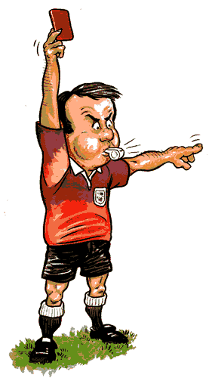
Time to PRACTICE
Notes:
Practice creating agendas using the Scenario presented in the 1st practice. Agendas will be developed in pairs or small groups then use some time for groups to shar their planned agendas with the larger group. Groups can use flipchart paper to draft their agendas so that it is easier for the larger group to see their work.

Slide 20
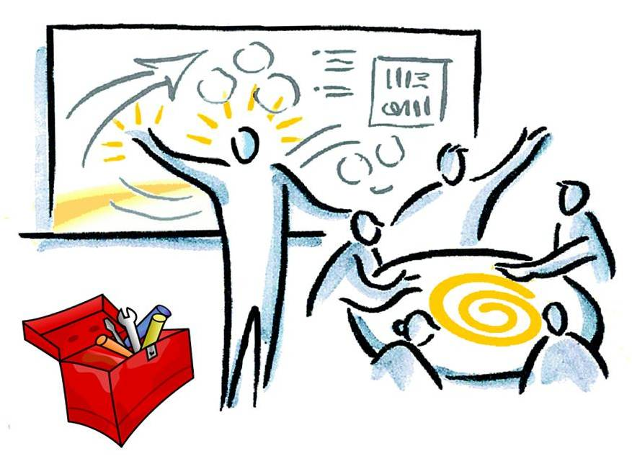
Facilitators…
Notes:
(1) Ask the group: what is a facilitator?
(2) Why would a group need a facilitator?
Chairperson: determines the meeting objectives and plans, and is responsible for the overall direction of the meeting. But as you can see from today’s session, we explored how useful it is to co-design/plan meeting with other involved partners.
The Distinction between a Meeting Facilitator and a Chairperson
The Chairperson is driving, or focusing on the content of the meeting. The Chair is allowed to have an opinion.
The Facilitator is managing the process of what goes on during the meeting to secure maximum productive involvement, the Facilitator must remain neutral where possible.

Slide 21
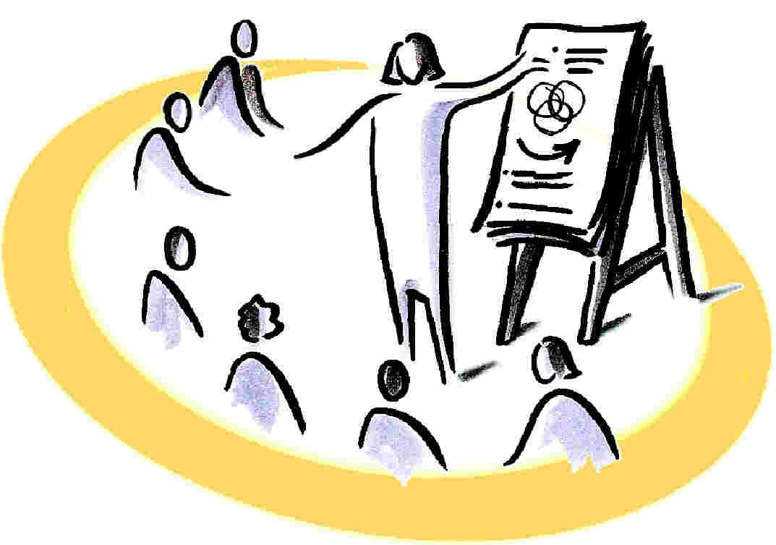

Remember a Facilitator…
Helps a group to do it’s best thinking, and creates a space where everyone can participate.
Guides and monitors the process of the meeting (Is the meeting running well?)
Monitors time or uses a timekeeper
Brings team back on-track when needed
Helps to clarify ideas
Provides feedback where appropriate
*Session 2 will cover Facilitation techniques*
Notes:
START HERE!!!

Slide 22
Training Reflections
Questions?
Please share 3 things you learned today

Slide 23
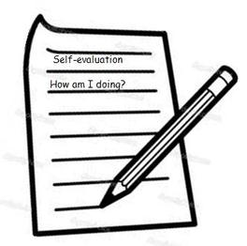
Training Evaluations
Please complete the evaluation form on your table

Slide 24
Resources
Facilitators Guide to Participatory Decision-Making, 2nd Edition, Sam Kaner, 2007.
Agency, Systems & Community Health Improvement Training, Laurie Call
The Skilled Facilitator New and Revised, Roger Schwarz, 2002.

Slide 25

THE END!
THANK YOU FOR PARTICIPATING!

