Slide 1
Session 2:
How to Have an Effective Meeting
Deepening Our Foundation for Facilitation
Date:

Slide 2
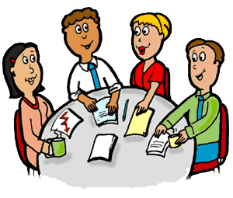
Agenda
Welcome & Introductions
Training Group Agreements / Ground Rules
Review Training Goals
Active Learning & Practice
Training Reflections
Evaluation & Closing
Notes:
1:30pm Welcome/Check-In/Icebreaker
1:45pm Agenda
1:50pm Training Agreements/Ground Rules
Training Goals
2:00pm Training Part 1: Slides – 5 – 10 (30 minutes)
2:30pm Many Hats of Facilitator (15 min)
2:45pm We Communicate In Many Ways (10 min)
2:55pm Hooks and Responses & Group Memory (15 minutes)
3:10pm Challenging Behavior Activity – Facilitation practice (25 min)
3:35pm Facilitation Tools (25 min)
4:00pm Training close-out, Reflection and Evaluation
**Time pacing may change based on the inclusion of breaks and/or other activities**

Slide 3

TRAINING AGREEMENTS
Be open
Show respect
Listen to each other
One person speaks at a time
Silence Cell Phones
Participate
Share experiences
Give feedback
Notes:
This slide may need to be updated based on agreements from Session 1. You can also share the group agreements sample sheet with participants as a reference point to support building agreements during meetings outside of this training session.

Slide 4

Training Goals
Share Strong characteristics of a Facilitator
Duties of a Facilitator
Facilitation techniques & tips
Identifying and addressing challenges
Practice with facilitation tools
Practice! Practice! Practice!

Slide 5
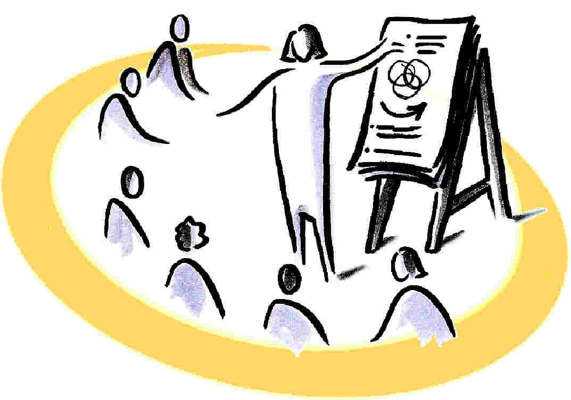

Remember: a Facilitator…
Helps a group to do it’s best thinking, and creates a space where everyone can participate.
Guides and monitors the process of the meeting (Is the meeting running well?)
Monitors time or uses a timekeeper
Brings team back on-track when needed
Helps to clarify ideas
Provides feedback where appropriate

Slide 6

A Good Facilitator has the following characteristics:
Positive attitude
Respectful
Motivational
Patient
Are respectful of time
Use appropriate vocabulary
Use appropriate body language
Listen well

Slide 7

A Good Facilitator is Prepared
Know the topic, audience, and relationships
Visit the meeting space
Sets goals
Has a defined agenda (with topics, processes and intended outcomes)
Has appropriate tools (e.g. markers, flip charts, projector, etc.)

Slide 8

How to Set the Stage for Your Meeting
Start & end on time
Establish ground rules/meeting agreements
Make sure you have adequate and appropriate space
Build in time to connect socially
Ensure members are aware of their roles
Include “Parking Lots” where possible

Slide 9
Running a Meeting Effectively
Include introductions/ice breakers/energizers
Get agreement on the agenda and ground rules
Keep the discussion on track
Stay aware of time
Encourage participation
Recap what you hear
Help members turn issues and concerns into action plans
Be neutral and use the power of your position wisely
Consider rotating roles to encourage new leaders

Slide 10
Meeting Follow-up
Take time to reflect on what went well & what areas can be improved (+/Δ).
Summarize what occurred at the meeting
Distribute meeting notes to participants
Develop next steps
Make follow-up contact with responsible parties
Review
Plan
Do

Slide 11
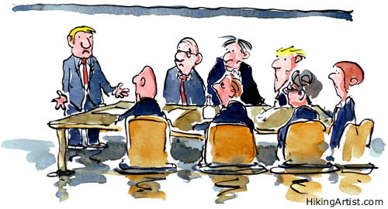
Active Facilitation

Slide 12

How?!

Slide 13




The Many Hats of a Facilitator
Uses humor or calls a break at appropriate moments
Tension Reliever
The Gate Keeper
Raises questions to test if group is ready to come to a decision
Keeps communication open, creates opportunities for participation
Tester
Offers rationales, probes for meaning, restates problems
Clarifier
Notes:
All of these hats required you to actively listen: Be genuinely interested in other people's thoughts and feelings. Listen intently. Make appropriate eye contact.

Slide 14



The Many Hats of a Facilitator
Praises and supports others in their contributions
Encourager
Tries to pull discussion together, reviews progress so far
Summarizer
Mediates differences of opinion, reconciles points of view
Mediator / Harmonizer
Notes:
The Encourager supports inclusion: Make sure everyone has an equal opportunity to participate. Encourage those who have been silent to comment. For example, say in a humorous way: “I’m being rated by my client on the degree to which I get everyone to talk!”
Summarizer recognizing progress: For example: "Nice job! We just brainstormed 36 items in that 4-minute time period."

Slide 15



We Communicate in Many Ways
Body Language
Voice
Visuals
Notes:
Body – Is the first thing people notice, whether you are open or closed determines whether or not they are going to be open to hear what you have to say and feel comfortable participating… As you all stated your tone/voice itself is important but there are some phrases that are useful in encouraging participation.
Be mindful of:
Modeling: Practice behavior that you want reflected back to you. Try to be non- judgmental. Watch your nonverbal messages; remember to have some fun.
Waiting or Silence: Remember that sometimes the hardest thing to do is nothing.
Scanning/Observing: Nurture full participation from the group. Watch nonverbal cues in the form of body movement, facial expression, and gesture (may indicate loss of attention, confusion, or discontent)−take a break, change the pace, change the topic, etc.

Slide 16
Encourage Participation Through Hooks and Responses
Let me build on that . . .
What I like about that . . .
What I hear you saying . . .
How would
we. . .
Help me understand . . .
Can you say more about that . . .
Notes:
Demonstrate hook usage by creating phrases with these hooks as examples of how they would be used to support guiding conversations.

Slide 17
The Group Memory: Flipchart or
Display Recordings
  Helps the group focus
  Provides instant record of meeting content
  Encourages participation
  “Depersonalizes” ideas
  Increases sense of accomplishment
Notes:
Some people are more comfortable writing, they need to see other ideas before they contribute, and it allows the group to focus on the content of the discussion not necessarily who said it. Visual recordings also allow participants to see what they’ve accomplished thus far.

Slide 18
Challenging Group Personalities
The Monopolizers The Debater Constant Talker “I Know Everything” | A member dominates the discussion
The Intimidators Challenger Nay-sayer “What-if Participant” | A member holds a strong position on an issue and presents it in a way that intimidates others and discounts their ideas.
The Silent Types Uninterested Non-participatory Quiet Participant | Members do not participate The challenge with these participants is that it’s hard to know if they are engaged and interested, BUT don’t make the assumption that someone who is quiet isn’t present or engaged in the topic.
The Cheerleaders | Agrees with everybody Does not take a firm position/agrees with everyone May appear to agree in the meeting but not support the decision later
The Unhappy Camper Angry Irritable Disgruntled Negative | Presents a negative attitude, may find fault with the process, may describe the meeting as a waste of time.
Notes:
Review “Managing Challenging Behavior Sheet”.

Slide 19

ADDRESSING CHALLENGES
Time to PRACTICE
Activity
Notes:
ACTIVITY - Group Activity: Facilitation Role Play
This activity should be done with 3 participants role-playing as facilitator, presenter and disrupter in the challenging roles. Chose as many groups as needed to make sure everyone has a chance to participate.
Discussion: Developing a recipe for spaghetti, burrito, sandwich or another favorite dish of your choice.
After each group presents, debrief by asking large group to: guess what challenging behavior was being displayed during the presentation, give team at least two points of feedback on practiced facilitation skills
After all groups have had a chance, you lead the whole group debrief, giving constructive feedback and making sure to hear how they felt about the process.

Slide 20

FACILITATION TOOLS
Storyboards
Ranking
Action Planning
Consensus Building
Force Field Analysis
Notes:
ACTIVITY – PRACTICE TOOLS
Choose 2-3 tools that you want to practice in session. Remind attendees that all 5 tools are in their training handouts.

Slide 21

THE END!
THANK YOU FOR PARTICIPATING!

