Slide 1
2018 Community SponsorSHip Forum
March 15, 2018, 12:00pm – 2:00pm

Slide 2
Best Start Compton-East Compton
COMMUNITY PARTNERSHIP OVERVIEW
What We Do
Major Activities
Affiliated Programs

Slide 3
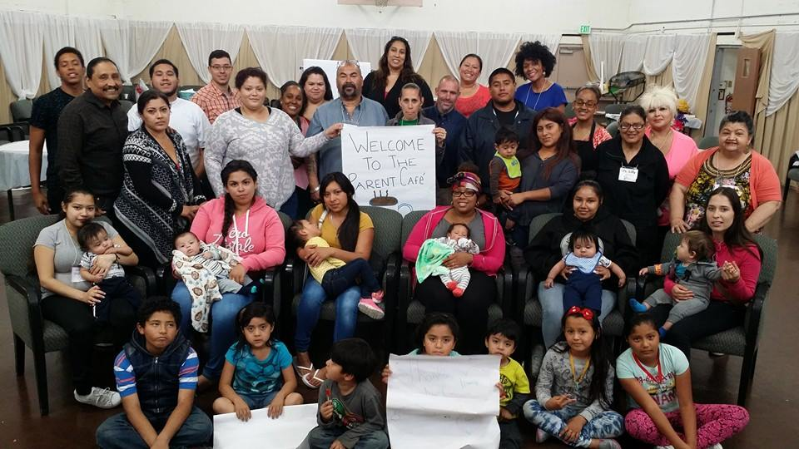
What We Do
Since 2011, Best Start Compton-East Compton (BSCEC) has been working to make a difference for our children and families. We are dedicated to:
Increasing connections between families, residents and community leaders.
Supporting parents and residents in becoming strong advocates for children ages 0-5 and their families.
Connecting residents to Compton-East Compton services and resources.

Slide 4
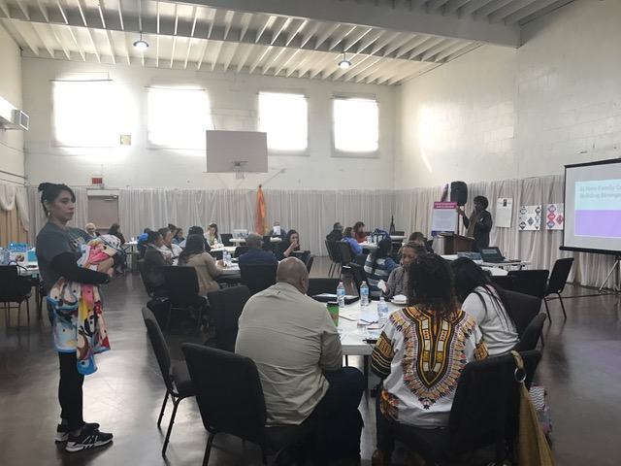
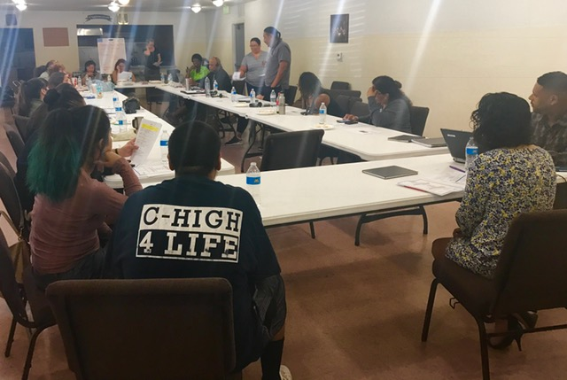
How We Do It
Our partnership hosts monthly meetings that are open to the public, where we share information and learn together about ways to ensure that children are healthy, safe and ready to succeed in school.

Slide 5
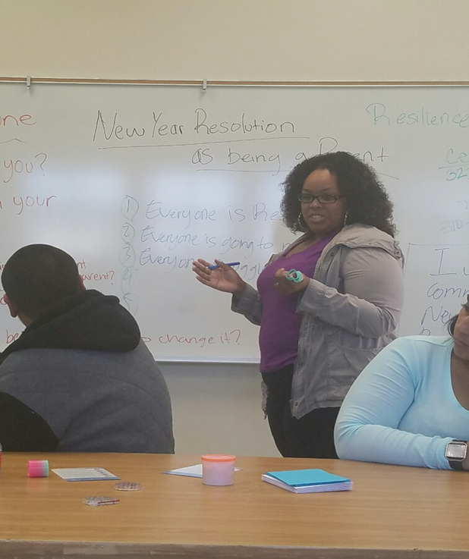
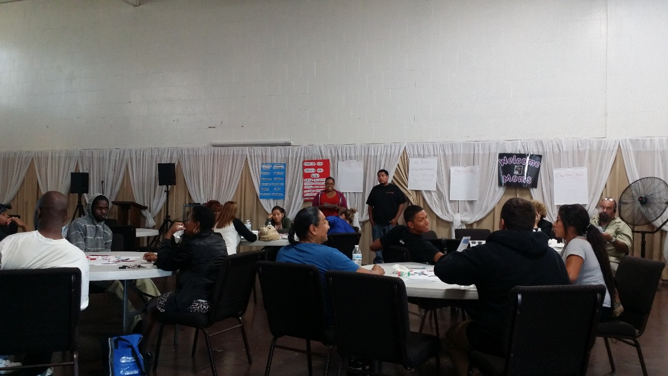
How We Do It
We provide free leadership development training for parents, residents and community partners.

Slide 6
How We Do It
Recent training topics include:
Advocacy & Coalition Building
Basic & Advanced Computer Literacy
Collaboration 101
Conflict Resolution
Critical Thinking & Decision Making
Inspiring & Motivating Others
Mindful Leadership
Outreach Skills
Parent Café Hosting & Design
Understanding Your Leadership Style

Slide 7
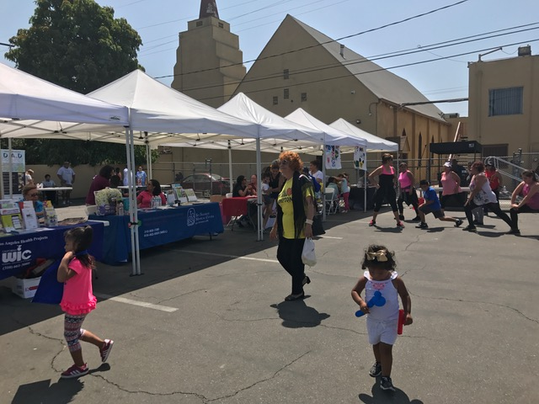
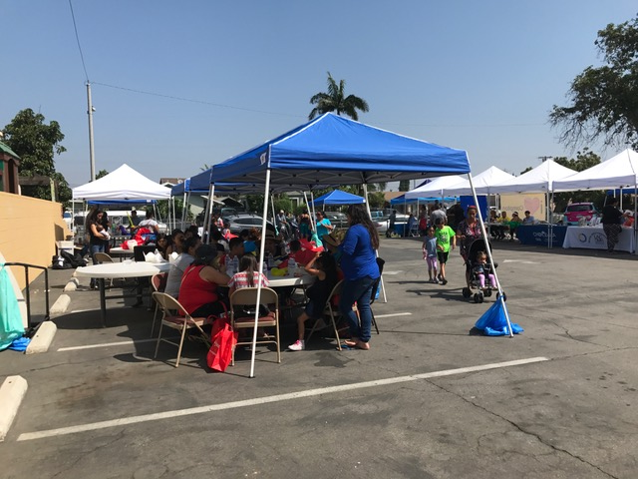
How We Do It
We host and co-sponsor special events with community partners who serve families.

Slide 8
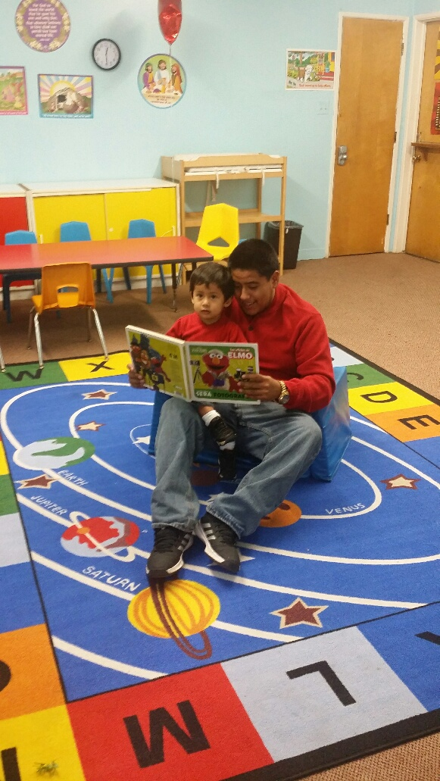
How We Do It
Supports knowledge and skill building about healthy parenting and family well-being. Past presentation and workshop topics include:
Father Engagement / DAD Project Series
Emergency Preparation for Families
Parks & Recreation Programs
Human Trafficking
Know Your Rights

Slide 9
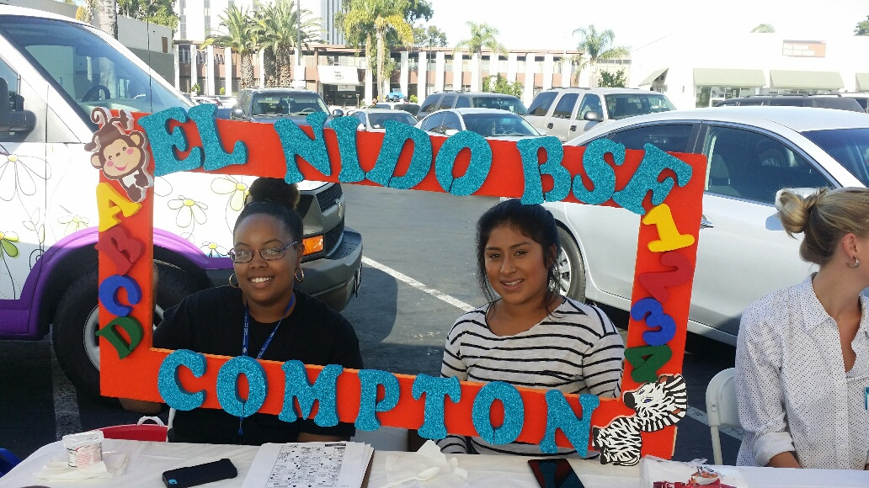
AFFILIATED PROGRAMS
With funding from First 5 LA, BSCEC is proud to support the following initiatives:
Building Stronger Families provides custom tailored support and leadership training for teen and young adult parents, including mentorship, advocacy training, Parent Circles, and community-based action research, all of which is parent-led and parent-driven.

Slide 10
AFFILIATED PROGRAMS contd.
With funding from First 5 LA, BSCEC is proud to support the following initiatives:
Welcome Baby provides pregnant women and new moms with information, support and a trusted partner to help them through the journey of pregnancy and early parenthood.
Home Visitation, as a partner to Welcome Baby, provides personalized, in-home support that is designed to assist parents in bonding with their children and supporting all aspects of their healthy development.

Slide 11
Best Start Compton-East Compton
COMMUNITY SPONSORSHIPS
Purpose of the Funds
Eligibility & Funding Limits
Application Process
Our Priorities & Expectations

Slide 12
Purpose of Sponsorship Funds
Each fiscal year, Best Start partnerships may designate a portion of their Communications and Outreach funds for sponsorships of local events and activities that are aligned with their goals.

Slide 13
BSCEC Sponsorship Funding Limits
Per each fiscal year:
Applicants that are BSCEC members with voting privileges may apply for up to $2,000.
Applicant that are not voting members of BSCEC may apply for up to $500.
*Per BSCEC bylaws, local residents and stakeholders can become voting members after attending a minimum of 2 Community Partnership meetings in a fiscal year.

Slide 14
WHO IS ELIGIBLE TO APPLY?
Community Sponsorship applicants must meet the following criteria:
Be in good standing with First 5 LA
Be a legal 501(c)3 nonprofit organization
Applicants and events that are not eligible for funding include:
An applicant that is already receiving funding from First 5 LA for the event.
Events that have a religious or political focus.

Slide 15
SPONSORSHIP CRITERIA
To qualify for sponsorship, events must also:
Be related to First 5 LA’s goal to ensure that every child enters kindergarten ready to succeed in school and life.
Be located within the boundaries of the Compton-East Compton Best Start community, or serve community members.
Be aligned with Best Start goals, priorities and/or action plan.
Provide networking and community engagement opportunities for Best start partnership members.

Slide 16
Recent Sponsorship Recipients
Children Striving Together
The Compton Initiative
El Nido Family Centers
Save Our Black Boys
SHIELDS for Families
South Los Angeles Health Projects

Slide 17
APPLICATION PROCESS
Submit to Program Officer for Eligibility Review
Communications Workgroup Review
Leadership Group Review
Community Partnership Vote
Submit Approval Documentation to First 5 LA

Slide 18
PLEASE NOTE…
Sponsorship applications must be submitted at least sixty (60) days before the event funding is being requested for.
For approved requests, applicants should allow for approximately thirty (30) business days for payment processing and mailing after all required documentation is submitted.

Slide 19
PLEASE NOTE…contd.
First 5 LA has final funding authority. Community Partnership approvals are considered funding recommendations to First 5 LA.
If an applicant is a voting member, they must recuse themselves during deliberation and voting on the application.

Slide 20
Other BSCEC Requirements
Funded applicants agree to:
Report on event outcomes to partnership members within 60 days.
Provide opportunities to promote BSCEC at the sponsored event (e.g. outreach table, speaking slot)
Feature the BSCEC logo on event materials.
Participate in at least 3 BSCEC partnership meetings or activities over the next year.

Slide 21
BSCEC Sponsorship Goals
Through the use of sponsorship funds, Best Start Compton - East Compton is seeking to:
Connect with organizations that have aligned goals and will be committed, engaged partners.
Promote Best Start goals and activities.
Encourage increased participation in Best Start meetings, trainings and events.
Identify opportunities to expand our reach in the community.

Slide 22
BSCEC Sponsorship Priorities
Events for children ages 0-5 and their families
Community change and advocacy
Teen parents
Parent and resident leadership
Built environment
Father engagement

Slide 23
Comments & Questions
What questions do you have about sponsorships and/or the application process?
What questions or comments do you have about BSCEC sponsorship goals, priorities and requirements?

Slide 24
Thank You for Joining Us!
For additional BSCEC sponsorship questions and application materials, please contact:
Alex Wade
Program Officer
Best Start Compton – East Compton
(213) 482-7542
awade@first5la.org

