Slide 1

PST RESOURCE OVERVIEW
NAME of the resource / tool | Performance Measures Examples PPT
WHAT is the purpose of the resource / tool? | This was used in a training with the BSF/LBD Workgroup to help them understand performance measures and begin to develop them with the BSF Grantee.
WHO developed the resource / tool? (If it was adapted from an existing document, please include a citation for the original source.) | This was adapted from an existing CSSP resource. The concepts come from the book “Trying Hard Isn’t Good Enough” and the RBA body of work from Mark Friedman.
HOW should the resource / tool be used? What circumstances are ideal/appropriate? By whom and when? Is a particular skill set or special preparation needed? | As a training tool/refresher tool for users of Results-based Accountability, when establishing, reviewing, or reporting on performance measures. It is a good teaching or brief reporting/presentation tool.
WHY is this resource being recommended? (What makes is especially effective or useful for community-based work?) | In case partnerships need a reminder/refresher/training on RBA Performance Measures

Slide 2
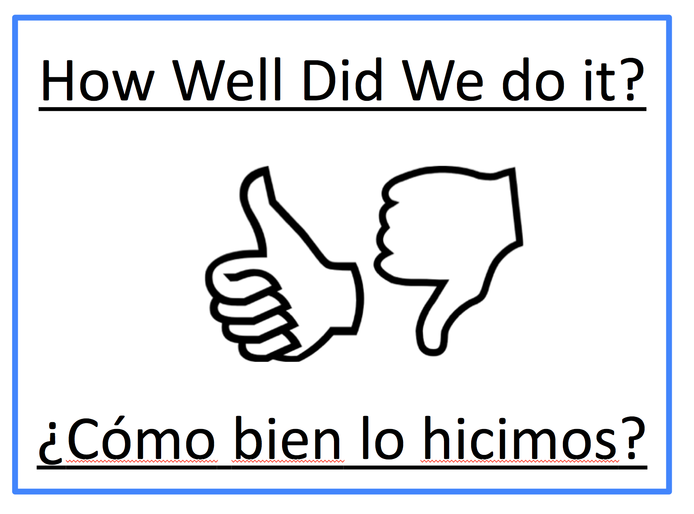
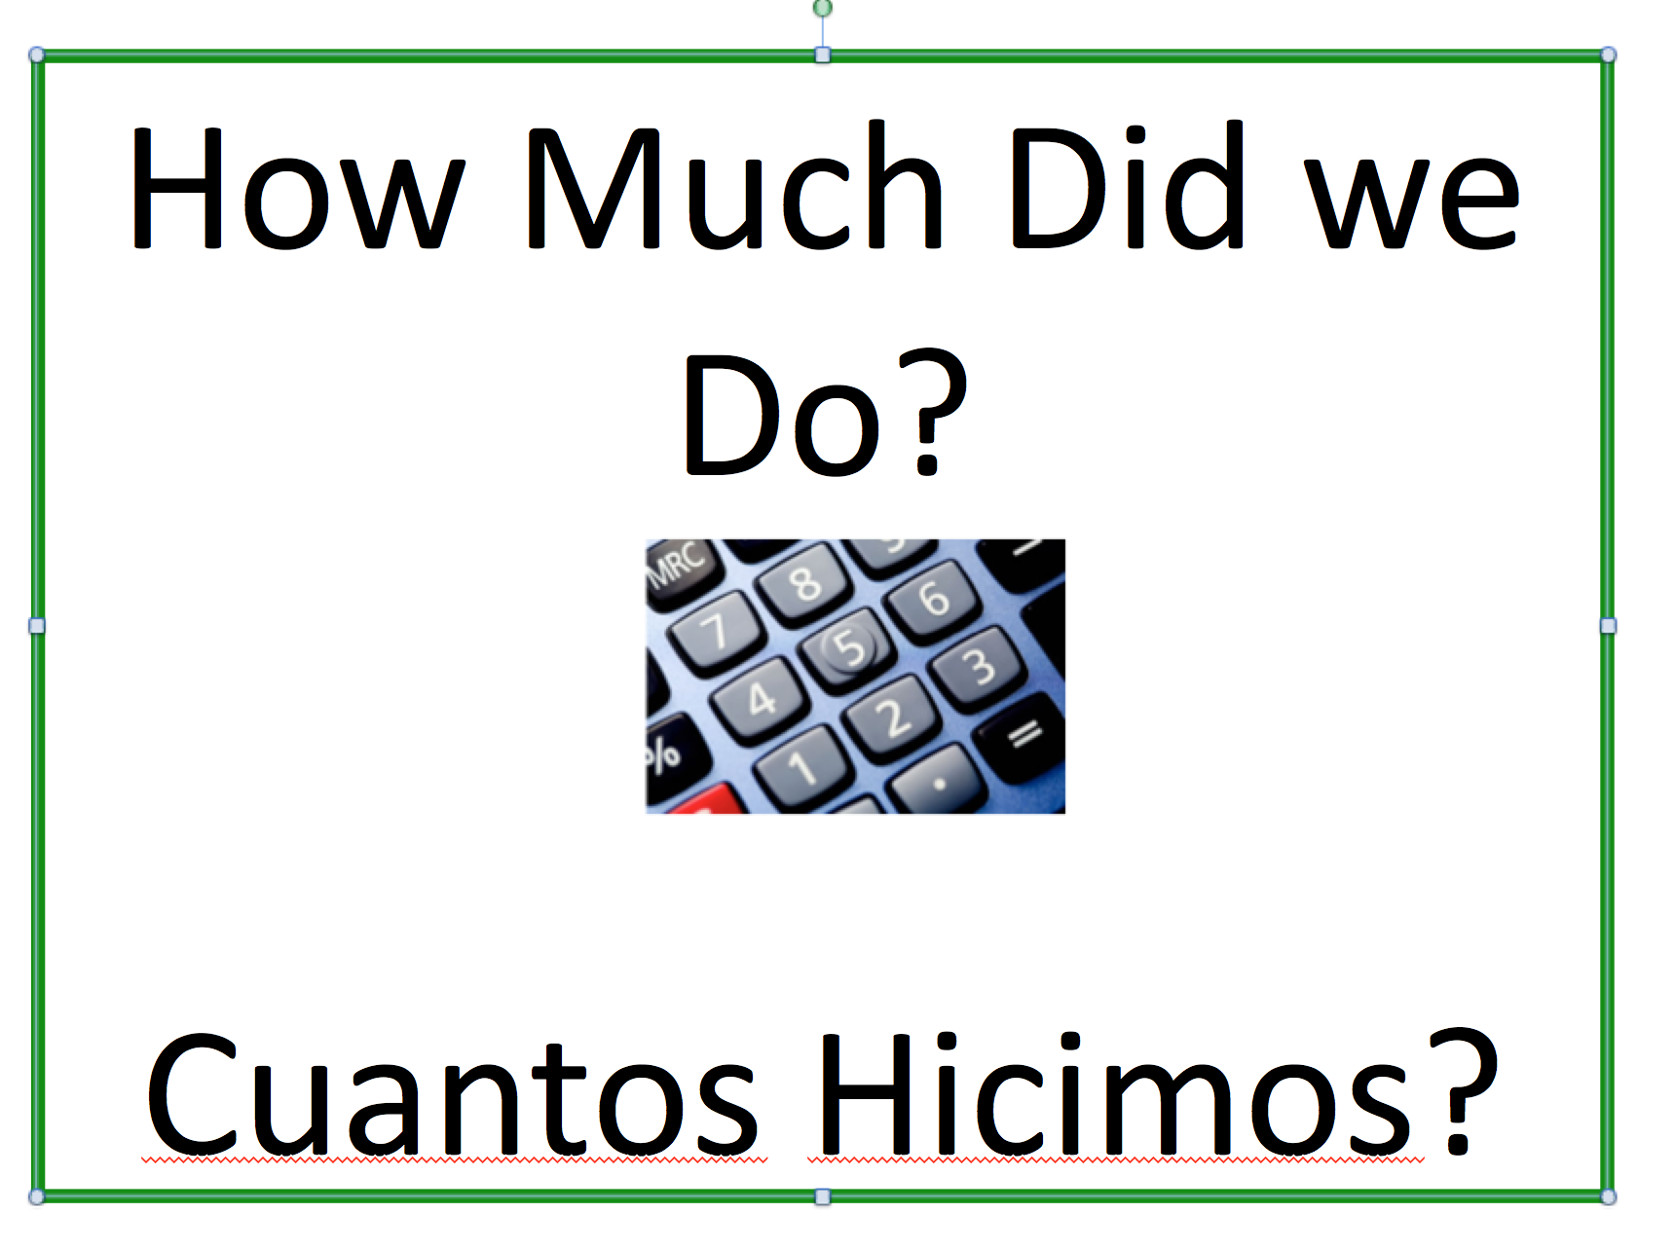
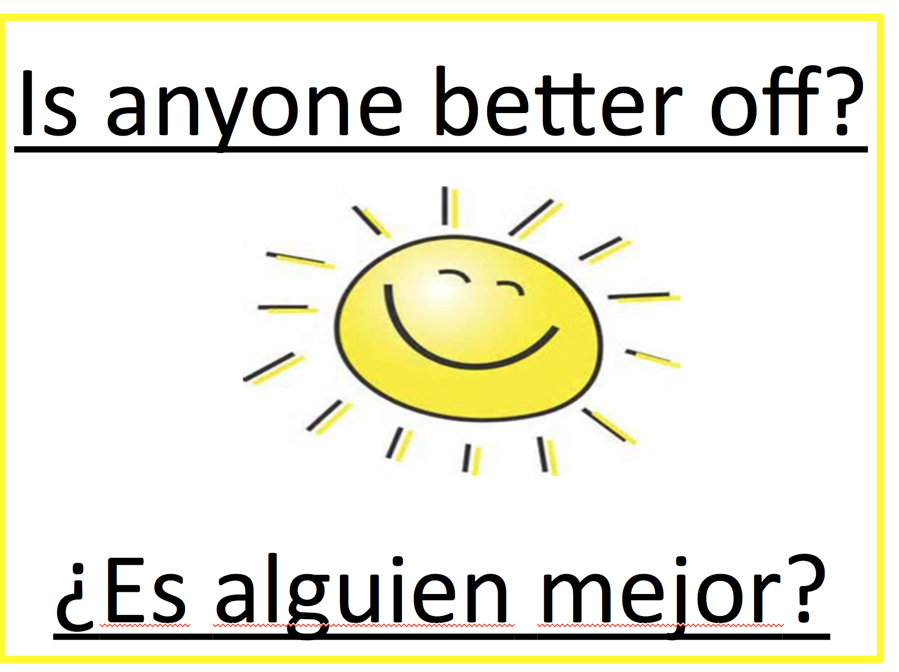
Performance Measures Examples
How much did we do?
- # of training participants
- # of community spaces created
- # of outreach and education materials developed
- # of partnerships developed
- # of doctors, nonprofit orgs, child care providers trained
How well did we do it?
- % that were satisfied with the training
- % that would invite a friend to attend the training
- % of people who shared the educational materials
Is anyone better off? #
- # of people who report they increased their knowledge
-# Number of organizations who increased their knowledge or skills
- # people who report building new skills
- # organizations who adopted family-strengthening policies
Is anyone better off? %
- % who report they increased their knowledge about violence prevention
- % who report being able to better nurture children
-% who report building new skills
-65 participants were satisfied with the training
-63 participants would continue with the program
- 100 training participants
- 6 trainings in 3 months
-90 participants report they increased their knowledge
-5 organizations changed their policies
-95% participants report they increased their knowledge
-50% of the organizations changed their policies

Slide 3
Ejemplos de Medidas
¿Cuánto hicimos?
-el número de participantes
-el número de nuevos programas en la comunidad
-el número de materiales que nosotros hemos desarrollado
-el número de nuevos relaciones entre miembros de la comunidad y organizaciones
-el número de reuniones or eventos
¿Como bien lo hicimos?
- el porcentaje (%) de los participantes que estuvieron satisfechos por los entrenamientos
- el porcentaje (%) de los participantes que dirían a su amigo sobre el programa.
- El porcentaje (%)de los participantes que siguen su participación en el Programa BSF.
¿Es alguien mejor?
(numeros)
-El número de los participantes que han mejorado su conocimiento
-El número de las organizaciones que aumentaron su conocimiento o habilidades
-el número de los participantes que construyeron nuevas habilidades
-el número de las organizaciones que cambiaron su política o procesos.-
¿Es alguien mejor? (porcentaje)
- El porcentaje de los participantes que han mejorado su conocimiento-
-El porcentaje de las organizaciones que aumentaron su conocimiento o habilidades
-el porcentaje de los participantes que construyeron nuevas habilidades
-65 participantes estuvo satisfecho por el entrenamiento
-63 participantes quiere seguir con el programa
- 100 participantes
6 capacitaciones en 3 meses
-90 participantes relatan que ellos aumentaron su conocimiento
-2 organizaciones cambiaron su política
-95% de los participantes relatan que ellos aumentaron su conocimiento
-50% de las organizaciones cambiaron sus política

