Slide 1
Conflict Management Styles

Slide 2
Conflict Management Styles Agenda
Welcome & Introductions
Training Group Agreements/Ground Rules
Review Training Goals
Active Learning
Training Reflections & Evaluation
Closing

Slide 3
Conflict Management Styles Training Goals
What is conflict
Identify sources of conflict
Understand your conflict management style
Understand how relationships and challenges are addressed through different conflict styles
Learn why it is important to resolve conflict

Slide 4
What is Conflict?
Opposing ideas and actions of different people, resulting in an hostile/unfriendly state. A fight, battle, struggle, disagreement..
Some sources of conflict include:
Discomforts
Incidents
Misunderstandings
Tension
Crisis
Notes:
Discomforts: Perhaps nothing is said yet. Things don’t feel right. It may be difficult to identify what the problem is. You feel uncomfortable about a situation, but not quite sure why.
Incidents: Short, sharp exchange occurs without any lasting internal reaction. Something occurred between you and someone else has left you upset, irritated or with a result you don’t want.
Misunderstandings: Motives and facts are often confused or misperceived. Your thoughts keep returning frequently to the problem.
Tension: Relationships are weighed down by negative attitudes and fixed opinions. The way you feel about and regard the other person significantly changed for the worse. The relationship is a source of constant worry and concern.
Crisis: Behavior is affected, normal functioning becomes difficult, extreme gestures are contemplated or executed. Generally this happens when you are you dealing with a major event like a possible rupture in a relationship, leaving a job, violence.
And we also have real life personal sources of conflict that sometimes make us feel “some kind of way” such as personality differences and group power struggles. More often than not these two are acted out through the above 5.

Slide 5
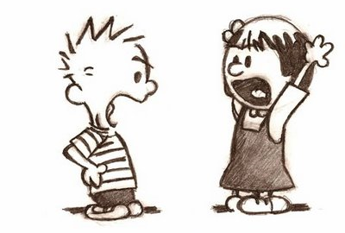
Conflict…
Why is it important to understand how you manage conflict?
Notes:
-It helps in preventing fights or disagreements in the first place
-It helps you maintain and strengthen relationships
-It reduces stress

Slide 6
Understanding Conflict Management Styles
SHARK
OWL
FOX
TURTLE
TEDDY BEAR
Notes:
Distribute surveys, have participants complete survey and scoring guide BEFORE you move forward to the next slide.

Slide 7
Read each of the statements on the following pages.
Please circle A or B in each box for the statement that MOST represent you.
Each of these statements will apply to all of us some of the time; we are interested in knowing which of these statements represent you most of the time.
Use the scoring guide to tally your A and B answers based on the instructions on the guide.
The section with the highest number is your dominant conflict style.
I
N
S
T
R
U
C
T
I
O
N
S
Notes:
Complete survey and score your answers using the provided Scoring Guide.

Slide 8
Understanding Conflict Management Styles
SHARK (Competing)
Is assertive and uncooperative.
Try to overpower others by forcing them to accept their solutions to the conflict.
Is an individual who pursues his/her own concerns at the other person’s expense using whatever power seems appropriate to win his/her position
Tactics such as attacking, overpowering, and intimidating others may be used.
Sharks assume conflicts are either won or lost and they want to be the winner.
Competing may also mean “standing up for your rights” or defending what you believe is correct.
Notes:
Assertive: Confident and direct in claiming one's rights or putting forward one's views.
Cooperation: An act or instance of working or acting together for a common purpose or benefit; joint action.

Slide 9
Understanding Conflict Management Styles
TEDDY BEAR (Accommodating)
Is unassertive and cooperative.
Relationships are very important, their own goals have little importance.
Give up their goals to preserve the relationship
There is an element of self-sacrifice in this style
May take the form of selfless generosity, obeying another person’s order when they prefer not to, or yielding to another’s point of view.

Slide 10
Understanding Conflict Management Styles
Is unassertive and uncooperative.
They withdraw into their shells to avoid conflict
They stay away from the conflicting issue and the person they are in conflict with.
They may sidestep or postpone an issue
Withdraw from a threatening situation
They believe it is easier to withdraw (physically and mentally) from a conflict than to face it.
TURTLE (Avoiding)

Slide 11
Understanding Conflict Management Styles
OWL (Collaborating)
Is assertive and cooperative.
Highly value their own goals and relationships.
Looks for solutions that fully satisfy the concerns of all parties
They don’t run from a conflict, they dig into it to find solutions that meet both party’s concerns.
They may explore disagreements to learn from each other’s insights and develop creative solutions.

Slide 12
Understanding Conflict Management Styles
FOX (Compromising)
Is the middle stage in both assertiveness and cooperation.
Looks for practical, mutually acceptable solutions that partially satisfy the concerns of all parties
They seek solutions where both parties gain and will give up part of their goal and relationship in order to find agreement for the common good.
They address issues directly but may not explore the issue in great depth.
Compromising might mean splitting the difference or seeking a quick middle-ground position.

Slide 13
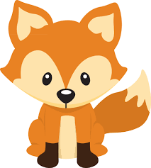
Approaches to Conflict
High concern for issue/self
(half way)
(My Way)
(Our Way)
(No Way)
(Your Way)
Low concern for Relationship
High concern for Relationship
Low concern for issue/self
Notes:
Use handout to discuss approaches in detail

Slide 14
Why should you resolve conflict?
To come to an agreement that benefits all parties.
To understand more about those whose ideas, beliefs, and backgrounds may be different from your own.
To ensure that your relationships with others continue and grow.
To find peaceful solutions to difficult situations.

Slide 15
Training Reflections
Questions?
Please share 3 things you learned today

Slide 16
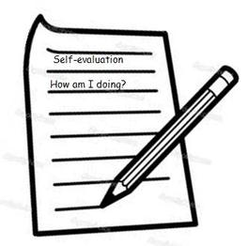
Training Evaluations
Please complete the evaluation form on your table

Slide 17
THE END!

