Slide 1
The Strengthening Families
Self-Assessments for Child- and Family-Serving Programs
Notes:
In 2012, the Center for the Study of Social Policy (CSSP) began updating core Strengthening Families materials including the foundational ideas and research, program self-assessments and other core materials related for training and implementation. This presentation provides a quick overview of the new materials and a more in-depth look at the revised self-assessment tools released in 2014.

Slide 2
About the Self-Assessment
Key implementation tool for programs adopting a Strengthening Families Approach
Helps programs identify “small but significant changes” that enhance their ability to build protective factors
Created based on a national study of exemplary practice
Designed to be used flexibly and to lead you to a concrete action plan
Helps programs identify strengths & areas to focus
Not an evaluation tool but a tool for continuous improvement
Notes:
About The Strengthening Families Program Self-Assessment:
Created based on a one-year study of exemplary practice
Core tool for shifting program practice toward a Strengthening Families approach
Designed to both identify strengths and develop action plans around areas of focus
Built around the everyday actions workers can take to support families in building protective factors
Not an evaluation tool but a tool for programmatic improvement

Slide 3
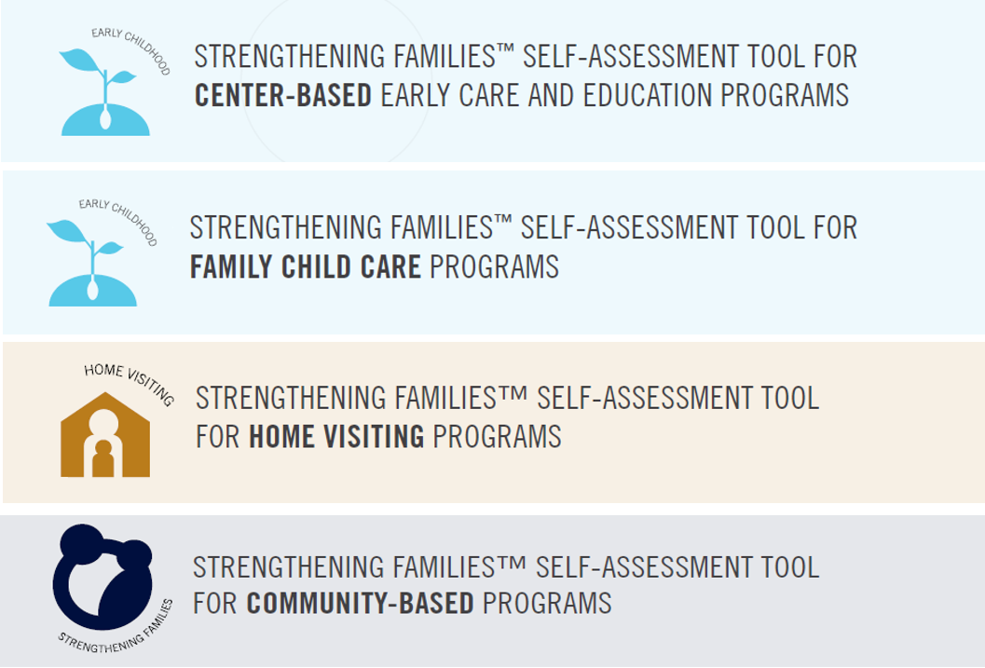
Four versions for different types of programs
Notes:
In the past, two versions of the self-assessment were available
One for any kind of child and family serving programs
One for family child care providers
We heard from users that there was a need for versions of the self-assessment specific to different kinds of programs. Strengthening Families self-assessments are now available for these four program types.
We credit the Florida Home Visiting Coalition for their initial impetus to adapt the Strengthening Families self-assessment tool for use by home visiting programs. They also came up with the idea to organize the tool by the Protective Factors.
While there is significant overlap in content across these separate program versions, there are also specific strategies aligned with the particular context of each setting. These changes may be as simple as changes in language, or as extensive as the addition of sections that are particular to areas of practice within these settings.
The Program Self-Assessment tools are applicable to relevant programs of any size, budget or structure. In general, the strategies described can be implemented without creating new staff positions, making significant changes to existing facilities or raising additional financial resources.

Slide 4
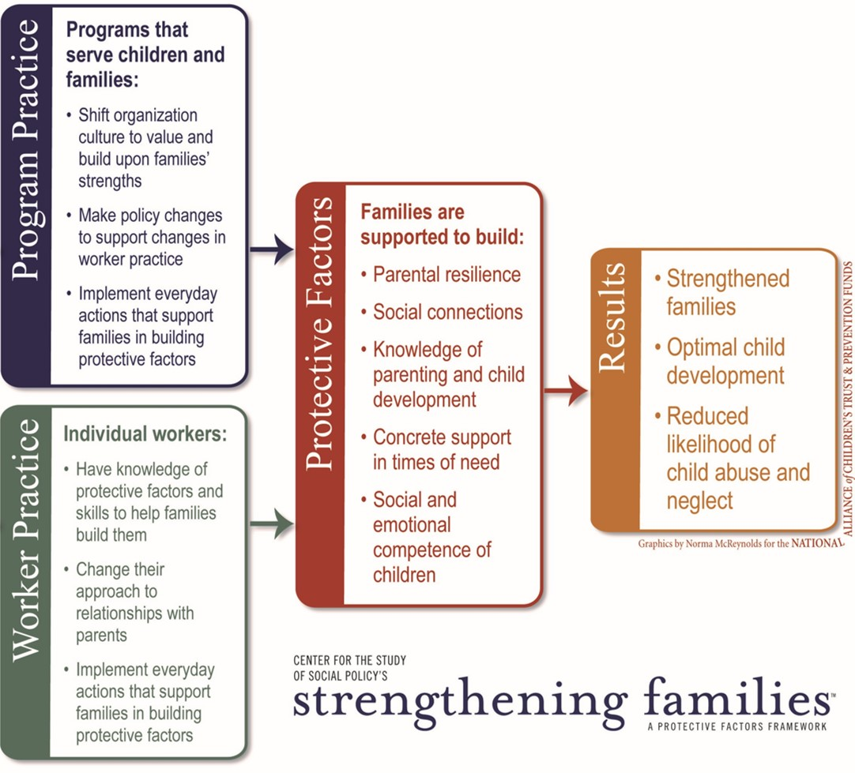
Organized around protective factors and the everyday actions that help families build them
Everyday actions
Five Protective Factor Sections
+
“Special Circumstances” Sections
Notes:
Each of the revised Strengthening Families program self-assessments is organized by the five protective factors in the Strengthening Families framework.
There are also “Special Circumstances” sections
More about everyday actions and the special circumstances sections on the following slides.

Slide 5
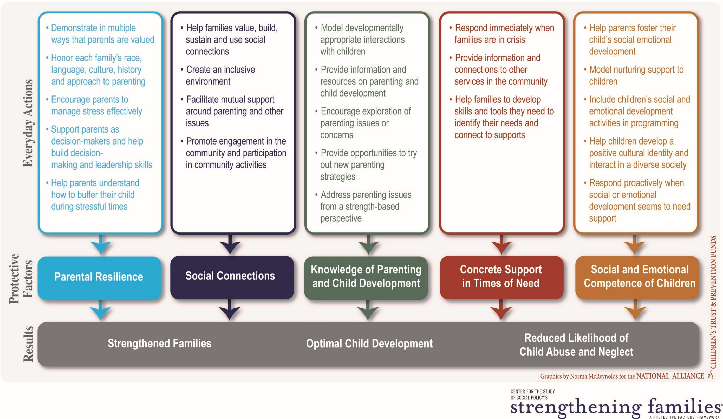
Notes:
Within each protective factor, a set of “Everyday Actions” describe a variety of experiences and resources that programs can provide, which help families build and strengthen that protective factor. Each Everyday Action is accompanied by a list of concrete, actionable, observable and measurable items that programs can adopt.

Slide 6
Special Circumstances Sections
Responding to Possible Child Abuse or Neglect (included in all four self-assessments)
Supporting a Child’s Transitions to School or Other Programs (Center-based ECE and Family Child Care tools)
Notes:
There are also “Strengthening Families in Special Circumstances” sections which include concrete actions related to Responding to Possible Child Abuse or Neglect (included in all four self-assessments) and Supporting a Child’s Transitions to School or Other Programs (for the early care and education and family child care tools).

Slide 7
ECE Self-Assessments are Tiered
ECE Center-based
  Baseline (i.e., any program)
  Mid-level (i.e., more attention to parent engagement)
  High (i.e., high attention to parent engagement and support)
  Comprehensive Service Programs, for those centers that offer a comprehensive range of supports and services in addition to ECE (e.g., Head Start, family support centers).
Family Child Care
  Baseline (i.e., simple day-to-day interactions),
  Mid-level (i.e., more intentional focus on supporting and engaging parents)
  High (i.e., reflect high level of focus on parent engagement and support— may be most appropriate or easiest to achieve for providers that are themselves receiving systemic support).
Notes:
Our goal was to facilitate use in states which are using the self-assessment in their QRIS systems
We were very careful not to define tiers around quality, but rather on intentionality of focus on parent engagement and support
Items in both tools are divided into three tiers that represent different depths of implementation in the program:
Baseline (what all programs can do very easily)
Mid-level (more attention to parent engagement) and
High (i.e., high level of focus on parent engagement and support)
For the FCC tool, we tried to be attentive to the capacity of family child care providers and not expect more than most programs can reasonably do. The “High” tier is most appropriate for providers that are themselves receiving systemic support.
The center-based tool includes a fourth tier, Comprehensive Service Programs, for those centers that offer a comprehensive range of supports and services to children and families in addition to early care and education (e.g., Head Start, family support centers, etc.).
More than 100 reviewers representing providers, program directors, local and state-level administrators and other stakeholders from around the country provided input on the placement of items within the tiers.

Slide 8
About the tools’ length
Promotes reflection and continuous improvement
Formatting adds to the length (esp. the tiered versions)
Use the tool to suit your needs, e.g.,
  One section at a time
  One tier at a time (ECE programs)
Best use: part of on-going, active, reflective process
Continuous Improvement
Notes:
A note about the tools’ length
The self-assessment is intended as a tool to guide practice and encourage reflection. Its length is a reflection of the depth and breadth of concrete actions that programs and providers can take to help families build protective factors. Particularly for the family child care and center-based early care and education program tools, the formatting also adds significantly to the length.
While the Self-Assessment forms may appear long at first glance. To make the process easier, the forms address specific practices; thus, multiple practice examples often appear under a single strategy. While the time it takes to complete the Self-Assessment will vary from program to program and from form to form, on average, each form can be completed in approximately 90 minutes. The only exception is the Family Child Care tool, which should only take between 20-30 minutes.
Users can approach the use of the tool to suit their needs. For example, providers can complete one protective factor section at a time to break it up. Whether they are using a paper copy or entering the self-assessment online, programs will be able to do these sections at their own pace. However, it is important to keep in mind that the protective factors are interrelated and not mutually exclusive. If a subset of the self-assessment sections are used, it is important that programs and providers are still aware of and understand how the other protective factors come into play.
Program directors and policy administrators can support this awareness through professional training and guidance. Another approach for early care and education centers and family child care programs is to focus first on all Tier 1 items and return at a later date to items in the higher tiers. Because the self-assessment is intended to promote reflection and continuous improvement, the hope is that it is used as part of an on-going, active process and not treated as a one-time administrative requirement.

Slide 9
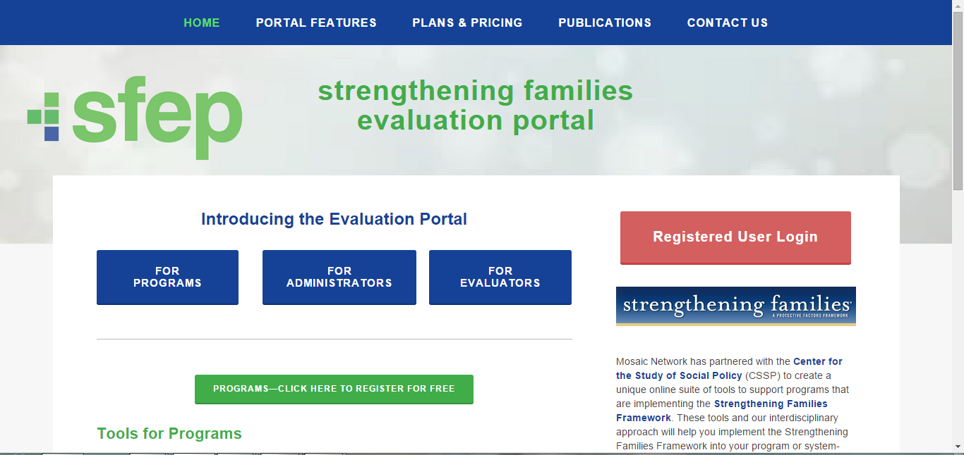

Strengthening Families Evaluation Portal
http://www.strengtheningfamiliesevaluationportal.com
Registration
Self-Assessments
Action Planning
Parent & Staff Surveys
Reports
Notes:
The Strengthening Families Evaluation Portal allows programs to:
Create an account,
Enter their self-assessment data,
Develop an action plan based on their Self-Assessment results, and
Collect and/or enter parent and staff surveys.
A variety of reports can be generated within the system to help programs analyze and document their Self-Assessment results. At the state level, administrators can also track aggregate data across programs.

Slide 10
Completing the Self-Assessment
Create a Self-Assessment team (administrators, practitioners, parents)
Fill-out the Self-Assessment individually
Convene to share and compare responses
Fill out a “group consensus” Self-Assessment
Notes:
CSSP strongly recommends that programs create a Self-Assessment team that represents a number of different perspectives at your program, including:
• Administrative staff and/or the program director
• Program practitioners / service providers
• Parents whose children participate in the program
Including a diverse group of participants in the Self- Assessment evaluation process allows programs to benefit from a large variety of viewpoints and perspectives. Once a team has been identified, the process begins by following the steps outlined below.
First, each member of the team should fill out the Self-Assessment forms individually.
Next, the team should convene to share and compare assessments. Teams should use this time to discuss rating results that differ among various team members, giving each person an opportunity to describe why they rated the practice the way they did and—if appropriate—to provide an example.
Once everyone has had a chance to speak, all team members should be given an opportunity to re-rate the practice. It is not necessary for the entire team to come to consensus on every practice, but it is important that all team members come to understand each other’s perspectives and that a final decision is made on how to rate the item based on broad input.
The consensus version of the Self-Assessment can be entered online at [link to Mosaic]. Completing the Self-Assessment online allows the program to print reports showing strengths and areas to focus on improvement, as well as to link to parent and staff surveys.

Slide 11
Developing an Action Plan
Hint – it’s easier to do this using the on-line tools
Identify areas of program strength
Create a sustainability plan to keep these areas strong
Identify practice areas that a majority rated poorly
Decide which should be addressed (1) immediately, (2) over time, or (3) not at all.
Brainstorm plans for improvement.
Notes:
CREATING AN ACTION PLAN
Once all team members have re-rated the practices, the team should identify areas where the program scored highly.
Next, the team should create a sustainability plan to keep these areas strong. In developing a sustainability plan for each successful area, teams should be sure to specify:
• Key reasons for success in the area
• What needs to be done to ensure continued strength in the area
• Who will be responsible for maintaining successful outcomes in the area
Next, the team should highlight practice areas that a majority of the team rated poorly. While we encourage programs to work on each of these areas eventually, the team can begin by deciding whether each poorly rated practice should be addressed (1) immediately, (2) over time, or (3) not at all. Again, teams should allow time for discussion and reevaluation if/when team members disagree on practice ratings. When a majority of team members identify items that should be addressed immediately, teams should brainstorm plans to improve associated area outcomes.
Teams should be sure to specify:
• The expected results
• All required resources (including staff hour costs)
• A timeline for achieving the desired results
• Who is responsible for each action step
• Check-in points for monitoring implementation progress
• How and when longer term action steps will be addressed/implemented

Slide 12
Tracking Progress and Using Results
Programs will be able to document progress over time
Results can become part of an active continuous improvement process
Local and state-level decision-makers can aggregate responses across programs to inform technical assistance and training offerings, target resources where they are needed most, and monitor trends.
Notes:
A variety of reports can be generated in the system to help programs analyze and document their self-assessment results or help state-level administrators track aggregate data across programs
Revisions to the online system mean that:
Programs can compare where they started to where they move forward over time. They will no longer have to “throw out” the previous self-assessment results and start over.
For local or state-level decision-makers, they can use results to make decisions about technical assistance and training, to inform technical assistance and training offerings, target resources where they are needed most, and monitor trends.

Slide 13
For More Information
Strengthening Families Self-Assessments:
  http://www.cssp.org/reform/strengtheningfamilies/practice/program-self-assesments
About the Self-Assessments (2-pager):
  http://www.cssp.org/reform/strengtheningfamilies/2014/
  AboutTheSelfAssessments.pdf
Strengthening Families Evaluation Portal:
  http://www.strengtheningfamiliesevaluationportal.com

