Slide 1
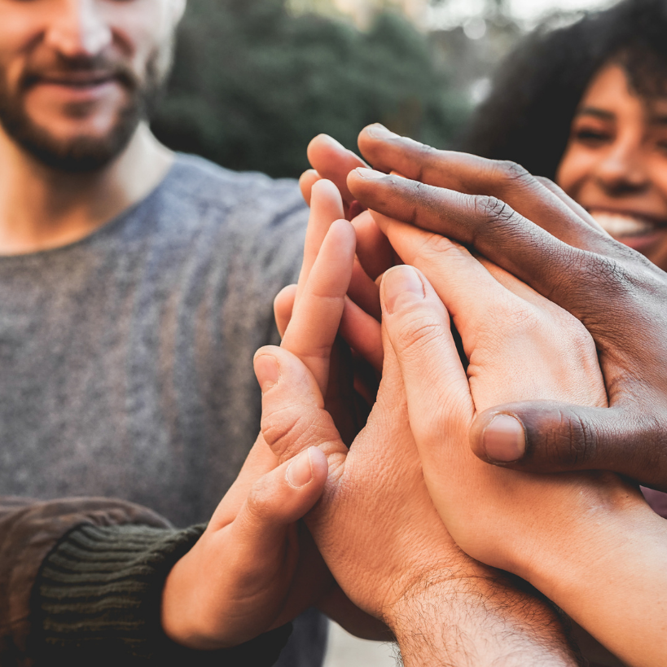
Social Connections
A Center for the Study of Social Policy
Initiative
Created by:
Dr. Julie Radlauer-Doerfler, L.M.H.C.
www.cssp.org

Slide 2
cssp.org/our-work/project/youth-thrive

Slide 3
Objectives
Participants will:
Learn how to discuss protective and promotive factors
Understand social connection and support
Utilize tools to assess social support
Practice skills to enhance social connection
Learn new techniques to expand social connection
Engage in reflection on thoughts, feelings and identification of actions to expand practice
Notes:
2 minutes
Today we will discuss and learn the following information. Review this material with participants.
Learn how to promote protective factors
Understand social connection and support
Utilize tools to assess social support
Practice skills to enhance social connection
Learn new techniques to expand social connection
Engage in reflection on thoughts, feelings and identification of actions to expand practice

Slide 4
What is the
magical formula for…
Increase life span (decreased the risk of premature death by 50%)
Lower stress (and triggering the release of stress-reducing hormones)
Better cardiovascular health and reduced risk of death from cardiovascular disease
Increased immunity (resistance to illness)
Decreased risk of substance abuse and mental health conditions (including depression and anxiety)
Help you think faster
Better psychological and physical well-being
Notes:
2 minutes
While participants know the purpose of the training, people do not usually correlate the outcomes mentioned on this slide with social support. Take time to review each of these outcomes and ask participants what they would attribute these outcomes to?

Slide 5
What happens when we don’t have the formula?
Studies show that when we don’t have this in our lives the effects are:
Increased risk of heart disease
Have the physical effects of smoking 15 cigarettes a day when we don’t even smoke
Increased risk of dementia and slows your brain functioning
Worse than obesity on your body
Have increased anxiety and depression
Notes:
2 minutes
Similar to the previous slide, ask participants why they think the above-mentioned outcomes occur- what do people need to make positive changes in their life. If the group has not already identified that social support creates better outcomes and lack of social support results in the above-mentioned outcomes, tell them what the “secret sauce”is.

Slide 6
Activity:
Social Supports
Think of a time when you were really struggling in your life…
Protective & Promotive Factors
Notes:
Trainer Task: (10 minutes)
Read the following paragraph to the group: Natural Supports: The team actively seeks out and encourages the full participation of team members drawn from family members’ networks of interpersonal and community relationships. The wraparound reflects activities and interventions that draw on sources of natural support.
Ask the group to write down or make a mental note of the biggest crisis they ever had in their own personal lives. This should be a crisis where they needed support from others.
Ask them to recall the details.
Ask them to think about the following questions while they are thinking about their crisis:
How did they get through this crisis?
What supports were the most critical to them?

Slide 7
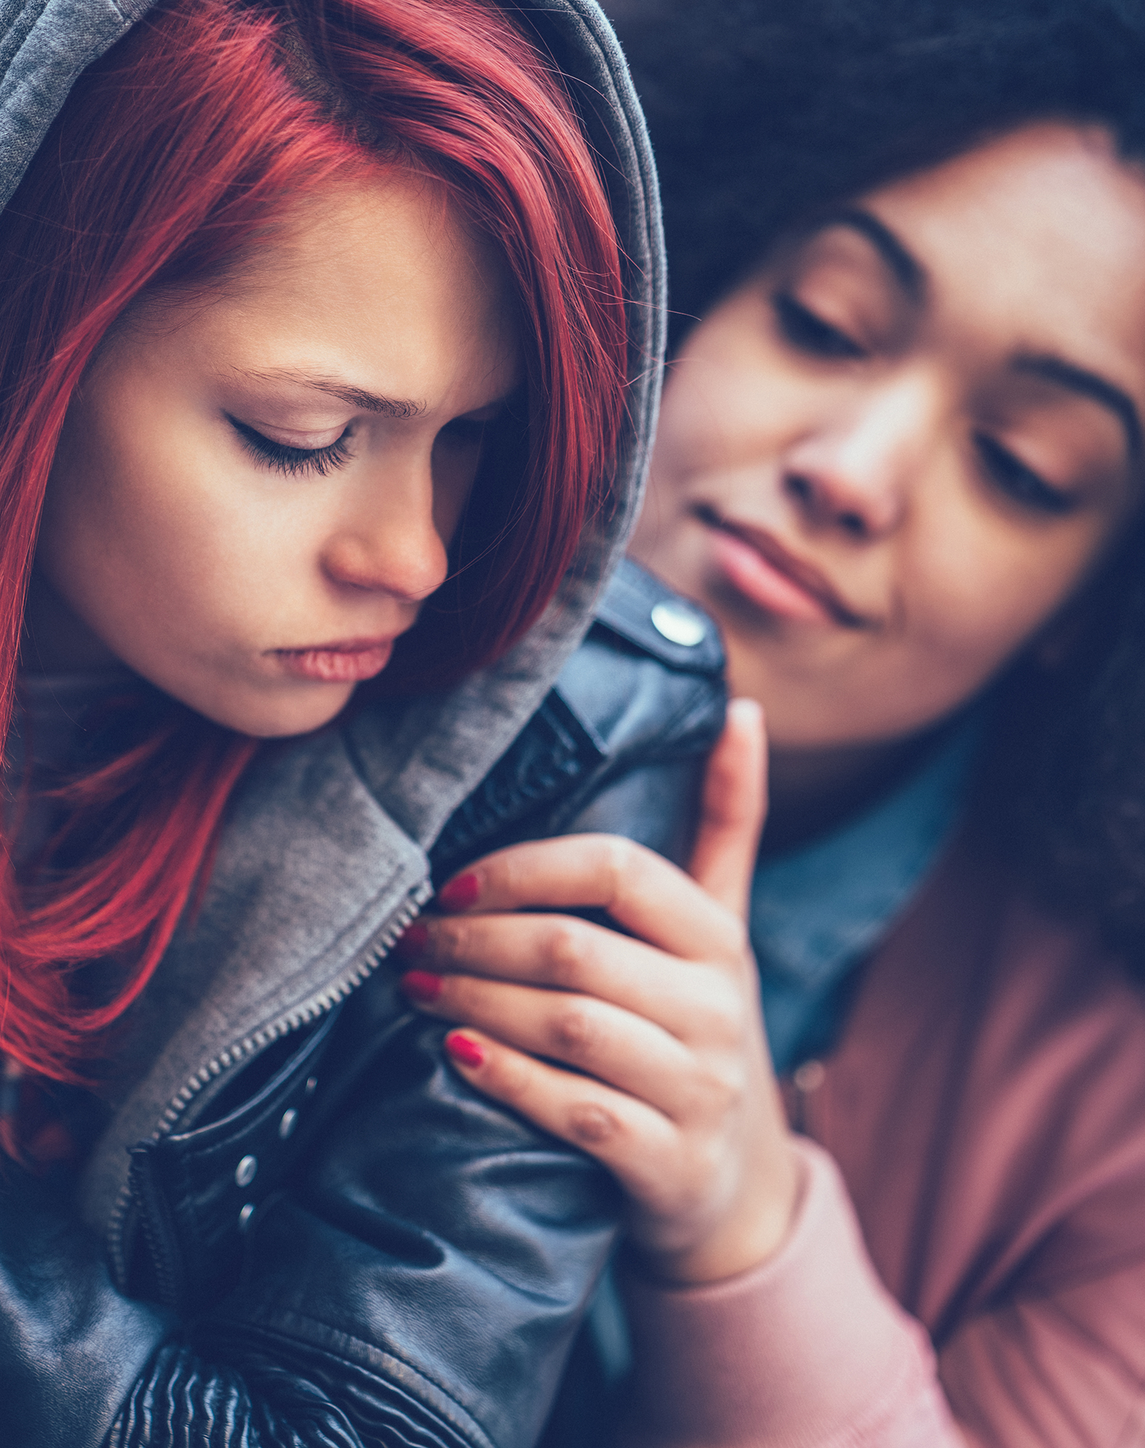
Who did you turn to for help?
Friends
Family
Faith
Paid professional with an advanced degree
Notes:
Ask the group to raise their hands to the following questions:
How many of you were able to get through the biggest crisis you have ever had in your entire life through the help of your family?
How many of you were able to get through the biggest crisis you have ever had in your entire life through the help of your friends?
How many of you were able to get through the biggest crisis you have ever had in your entire life through the help of your faith?
How many of you were able to get through the biggest crisis you have ever had in your entire life through the assistance of a paid professional with an advanced degree?
Have them raise their hands for family (and keep them up), for friends (and keep them up) and faith (and keep them up). Now, have everybody look around the room before putting their hands down.
Then have them raise their hands for paid professionals with advanced degrees again and look around the room.
After the questions and having everyone raise their hands, discuss the number of participants that got through their biggest crisis with help from their family, friends, and faith compared to paid professionals.
The ask the question, “why is it that this room full of people get through our biggest crises through the assistance of our faith, friends and family but we think that the families that we are working with can only get through their biggest crisis through the assistance of us (paid professionals)?

Slide 8
Activity:
Who are your social connections?
Protective & Promotive Factors
Notes:
Who Are Your Social Supports? Pipe cleaner activity (15 minutes)
Break people into small groups (4-6 people) and give each group one of each color pipe cleaner per participant.
Use different color pipe cleaners to represent the race/ethnicity while answering the following questions. You must answer the questions based on majority representation and can only use one pipe cleaner per question. (Blue represents Black, Red represent White, Green represents Hispanic, Yellow represents Asian/Pacific Island, Purple represents Indigenous, Pink represents other)
Who do you work with?
Who lives in your neighborhood?
Who is part of your friend circle?
Who were the last three people that came to visit your home?
What shows do you watch on TV?
Who do you pray with?
Look on page 5 for instructions
Process what people noticed about the diversity of their groups.

Slide 9
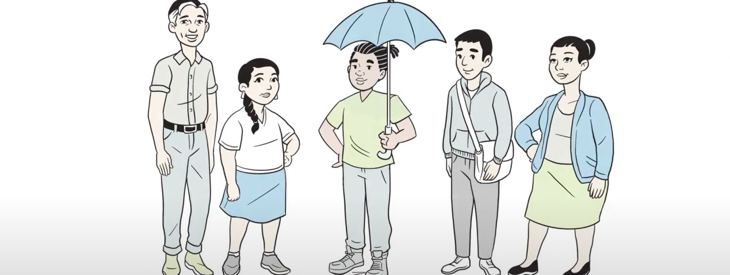
Video: Protective and Promotive Factors
https://youtu.be/PUAKgvwFG3A
Notes:
Show Youth Thrive The Five Protective and Promotive Factors video (5 minutes)
Process following the video

Slide 10
Let’s Talk Protective and Promotive Factors
Resilience- managing stress and functioning well when faced with challenges, adversity or trauma
Social Connections- positive relationships that provide emotional, informational, instrumental, and spiritual support
Concrete Support in Times of Need- Access to concrete support and services that address a person's needs and help minimize stress caused by challenges
Knowledge of Child, Adolescent or Parent Development- Understanding development and strategies that support physical, cognitive, language, social and emotional development
Social and Emotional Competence- interactions that support the ability to communicate clearly, recognize and regulate their emotions and establish and maintain relationships.
Center for the Study of Social Policy, Strengthening Families™ Protective and Promotive Factors https://cssp.org/our-work/projects/protective-factors-framework
Notes:
5 minutes
Explain Protective factors in more depth and have brief conversation about what people know about Protective Factors and how they explain it to the youth that they work with.

Slide 11
What are Social Connections?
Social connection is the experience of feeling close and connected to others. It involves feeling loved, cared for, and valued, and forms the basis of interpersonal relationships.
Notes:
3 minutes
Read this definition and ask people what they consider to be social connections

Slide 12
The Components of Social Connection
Social Integration and a sense of belonging (quality of social relationships)
Social network structure (network ties to relationships)
Relational content (emotional caring and concern)
Social influence and comparison- guidance about norms and behaviors
Social control includes how social network members monitor, encourage, persuade and pressure adherence to positive practices
Behavioral guidance, purpose and meaning (mattering) by occupying social roles
Includes emotional support, instrumental support and informational support
An important source of healing
Let’s look through a cultural lens…
Notes:
15 minutes
After reading the slide facilitate a conversation about how culture plays a part in each of these components of social connection. It is important to recognize that different cultures connect in different ways and that if we are not grounding in culture, we will miss important cues in how to facilitate connections with youth.

Slide 13
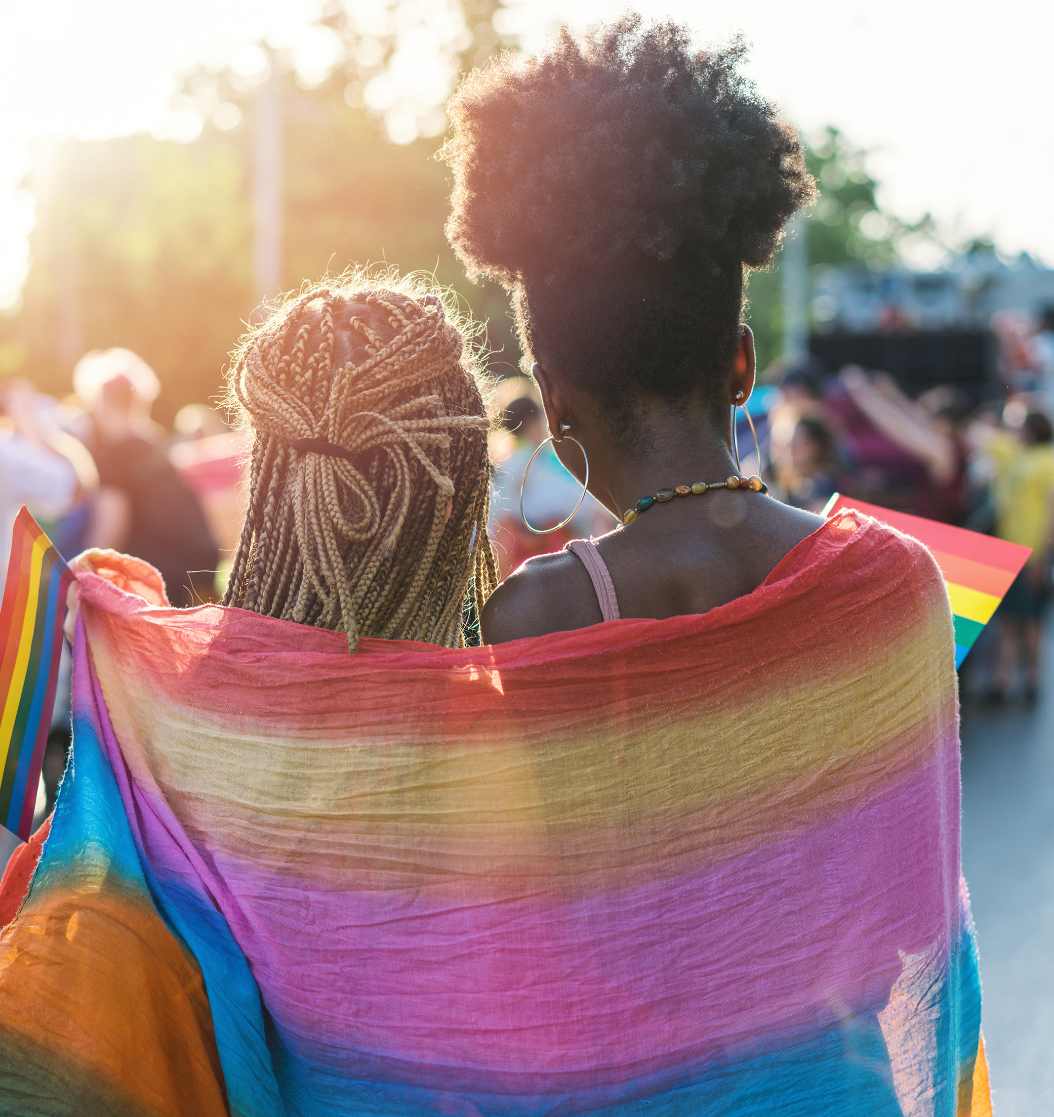
Friends
School
Family
Community service
Community building activities
Leadership activities
Activism
Social Media online communities
Faith or spiritual connection
Sports and hobbies
Others…
Potential Sources of Social Connections
Notes:
2 minutes
Read the list and facilitate a conversation about other potential sources of connections with youth

Slide 14
Let’s Assess: Youth Thrive Survey: Social Connections Scale
Notes:
15 minutes
Pass out the Social Connections Survey page and have participants break into pairs and discuss the survey. Have participants brainstorm how they would present this information to youth and process out as a large group
Look on page 6 for Youth Thrive Assessment tool

Slide 15
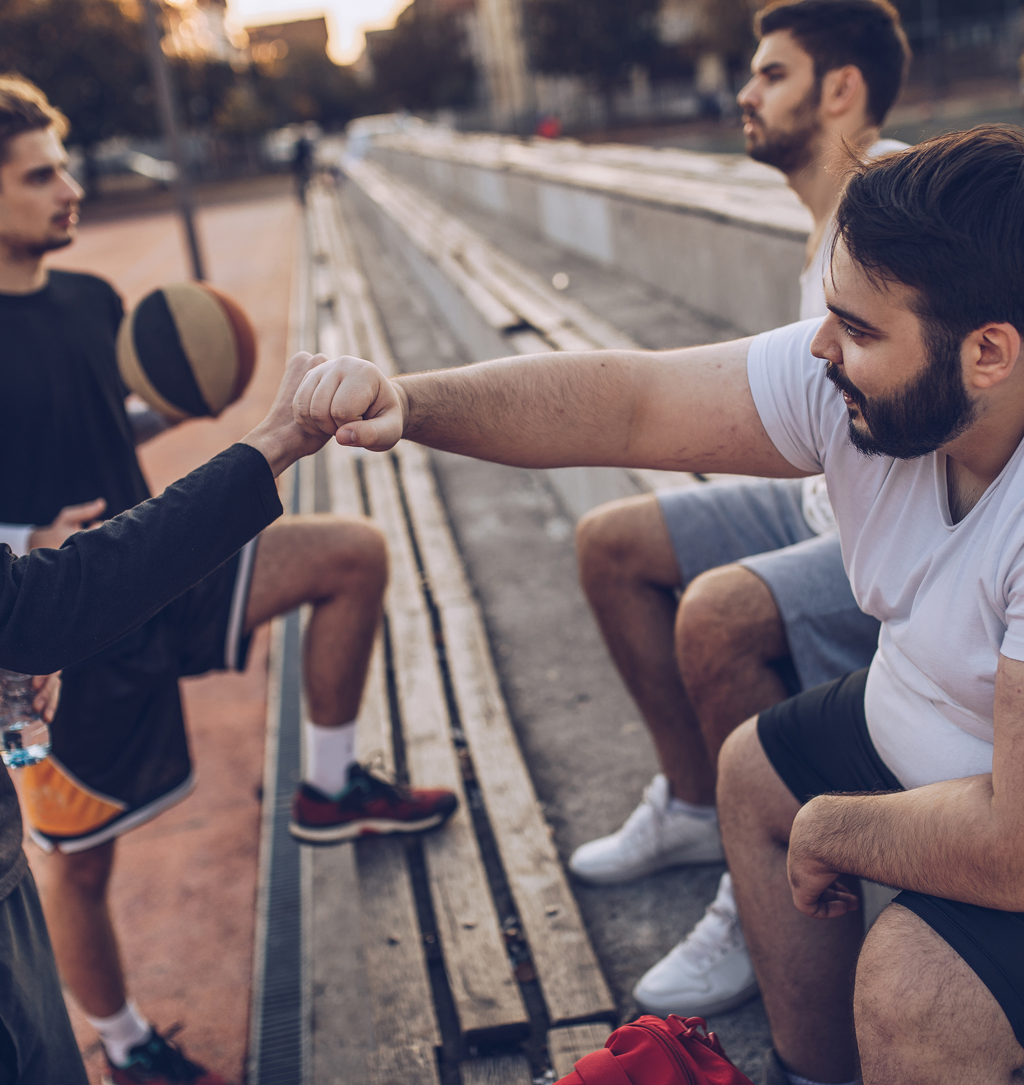
How Do We Help Build Social Connections?
Notes:
Now that we understand the why behind the need for social connections, let’s talk about tangible techniques to help youth build social connections

Slide 16
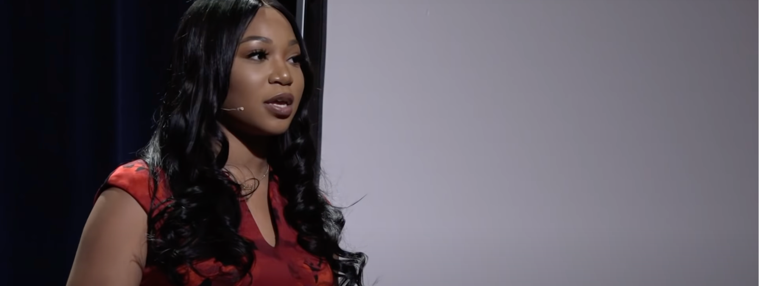
Video: Guide Someone to Ask for Help
https://youtu.be/WnNCOvYYT14
Notes:
15 minutes
Janesha Bull Ted Talk about how social supports can help struggling youth. Watch the Ted Talk and process how you would use some of this information with the youth you are working with

Slide 17
Sample Questions to Help Youth Identify Social Connections
Who do you trust? Who do your parents/family trust? Tell me about them.
Do you have neighbors, friends, or family members who are aware of your situation and can help you? Tell me about them.
Are there any activities in the community? What about for you? Tell me about them.
Are you involved in any spiritual or religious activities? What kind and how often? Tell me more about that.
Who is your emergency contact? Tell me about them.
If your car breaks down, who will you call? Tell me about them.
Who helps you now? Who helped you in the past? Tell me about those people.
Who do you call when you need to vent or are sad about something? Tell me about them.
Who do you have fun with? Tell me about them.
Who are the last 5 people you called or texted. Tell me about them.
Notes:
10 minutes
Here is a brief list of questions that you can use with youth to ask questions and have conversation about social support. Break into small groups and review these questions and add more. Come back to the larger group and share one new questions from each group.
Look on page 7 for sample questions

Slide 18
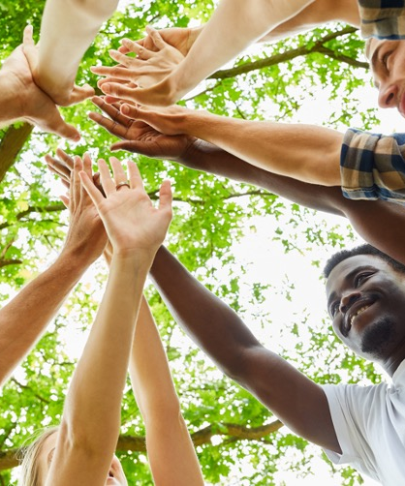
Building Social Connections
Attending to existing relationships
Take social risks
Increase community involvement
Attend Support Groups
Use Professional Support
My Five
Reciprocity- what can you do for others
Identify your interests
Others?
Notes:
5 minutes
Discuss identified avenues to build social connections and list in a large group additional ideas

Slide 19
Using Circles to Identify Supports and Connections
Concentric Circles
Ecogram
Youth in inner circle and lines attach to people connected to their family and young person
Inner circle is for immediate family and caregivers
Second circle is for people they know well
Third circle is for potential people in their lives
Notes:
2 minutes
The next three slides will share a couple of tangible techniques that can be used to understand the existing support systems with youth.
Social Support Ecogram
Concentric/Communication Circles

Slide 20
Ecograms & Social Support
Notes:
10 minutes
This is an example of a tool that can be used with youth to assist them in identifying support. Ask, has anybody utilized an ecogram before?
We use an ecogram by writing the youth and their need in the center circle. In the smaller circles we represent informal supports that the youth uses for assistance when they need help. In each circle, this of a different domain or area of life and ask the youth about their support in that area of life. Examples of domains are:
School
Family
Friends
Work
Home
Neighborhood
Faith base community
Social media
Look on page 8 for sample form

Slide 21
Communication / Concentric Circles
Must
In the first circle identify what you MUST know about the youth’s connections (who are their peeps)
In the second circle identify what you SHOULD know about the youth’s connections (who can they spend time with)
In the third circle identify what would be NICE TO KNOW about the youth’s connections (who would they like to get to know better)
Should
Nice to know
Notes:
10 minutes
This tool is used to identify the support that youth have and at what level each support person is. Research demonstrates that we need a mixture of strong/deep connections as well as superficial/weak connections. Supports in the middle circle are strong ties and those on the outside circle are weak ties. Using this activity, helpers will be about to get an understanding of the strength of connections that their youth experiences. This knowledge can then guide how to assist youth in making connections.
Communication Circles
In the first circle identify what you MUST know about the youth’s people (who are their peeps)
In the second circle identify what you SHOULD know about the youth’s connections (who can they spend time with)
In the third circle identify what would be NICE TO KNOW about the youth’s connections (who would they like to get to know better)
Look on page 9 of the curriculum for written instructions

Slide 22
Activity: Developing Social Connections
Identify a need
List strengths associated with this need
Brainstorm at least 10 community options that would meet this need while building on the strengths and culture (use resources available in your community). Circle the one you think the individual would pick
Who could help them get involved in the option you selected (who would you want to connect them with)?
Complete the action plan
Notes:
15 minutes
Break the class into groups of 4 or 5 people.
In each small group have them complete the following worksheet.
You are trying to help the youth create positive peer relationships in the community. Complete the worksheet below answering the following questions from the needs-based approach.
List the strengths associated with this need:
2. List the culture associated with this need:
3. Brainstorm at least 10 community options that would meet this need while building on the strengths and culture (use resources available in your community). Circle the one you think the youth would pick:
Who could help them get involved in the option you selected (who would you want to hook them up with)?
Develop an action plan for getting started
Look on page 10 of the curriculum for the story and worksheet

Slide 23
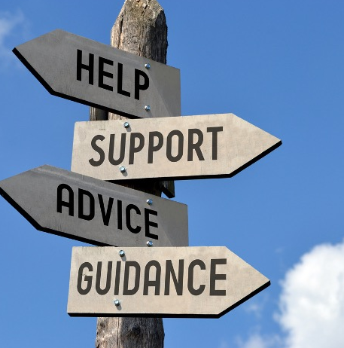
Points to Consider
Culture plays an important part in how people connect
Relationships are dynamic and people may change roles in our lives
It is often through shared activity – groups, clubs, faith communities, shared passions, schools, even workplaces – that new relationships are formed.
People often have lives which are heavy with people providing economic exchange, and can be lacking people who are friends – thus people may be vulnerable to loneliness and social isolation
Promoting better lives for people includes an intentional focus on genuine participation in the community at all levels.
Small gestures lead to big things. (Ex: waving at your neighbor everyday may lead into a friendship)
Notes:
2 minutes
Read and discuss each bullet
Culture plays an important part in how people connect
Relationships are dynamic and people may change roles in our lives
It is often through shared activity – groups, clubs, shared passions, schools, even workplaces – that new relationships are formed.
People often have lives which are heavy with people providing economic exchange, and can be lacking people who are friends – thus people may be vulnerable to loneliness and social isolation
Promoting better lives for people includes an intentional focus on genuine participation in the community at all levels.
Small gestures lead to big things. (Ex: waving at your neighbor everyday may lead into a friendship)

Slide 24
Activity:
Find My 5
Who are the 5 people you could count on when you need support?
Favorites
1
2
3
4
5
Notes:
3-5 minutes
Explain the Find My 5 Activity:
Explain the value of support and that asking for help is challenging for many
Work with youth to identify 5 people that they would ask for help
Ask those 5 if they would like to be part of their “Find My 5” group
Once they agree, pre-load their information into a texting, group me or other application
Start the text with the sample note and invite them to communicate with each other.
Look on page 13 of the curriculum for information

Slide 25
A person in need of support, looks a lot more like a person in need of treatment, than a person that has support
Notes:
1 minute
Read this quote out loud to the group. Once you are finished, ask them to listen again and re-read the quote.

Slide 26
Let’s Talk About Social Capital
Notes:
Now we are moving into the Social Capital Section

Slide 27
Objectives
Participants will:
Understand the value of social capital
Explore how to expand social capital with youth and families
Practice techniques to develop social capital
Engage in reflection on thoughts, feelings and identification of actions
Notes:
2 minutes
Now we will discuss and learn the following information. Review this material with participants.
Understand the value of social capital
Explore how to expand social capital with families
Practice techniques to develop social capital
Engage in reflection on thoughts, feelings and identification of actions

Slide 28
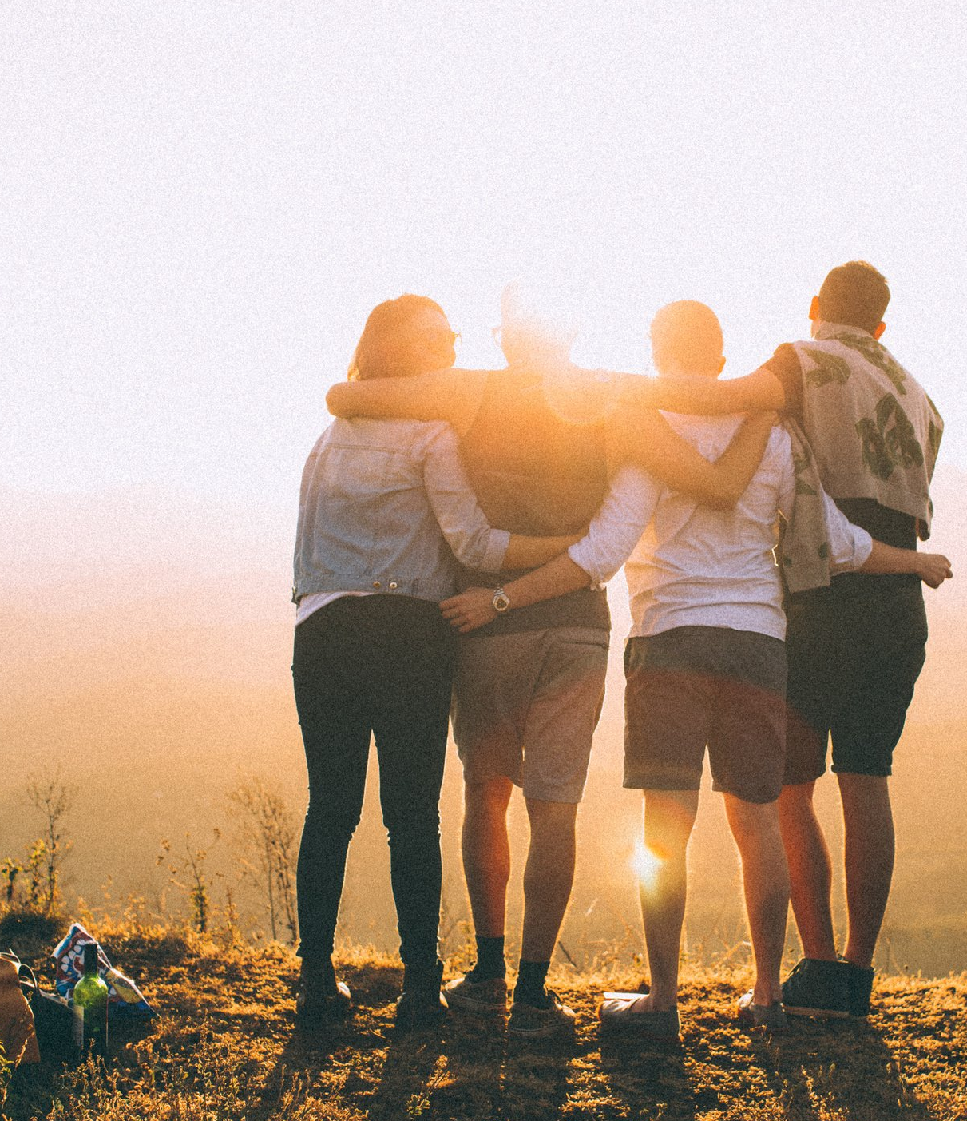
What is Social Capital?
The effective functioning of social groups through interpersonal relationships with:
Shared sense of identity
Shared understanding
Shared norms,
Shared values
Trust, cooperation, and reciprocity
Notes:
2 minutes
Social capital is social support at the macro/community level.
The definition of Social Capital:
structure of networks and collective resources within a community that individuals within that community can draw upon and that will benefit them.

Slide 29
Benefits of Social Capital
Social relationships help youth access resources
One’s perception of their community predicts psychological well-being
People that attend faith institutions report more life satisfaction
Social networks results in better overall health
Building relationships provides social support, and soft skills- allowing for better parent-child interactions and healthier child development
Notes:
2 minutes
Discuss the benefits of Social Capital
Social relationships help families access resources
One’s perception of their community predicts psychological well-being
People that attend faith institutions report report more life satisfaction
Social networks results in better overall health
Building relationships provides social support, and soft skills- allowing for better parent-child interactions and healthier child development

Slide 30
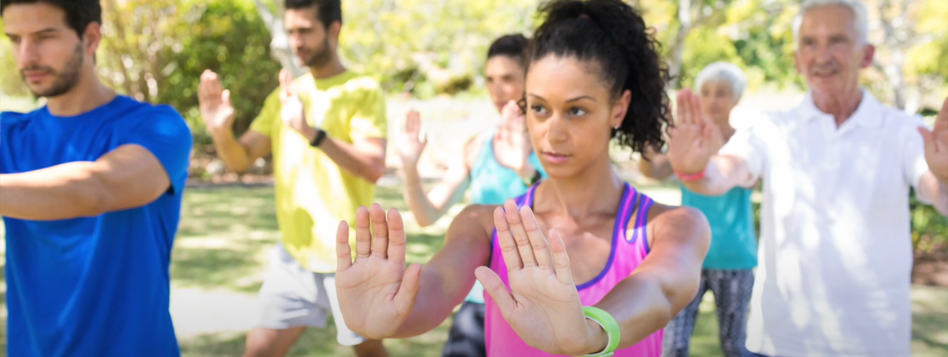
Video: Build Socially Connected Communities
https://youtu.be/f_c6FokE_i8
Notes:
5 minutes
Let’s watch a video explaining social capital
Then discuss what social capital looks like in communities
Let’s talk about collective trauma for a moment

Slide 31
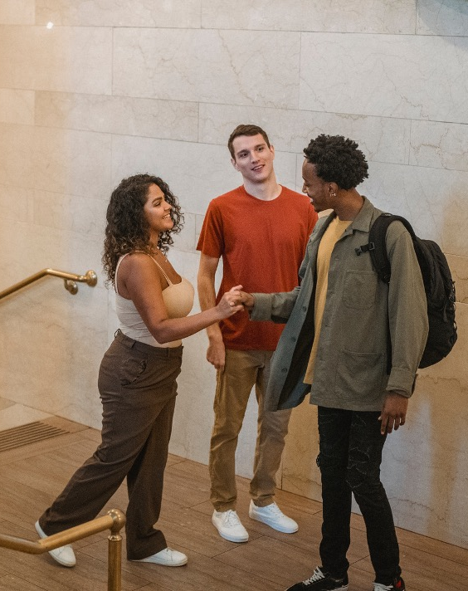
Components of Social Capital
Networks (friendship)
Norms
Trust (feeling safe)
Social support (rely on others for support)
Connections
Reciprocity
Neighborhood organization (community building activities)
Institutional linkage (relationships with leadership)
Notes:
5 minutes
Break down the components of Social Capital and how they work for youth
Networks (friendship)- who are the people that youth associate with
Norms- the rules/expectations that regulate behavior in a group
Trust (feeling safe)- there must be trust to build capital
Social support (rely on others for support)- as previously discussed, social support is the framework for Social Capital
Connections- helping people get their needs met by connecting them with others
Reciprocity- building an expectation that you will not only benefit from others, but that you will also give to others to create sustainable relationships
Neighborhood organization (community building activities)- helps build networks with common culture
Institutional linkage (relationships with leadership)- helps youth expand their experiences and reach

Slide 32
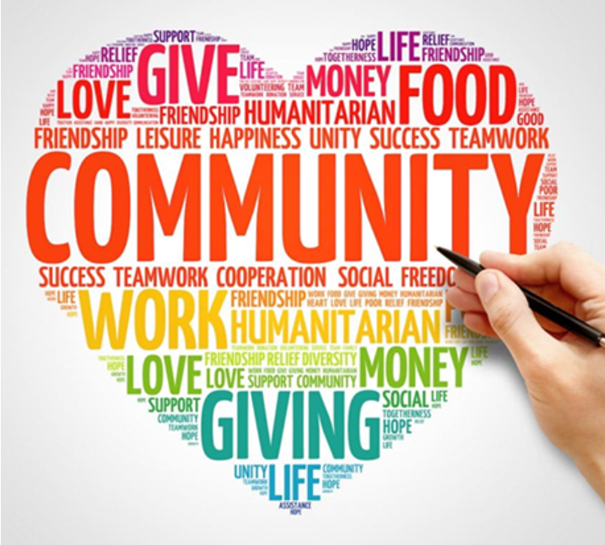
Recruiting Community Supports
When identifying community supports make sure culture is addressed.
Identify community organizations including faith-based institutions, service clubs, support groups and other community organizations.
Strength-based recruitment of interest-specific supports like pairing youth interested in cars with a mechanic.
Locate and advocate for resources in the community.
Good communication and relationships with schools, families, and communities maximizes success.
Notes:
3 minutes
One of the biggest challenges in building social capital is finding community supports for our youth. When we start at the individual level with the identified assets and strengths of the youth, whatever community supports that are identified will be meeting their needs. Here are ways to find the right support.
When identifying community supports make sure culture is addressed.
Identify community organizations including faith-based institutions, service clubs, support groups and other community organizations.
Strength-based recruitment of interest-specific supports like pairing auto interested youth with a mechanic.
Locate and advocate for resources in the community.
Good communication and relationships with schools, families, and communities maximizes success.

Slide 33
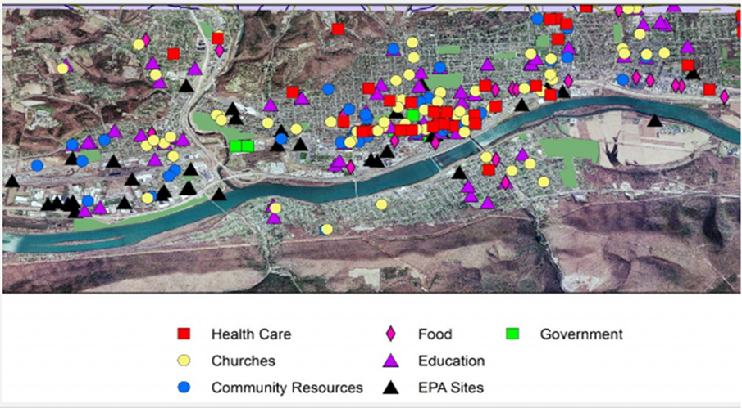
Activity: Asset Mapping
Notes:
10 minutes
This is an activity to build Social Capital in the community. Utilize Bryan’s story from the previous activity and complete the worksheet on page
14
Answer the following questions:
List organizations in your community to meet Bryan’s needs
Select three of these groups and discuss how their missions or activities might provide reciprocal support for some of the children, youth, or families you are working with that have similar needs to Bryan
Discuss what would these groups want or need to get involved as natural supports for some of our youth and families.
Select one of the identified groups and develop an action plan for how you could get them involved. Remember that reciprocity is a key part of sustainable natural supports.

Slide 34
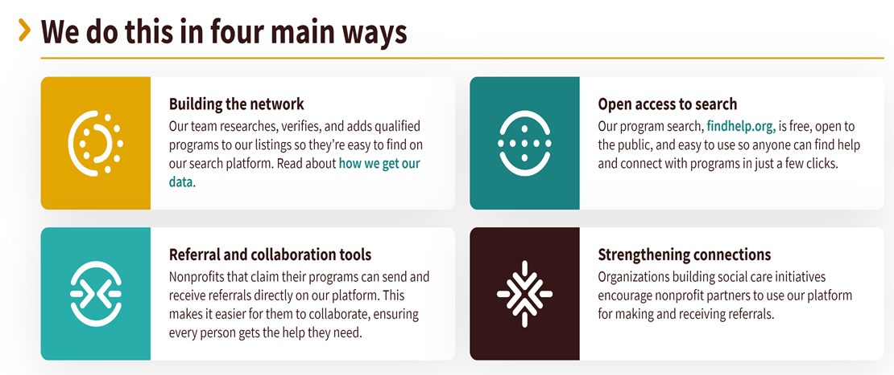
Need Help? Find Help
https://www.findhelp.org/
Notes:
Has anyone ever used Find Help? This is an example of Social Capital. If no one can speak about it, you can load the website and type in a local zip code and a concrete need in the community to see what resources come up

Slide 35
Notes:
This is the contact information for the curriculum developer, who focuses on social support and social connection so follow the links for more information.

Slide 36
info@cssp.org
https://www.facebook.com/CtrSocialPolicy/
https://cssp.org/
https://twitter.com/ctrsocialpolicy
https://www.youtube.com/channel/UCgw_slCsjgt4FqOiouYjD4g
Notes:
Here is information about the Center for the Study of Social Policy

Slide 37
Thank you!

